Slide 1
Capacity Building Activities
2016-2018
Darla Spence Coffey, Chair
Vimla Nadkarni, Co-Chair

Slide 2
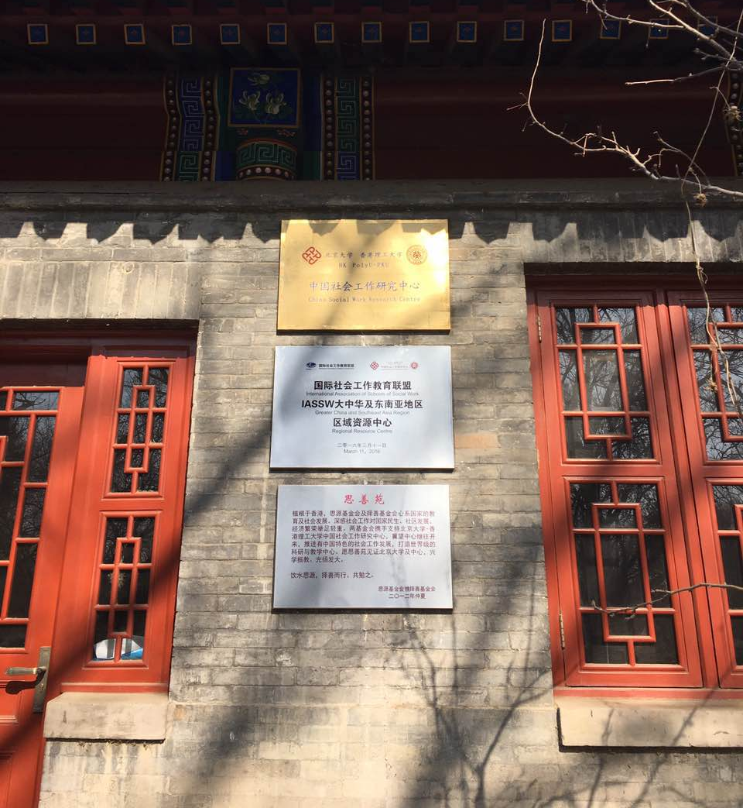
Regional Resource Centers
In March 2016 the first IASSW RRC was launched in the China Social Work Research Centre, a collaboration between Peking and Hong Kong Polytechnic Universities.
In March 2017, the second IASSW RRC was launched in New Zealand, a collaboration between Massey University (lead), Whitireia New Zealand, Te Wananga o Aotearoa, Western Sydney University, and the University of the South Pacific
The committee is preparing a call for applications for a third RRC that will be released this fall.

Slide 3
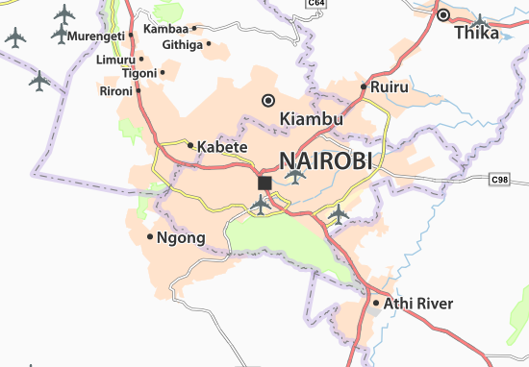
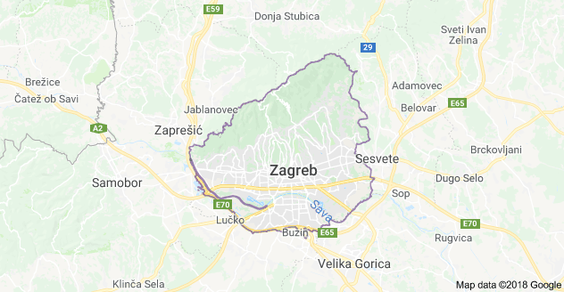
Workshops
Held contingent to Board meeting locations
Nairobi, January 2017: Intersecting social work ethics in academic writing, training and field supervision for ethical social work practice
Zagreb, January 2018: Social Work Education and Practice – Dance on Wire

Slide 4

Supporting social work education development
Completed the 3-year commitment to provide support for SW education in Vietnam.
  Conferences held in Hanoi and Ho Chi Minh City 2015, 2016, and 2017
  Exploring additional opportunities for funding for future activities
The Fourth Conference on Advancement of Social Work in Post-Soviet Countries: Achievements and Challenges of Social Work Education Baku, Azerbaijan: April 26-27, 2018

