Slide 1
Publication and communication committee, IASSW
2016-2018
Chair: Linda Kreitzer
Co-chair: Carolyn Noble
Committee members: helle Straus, vimla Nadkarni, Faisal Azaiza, karen Schwartz, brian Littlechild, Edgardo Toto, Arpita Das, Leticia Villarreal Soso, Rashmi Pandey, Annamaria Campanini.

Slide 2
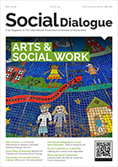
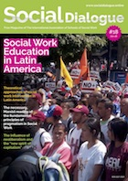
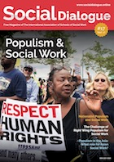
Social Dialogue magazines
#13 – International Social Work Research
#14 – The Global Agenda for Social Work and Social Development
#15 – Social work in Oceania
#16 – Nurturing University Community Engagement
#17 – Populism and Social Work
#18 – Social Work Education in Latin America – English and Spanish versions
#19 – Arts and Social Work

Slide 3

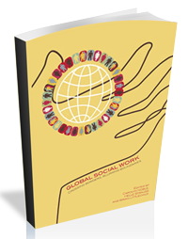
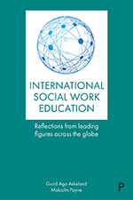
Books published with support of IASSW
Global Social Work: Crossing borders, blurring boundaries.
Getting to Zero: Global social work responds to HIV
International Social Work Education: Reflections from leading figures across the globe.
Voices of Social Work: The Eileen Younghusband Lectures 1984-2018

Slide 4
Future plans for publications
1. Book on International Community Development
2. Social Dialogue to be published three times a year.
3. Ideas for other books to be published by IASSW.

Slide 5

We need to secure advertising to keep the Social Dialogue magazine going.
A mentor plan to continue Social Dialogue in the event that Carolyn decides to retire.
More ideas for books in the future.
Sell our books on the webpage for individuals, universities and libraries e-version form.

Slide 6
Needs of the publication and communication committee
We need to develop the communications part of our webpage. For example, developing ways to provide feedback about the webpage, creating blogs, podcasts, etc.

Slide 7

Thank you
Let’s extend a great thanks to Carolyn Noble for the work she has completed with the Social Dialogue Magazine and the books she has helped produce.
We would like to hear from all of
you, please send your feedback to
hello@iassw-aiets,org

