Slide 1

Treasurer’s Report
July 2018
Dublin, Ireland
Prepared by Mark Henrickson, Treasurer

Slide 2
IASSW is in a strong and stable financial position
  Total assets of $356,721 at 31/12/17, an increase of $45,677 over 31/12/16, largely due to investment growth
  We made a net profit of $49,895 in 2017
  Institutional membership income was short of our income target by about $9,000, but we exceeded our target for bulk memberships by $13,000 (this is a positive trend)
  Other income
    Website a modest source of income through advertising, with room to grow– tell your friends!
    IASSW Foundation pass-through grant for capacity building
  Expenses increased by ~$22,000 over 2016, showing greater programme activity
    While the Capacity Building Committee appears to have overspent by nearly 300%, this spend was offset by grant income from the IASSW Foundation to support workshops in Vietnam
  A copy of the audited CY2017 financial report and the CY2018 Operating Budget are available in the printed report

Slide 3

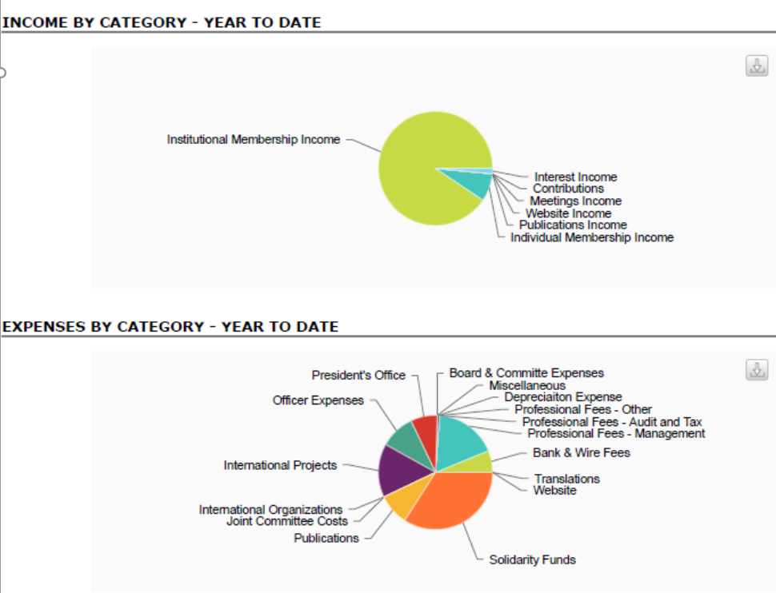
based on 2018 Q1 data

Slide 4
Membership income
  Invoicing system has been in place for all members for three years
    1 November every year invoices are sent for the following year
    Please help us by responding to the invoice the first time, renew on time!!
    Advise the Secretary and Treasurer when the contact person changes
  ‘Bulk’ membership arrangements are in place with Aotearoa New Zealand, Belgium, P.R. China, Finland, Israel, Hong Kong, Japan, Puerto Rico, and South Africa; other group arrangements are in place with Bangladesh, ASSWA, Indonesia, Vietnam
    Such arrangements are encouraged wherever possible; discounts are available

Slide 5
Audit
  IASSW-AIETS completed a full audit for CY2017 in accordance with the Board’s policy
    The Auditor’s letter is attached to the printed report
    A copy of the full audit report can be made available on request, and will be posted to the website
    There were no significant issues in respect of this audit
      There were two policy recommendations, on documentation retention and destruction, and on capitalisation of assets

Slide 6
Investments
  IASSW-AIETS Board revised our investment policy in July 2015 to reflect an ethical investment strategy
    We have not seen the major gains or losses of standard investments
    We have seen substantial growth in our investments, and at the close of 2017 we had investments of US$283,641.27
      Approximately US$21,000 is designated as the Eileen Younghusband Fund to support the EY lecture at these international conferences
    This means we are strong and stable as an independent association for the foreseeable future

Slide 7
Financial management
  We are very aware that a disproportionate share of our budget goes to fiscal management and compliance costs
    The Budget and Finance Committee went through an extensive process consulting lawyers, accounts, and international financial and banking experts, and several different international banks, to see if and how we could reduce management expenses
    With a non-US treasurer this is almost impossible thanks to US regulations; any change will inevitably require fundamental changes to our constitutional, geographical and financial structures
    A Board strategic review is in process, and recommendations will be brought forward in a separate report

Slide 8

Other matters
  The IASSW Foundation has been deregistered in Hong Kong, and the Board has expressed its thanks to Prof Angie Yeun Tsang and their independent board for their hard work on this initiative
  GPR is now in force, and IASSW is currently working with our contractors to ensure we are in compliance
    This has been taken up by the Secretary

Slide 9
Accountability
  I now step back at the end of my four-year term
    I promised three things in my original statement: regular member invoicing, introduction of an ethical investment strategy, and reviewing our structure to reduce compliance costs and allow greater flexibility in fiscal management
    Those three things have been accomplished, or are very much in process
      I highly recommend our ethical investment strategy as a model for other SW associations
  I acknowledge the hard work of the Board in writing, producing, and selling IASSW-sponsored books which have contributed significantly to the income side of our work
  I wish my very best to the new Treasurer, and have prepared documentation to support the transition

Slide 10
Thank you!
    Thanks to IASSW members who renew on time and answer their emails in a timely way!
    Thanks to the President and Executive Officer Rashmi Pandey for their invaluable and timely assistance
    Profound thanks to the Budget and Finance Committee (Darla Spence Coffey, John Rautenbach and Sheri McConnell), for their timely and wise counsel on complex matters, Solidarity Fund decisions, and for being willing to hear my out
    My thanks to the entire Board for helping to develop and manage a sound budget and budgeting process that is responsive to a dynamic global fiscal and social work environment, that is fiscally responsible and transparent, and for being willing to learn that responsible management of money is a social work responsibility

