Slide 1
The State of Social Work Education in the U.S.
Global becomes Glocal

Slide 2


Current Status
682,100 social work jobs in the US
Field of social work is growing at 16%, compared to average growth rate of all occupations of 7%
Levels of Education
  BSW – Bachelor’s Degree in Social Work
    Prepares students for direct-service positions (ex: casework or mental health assistant)
  MSW – Master’s Degree in Social Work
    2-year program
    Required for clinical positions
    Area of specialized practice
  DSW – Practice Doctorate
    Distinct from the PhD
    15 programs and growing
  PhD – Research Doctorate
    78 programs
Bureau of Labor Statistics, U.S. Department of Labor, Occupational Outlook Handbook, Social Workers,
on the Internet at https://www.bls.gov/ooh/community-and-social-service/social-workers.htm (visited November 20, 2018).
Notes:
MSW: Programs prepare students for work in a chosen specialty, including clinical assessment and management skills; require supervised practicum or internship

Slide 3
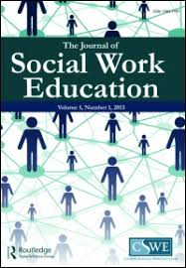
Current Status of Social Work Education in the United States
Council on Social Work Education (CSWE)
  Founded in 1952, CSWE is the national association representing social work education the US.
  Accreditation is a voluntary, non-governmental process of review.
  Multi-step process: preparation & self-examination, peer review, visit and examination, decision, continuous review
As of the October 2018 Commission on Accreditation meeting, there are:
  521 accredited baccalaureate social work programs (BSW)
  262 accredited master’s social work programs (MSW)
  16 baccalaureate social work programs in candidacy
  30 master’s programs in candidacy
Notes:
Some challenges with accreditation: - push/pull about being perscriptive, this is our way, but not necessarily the only way! There exists some tension about being perscriptive vs. more context-based.

Slide 4
Macro Issues Affecting Education and Profession

Slide 5

Globalization
Populism
Neoliberalism
Waning Confidence in Public Institutions
Immigration/Refugees
Climate Change/ Environmental Impact
Technology & Automation
Violence

Slide 6

Globalization
Notes:
Globalization results in the expansion of international cultural, economic, and political activities. As people, ideas, knowledge, and goods move more easily around the globe, the experiences of people around the world become more similar."

Slide 7

Nationalism/White Supremacist Culture
  Groups focused on the alleged inferiority of nonwhites (Ku Klux Klan, neo-Confederate, neo-Nazi, racist skinhead, Christian Identity)
  Rise of antisemitism as well
  Tension rising during and post 2016 Presidential election, inciting violence
  Increased polarization of political positions
  Voss, T., Bailey, J.D., Ife, J. et al. J. Hum. Rights Soc. Work (2018) 3: 109. https://doi.org/10.1007/s41134-018-0072-5
Notes:
- White nationalists seek to return to an America that predates the implementation of the Civil Rights Act of 1964 and the Immigration and Nationality Act of 1965 – both landmark pieces of legislation

Slide 8
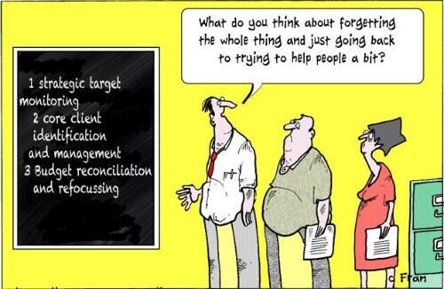

Neoliberalism and managerialism

Slide 9
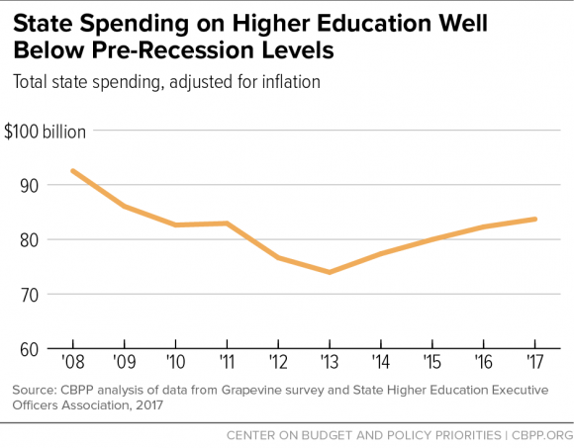
Waning confidence in public institutions

Slide 10
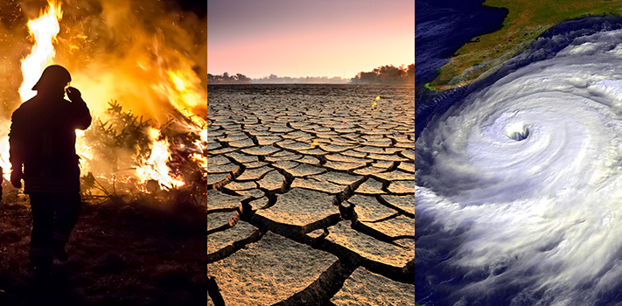
Climate Change/ Environmental Impact
Synopsis
  Overwhelming body of evidence affirming that the earth is warming, largely due to greenhouse gas produced by human activities.
  The Intergovernmental Panel on Climate Change (IPCC) states, "...the net damage costs of climate change are likely to be significant and increase over time."
Social Work Considerations
  Climate change is a public health issues because of its impact on water, air, food supplies, and living spaces
  Climate-centered crises (draught, flood, fire, hurricane, etc.) impact on communities and livelihoods
  New, worsening health conditions (infections disease, illness, emotional/mental stress)
  Vulnerable populations more at risk
  Social workers as change agents – macro-level work, advocacy
https://climate.nasa.gov/effects/ text

Slide 11
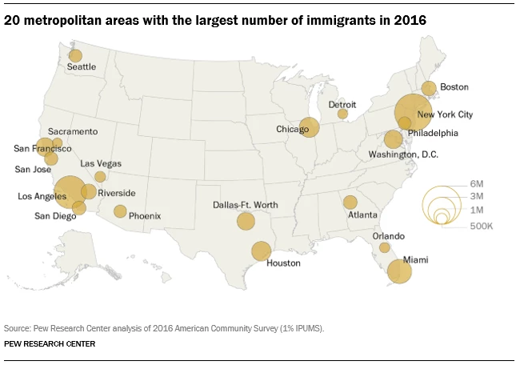
Immigration & Refugees
Synopsis
  40 million immigrants in the US (1/5th of the world’s migrants) – more than any other country in the world
  Mexico, China, and India are top birthplaces for immigrants in the U.S.
    Largest origin group: Democratic Republic of Congo, Iraq, Syria, Somalia, and Burma (Myanmar)
    In 2017, 22,861 were Muslims (43%) and 25,194 were Christian (47%)
    Roughly half (46%) of nation's 43.7 million immigrants live in California, Texas, and New York
Social Work Considerations
Political and social anti-immigrant and refugee rhetoric, dehumanization
Documentation challenges for clients, students
Increased violence & tension in communities
López, G., Bialik, K., & Radford, J. (2018, November 30). Key findings about U.S. immigrants. Retrieved from http://www.pewresearch.org/fact-tank/2018/11/30/key-findings-about-u-s-immigrants/
Notes:
Example of increased violence:
From November 6th – November 11th, 2016 (following election), 201 incident of election-related harassment and intimidation across the country (source: Southern Poverty Law)

Slide 12



Technology & Automation
Synopsis
  Rapid growth in technology sector leading to the "computerizations" of American businesses, industries, and homes.
  Technology transforming the way, and the speed with which, people think, connect, collaborate, locate resources, manipulate and conduct research, etc.
  Digitization, the rise of robots, artificial intelligence seem to favor capital and higher-level skills at the expense of orgindary workers.
Notes:
United States Department of Labor. (1999). Futurework—trends and challenges for work in the 21st century. Retrieved from http://www.dol.gov/oasam/programs/history/herman/reports/futurework/report.htm.
https://www.brookings.edu/blog/up-front/2018/02/16/globalization-technology-and-inequality-its-the-policies-stupid/

Slide 13

Violence
Synopsis
  Interpersonal Violence
    500,000 people killed by interpersonal violence each year
    10 million men & women in US are subject to domestic violence
    5 million children are exposed to domestic violence in the US per year
  Gun Violence
    6.5 million people killed by gun violence worldwide since 1990
    Gun violence is concentrated. Just 15 countries (35% of world's population) account for 75% of all gun deaths: the worst in the Americas (Guatemala, Venezuela, Colombia, Mexico, Brazil, & United States)
Social Work Considerations
  Culture of violence
  Systemic harm
    Economic exploitation
    Poverty
    Unequal treatment under the law
    Human Rights violations
  Political atmosphere
Notes:
https://www.vox.com/2018/8/29/17792776/us-gun-deaths-global
http://www.socialworkpolicy.org/research/violence-and-injury-prevention.html
https://www.un.org/pga/70/wp-content/uploads/sites/10/2016/01/Conflict-and-violence-in-the-21st-century-Current-trends-as-observed-in-empirical-research-and-statistics-Mr.-Alexandre-Marc-Chief-Specialist-Fragility-Conflict-and-Violence-World-Bank-Group.pdf
https://www.economist.com/graphic-detail/2018/08/30/gun-violence-has-killed-65m-people-worldwide-since-1990
https://www.socialsolutions.com/blog/domestic-violence-statistics-2018/

Slide 14
Responses

Slide 15

American Academy of Social Work & Social Welfare
12 Grand Challenges
  Ensure health development for all youth
  Close the health gap
  Stop family violence
  Advance long and productive lives
  Eradicate social isolation
  End homelessness
  Create social responses to a changing environment
  Harness technology for social good
  Promote smart decarceration
  Reduce extreme economic inequality
  Build financial capability for all
  Achieve equal opportunity and justice

Slide 16
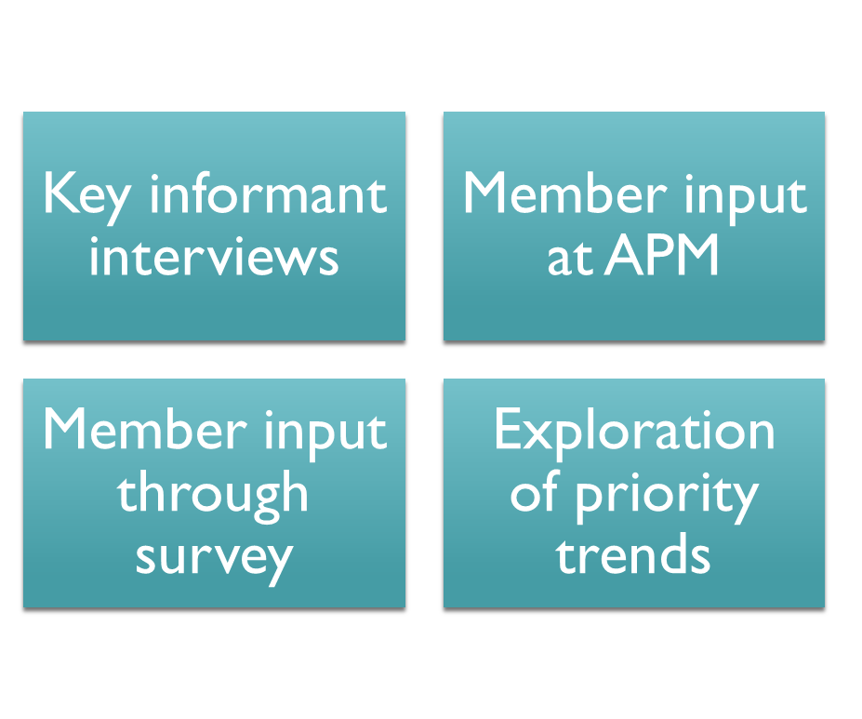

Future of the Profession: Futures Task Force
Embracing Technology to Enhance Practice
Social Workers are Leaders Everywhere
Social Work Leadership for a High-Tech World
Building on our Successes

Slide 17

Voter mobilization drive

Slide 18

Our responses need to be
Interdisciplinary/Interprofessional
Collaborative (Collective Impact)
Activist
  Engaging in political activism / developing policy priorities
Educational Initiatives
  Use of technology
  Global collaborations
  Faculty development
  Field education opportunities

Slide 19


Slide 20
Thank you!

