Slide 1
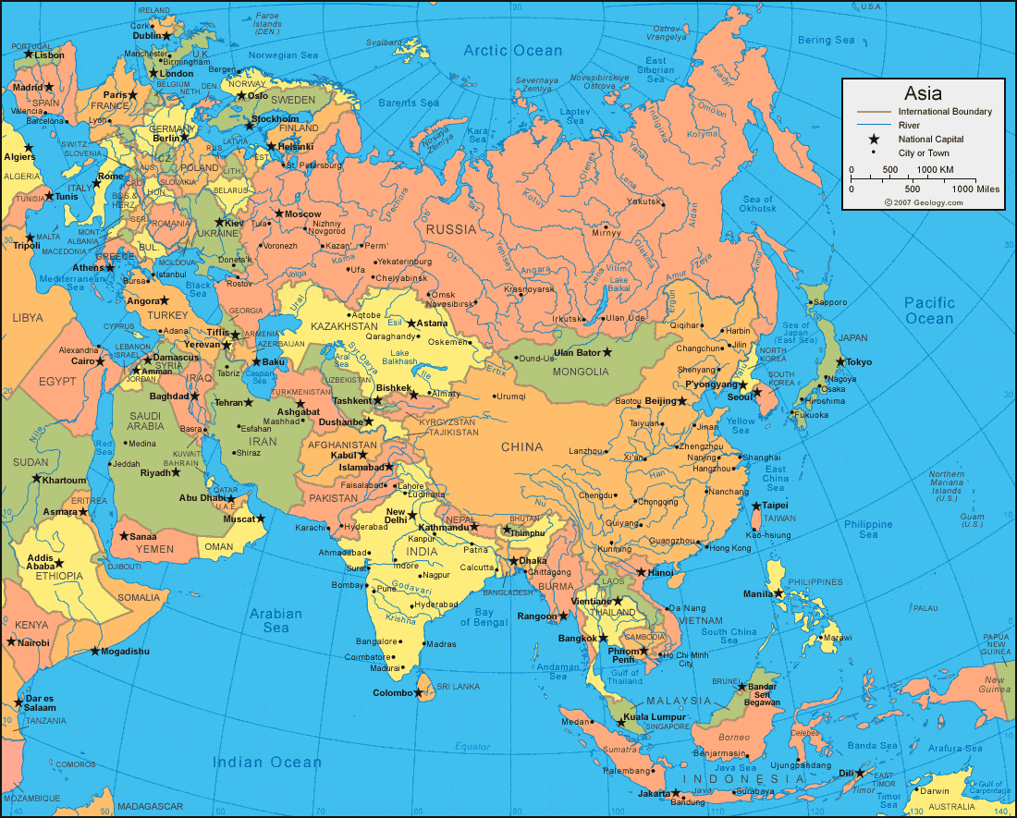

Social Work Development in Singapore and Asia
Capacity Building Seminar
Tokyo, 13 Jan 2019
Professor TAN Ngoh Tiong
Treasurer IASSW
Singapore University of Social Sciences

Slide 2
Development of Social Work and
SW Education
Status of social work and its education in Singapore and Asia.
Modern Social Work in Singapore, for the last 60 years, has moved from a Western colonial orientation and adapted a Glocal model.
Early days from 1950s it has practitioners and educators either from or trained in the West especially Britain and the USA. There are now more trained locally with many receiving training at Masters and PhDs levels.
Instead of imported models, more research and local training and thus the practice is adapted towards local contexts.
Eg Family services, and the development of Family Service Centres

Slide 3
Contemporary Glocal Social Work
Need for family strengthening and support – reinforcing family life, kinship and neighbourhood networks.
Eg Supporting multi-generational living and Community based orientation in elderly support, law for maintenance and support of elderly, and children.
Eg. Protection of women against family violence. Involving systemic untervention.

Slide 4
Innovation in SW Education and Social Work Effectiveness.
Constant need for restructuring social work education and practice:
Social work as versatile - developed social work in health settings, rehabilitative SW and enhancing training in-house as well as at tertiary level.
Continuing education development to strengthen professional capacity.
Need for social work education to be innovative, not just current but futuristic, to lead practice.
Eg rehab services - prison system focused to community support and social integration.
SUSS social work reviews curriculum every 3-5 years.
Innovative online social work courses, eg. blended learning, reverse classrooms.

Slide 5
Challenges and Future for Social Work
Challenges towards distinctive models of practice – Community focused practice.
Building social resilience and strong support network in a digital age.
eg. disaster preparedness strengthening community bonding.
Ability to develop local strategies and network at crisis management and building community resilience.

Slide 6


Asian Context
Asia is the largest continent on planet earth
Asian culture generally relies on traditional systems of social support from the family and community.
Growth of social services in the Asian countries are largely fuelled by the economy, urbanisation and political reforms.

Slide 7

Future Directions
Future direction of Social Work in Asia, especially for the Chinese speaking countries.
call for primary intervention starts with assessment of strengths and potentials of every social unit and social system.
strategies as recommendations for the way ahead:

Slide 8

Foci and Priorities
1.Focus on Community Strengths
2. Strengthening Families and Support Network
3. Standardizing and Evaluating Professional Practice
4.Enhancing Competencies and Ethical Practice
5.Developing Specialization in Niche Areas
6. Registration and Licencing for Effective Practice
7.Development and Use of Volunteers
8. Social R&D

Slide 9


Discussion
The nature and practice of a social work system, is to a large extent the outcome of particular social, political, economic, and cultural forces.
All over the world, social service organizations have been called to greater accountability.
Professionalization and the required ethical and competent practice is the pressure for social workers in Asia and the rest of the world.

Slide 10

Conclusion
Call for social work in Asia and the world:
To benefit individuals, families, community and society. Social work has changed from charity approach towards empowerment and needs continually to develop towards capacity building and a good fit for modern society.

