Slide 1
Social Work Education in Nigeria: Glocalization Realities and Impact
Presented by: Augusta Y Olaore PhD
Associate Professor of Social Work
Babcock University, Nigeria

Slide 2
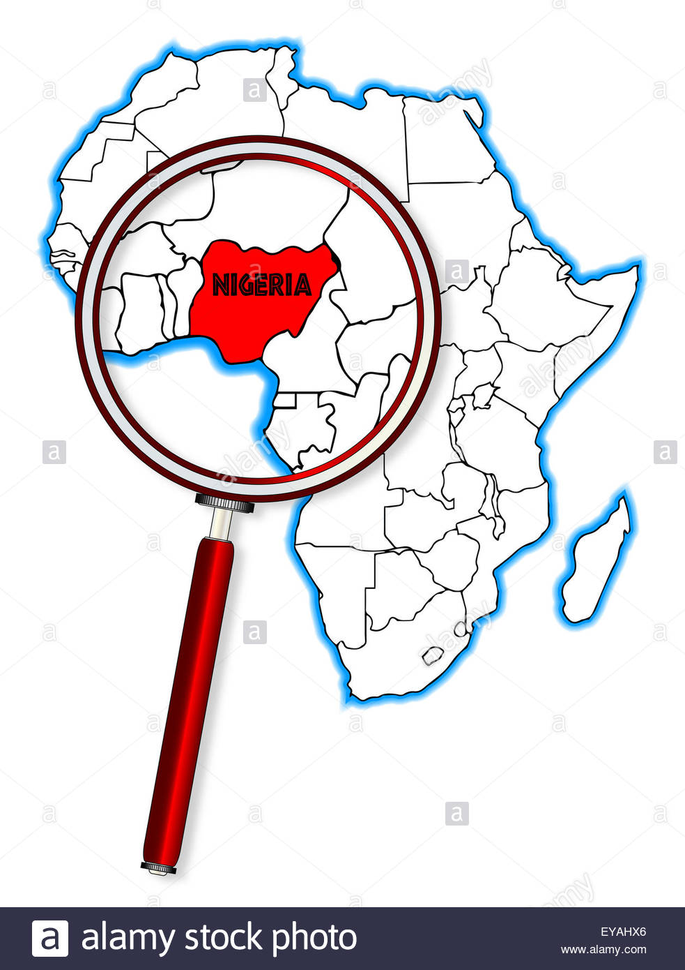
Climate Change
Human Trafficking
Migration

Slide 3
Climate Change
Human Trafficking
Migration

Slide 4
Climate Change
Nigeria contributes 40% of gross national greenhouse emissions
Sources of CO2 emission are gas flaring and transportation which accounts for 20% and 30%, respectively
3. Decreased in H2O availability to many region affecting hydropower generations and agriculture.
4. Desertification has moved inland progressively and several kilometers of descant encroachment has been witnessed in the Northern parts of Nigeria in the last 3 decades.

Slide 5
Climate Change
5.Irregular Storm laden rainfall leading to Increased incidence of flooding and physical habitat destruction complicates the poor sanitation infrastructure resulting in high increase of water related and vector diseases such as Cholera and Malaria
6. High surface temperature resulted Heat stress mortality.
7. River Niger, the reliable source of Kanji Dam for electricity generation has witnessed a great level of dryness over the past 15 years.

Slide 6
Climate Change
8. Increased drought has caused negative impact on food Production with resultant “Reduction in farm – incomes” thereby results in increased Starvation and Poverty.
9. The removal of wood for fuel contributes to the increasing rate of deforestation leading to reduced conversion of CO₂ to O₂ and increased release of CO₂ which depletes the ozone layer
These foregoing effect have unquantifiable consequences on human health and livelihood of people in Nigeria.

Slide 7
Climate Change
Human Trafficking
Migration
Human trafficking, a form of modern day slavery, involves the illegal trade of people for exploitation or commercial gain and is a $150 billion global industry. Two thirds of this figure ($99 billion) is generated from commercial sexual exploitation, while another $51 billion results from forced economic exploitation, including domestic work, agriculture and other economic activities

Slide 8
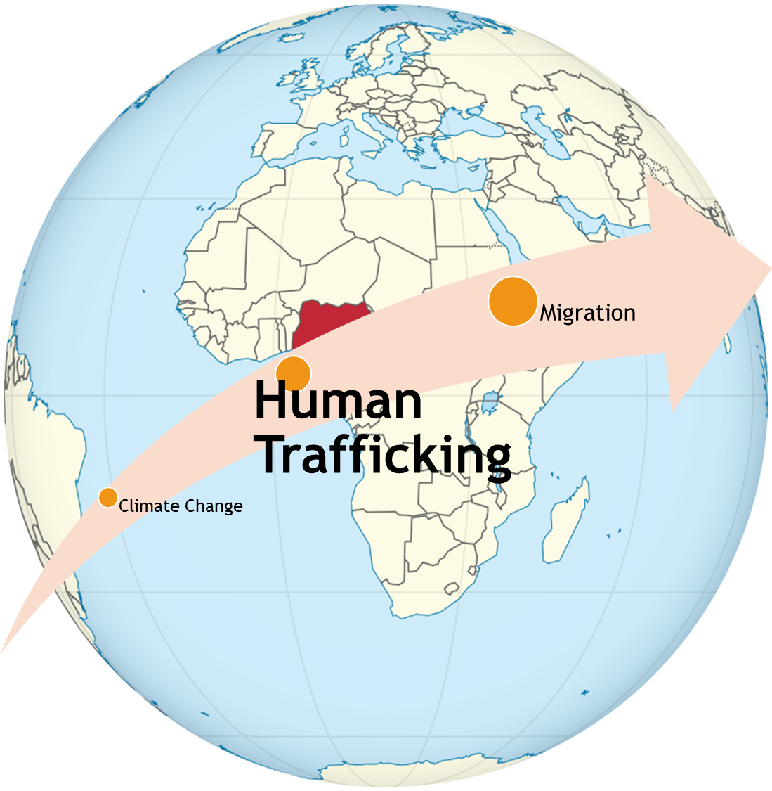
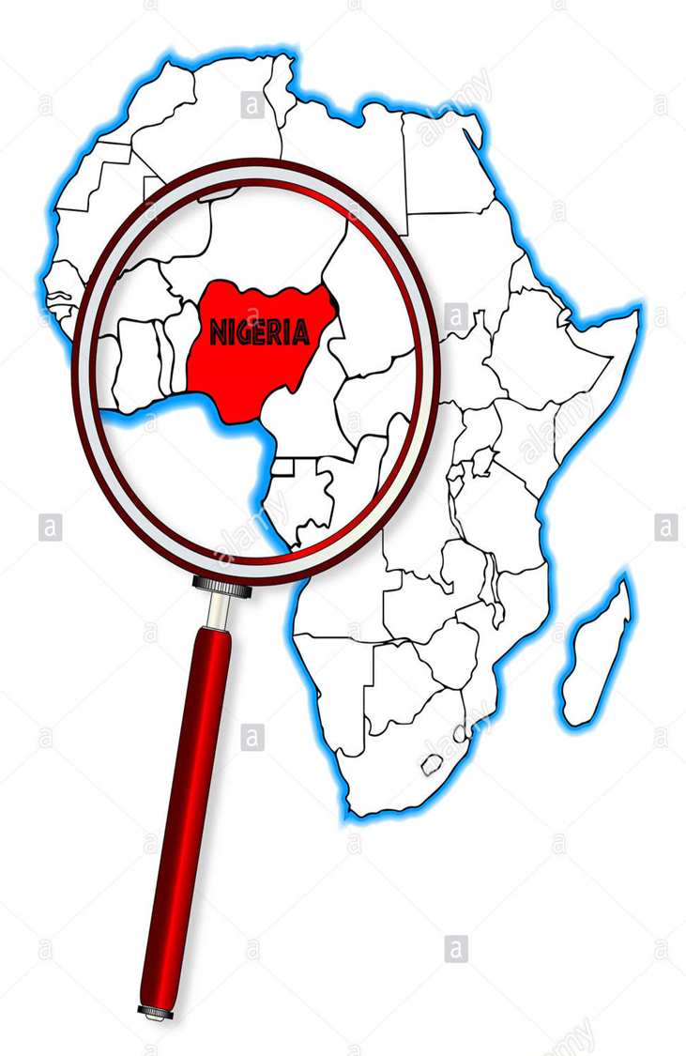

Slide 9
Human Trafficking
Nigeria is a source, transit and destination country for human trafficking. Per the latest Global Slavery Index (2018) Report, Nigeria ranks 32/167 of the countries with the highest number of slaves – 1,386,000
The general factors that increase vulnerability to trafficking in Nigeria include extreme poverty, corruption, conflict, climate change/resulting migration and western consumerism.

Slide 10
Nigeria is listed as one of the countries with the largest number of trafficking victims overseas (particularly in Europe), with victims identified in over 40 countries in 2017. The recent scourge of illegal migration has highlighted Nigeria’s challenges in this area

Slide 11
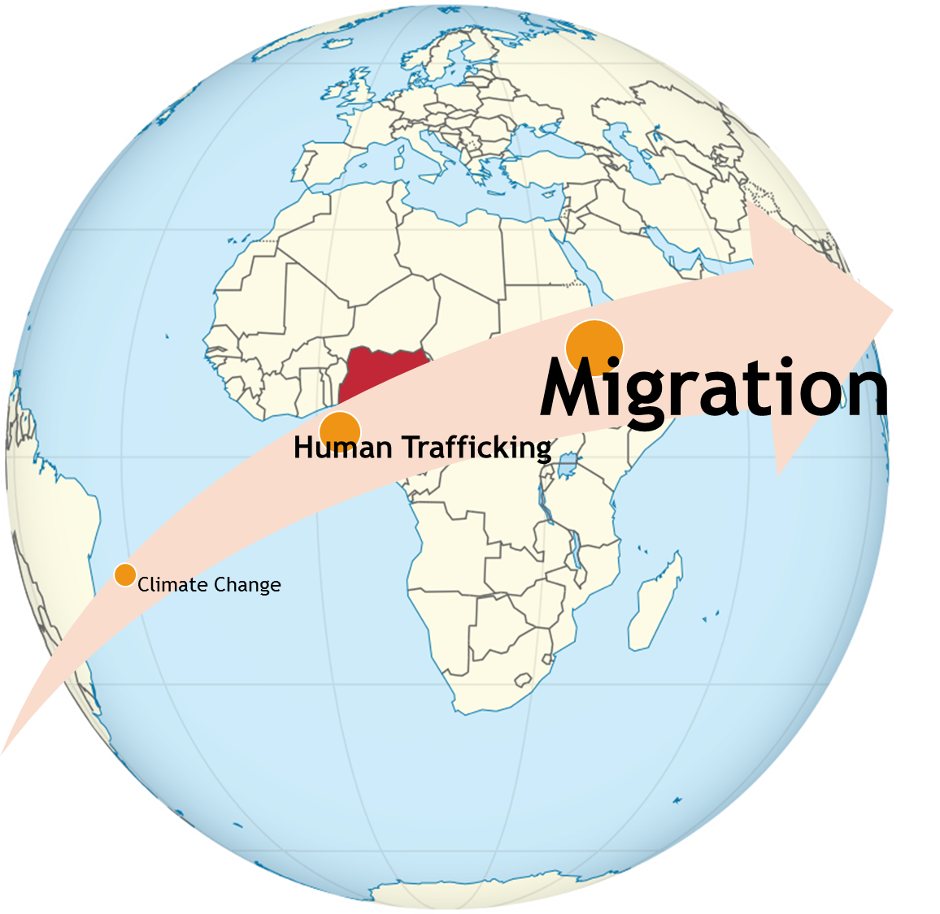
The world’s attention has been focused on the European Union as it struggles to cope with a growing migrant crisis that has overwhelmed key members, redefined internal politics and posed as a real threat to the EU cohesion

Slide 13
Global Issues
Large-scale Nigerian migration to Western destinations, particularly the United States, the United Kingdom, Germany, Italy, and the Netherlands, began in the early 1980s, when the Nigerian economy, experienced a downturn due to declining oil prices. There were 1 million Nigerian international migrants in 2010 (World Bank, 2011)

Slide 14
Migration
In 2016 Nigeria topped the list of African migrants to Europe. By the end of December, out of 387,739 arrivals to Europe, almost half (173,000), were from Nigeria.
In 2017, that number decreased from 21% of the total 181,000 migrants braving the Mediterranean to arrive into Italy to 15.5% of total migrants arriving into Italy (119,000) in light of the numerous efforts made by Italy to stem the flow of migrants from Libya.

Slide 15
The consequences of all this is that EU nations are now caught between living up to their well espoused principles, which guarantee humane treatment of refugees, especially those fleeing persecution and wars, and avoiding the increased pressure on resources as well as risk of antagonizing voters, who are nowincreasingly leaning towards nationalist, right wing politics. Disagreements have also broken out amongst EU members over how to take and share responsibility for the growing numbers of migrants which leaders are trying to resolve.

Slide 16
Local Response
A concerted effort from the government, professional bodies,
Academia and all stakeholders is needed to address global issues such as climate change, human trafficking and migration at local levels.

Slide 17
Nigerian Social Work Education
Climate Change
Human Trafficking
Migration

Slide 18
Nigerian Social Work Education Issues
Developmental Stage of the Social Work profession
Lack of Professional Recognition
Poor Public Awareness
Weak Indigenous Professional Identity
Harmonization and standardization of Curriculum

Slide 19
The Place of Social Work Education
Connecting students expereiencially to poverty: poverty day experience
Developing culturally authentic interventions and public awareness. Human trafficking and talking drum
Developing an indigenous Social Work identity
Climate change classes in the social Sciences including Social Work

Slide 20
The role of Nigerian Social Work Education
Develop curricula that strengthens and affirm indigenous identity
Provide experiential awareness of global issues ( Poverty Day Exercise)
Exposure to best practices around the world through Staff and Student mobility
Develop local interventions that culturally fits and can transmit information to reduce Climatic harmful behaviors, Human trafficking and wholesome immigration patterns ( Talking drum class)

Slide 21
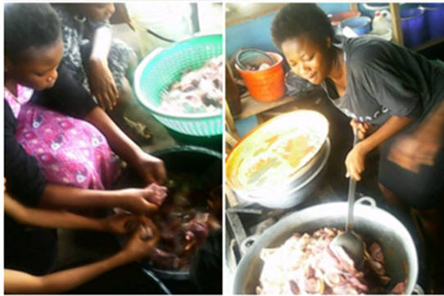
Provide experiential awareness of global issues ( Poverty Day Exercise)

Slide 22
Developing culturally ‘fit’ local interventions and messages to reduce Climate harmful behaviors, Human trafficking and wholesome immigration patterns ( Talking drum class)

Slide 23
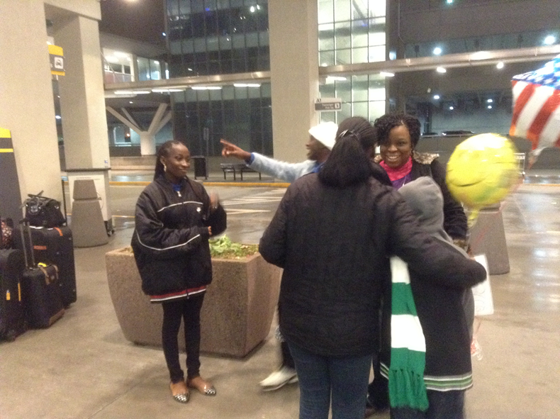
Exposure to best practices around the world ( Staff and Student mobility)

Slide 24
International Exchanges

Slide 25
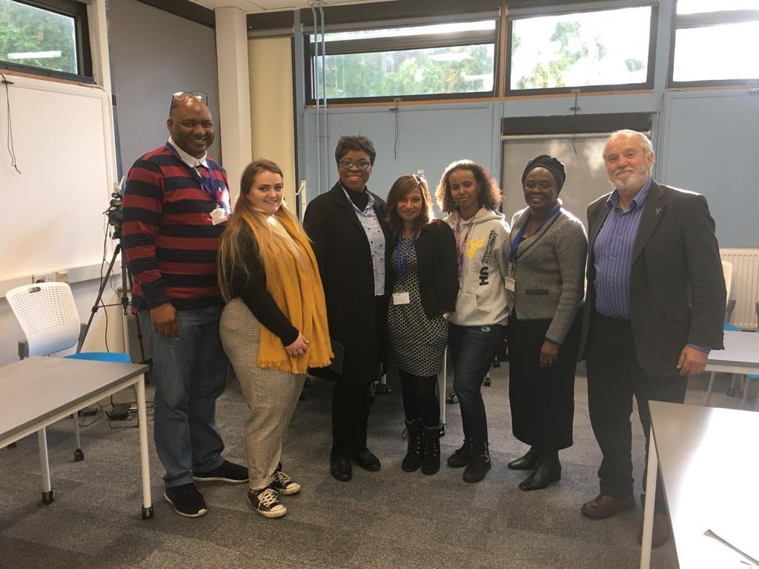
Staff Mobility Nigeria UK

Slide 26
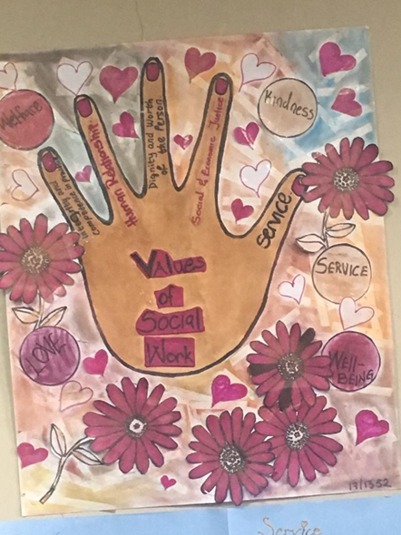
Universal Social Work Values on our Finger tips
1.Service
2. Social and Economic Justice
3.Dignity and Worth of the person
4.Value of Human Relationship
5. Integrity and Competence

Slide 27
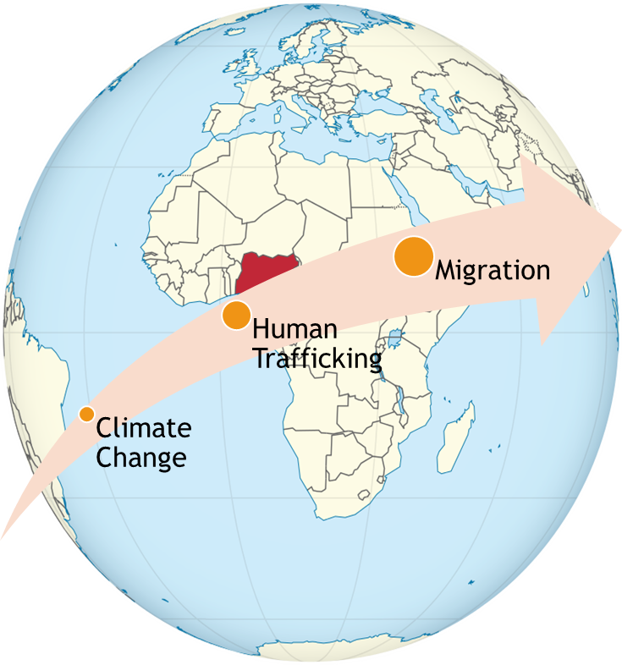
Thanks For Listening

Slide 28
Sources
Mazzucato, V., Cebotari, V., Veale, A., White, A., Grassi, M., & Vivet, J. (2015). International parental migration and the psychological well-being of children in Ghana, Nigeria, and Angola. Social Science & Medicine, 132, 215-224.
Oguniran B (2018) Ozone Layer Depletion and Climate Change in
Nigeria - Problems and Prospects: A Review Global Journal of Research and Review Vol.5 No.1:2
http://pathfindersji.org/nigeria-human-trafficking-factsheet/
https://www.vanguardngr.com/2018/07/illegal-migration-eu-must-start-in-nigeria

