Slide 1
Military social work developments in South Africa: Practice theory, resilience and research
Prof Rev’d Adrian D. van Breda
Department of Social Work
University of Johannesburg
International Military Social Work Roundtable Conference
West Point, USA
25 April 2019

Slide 2
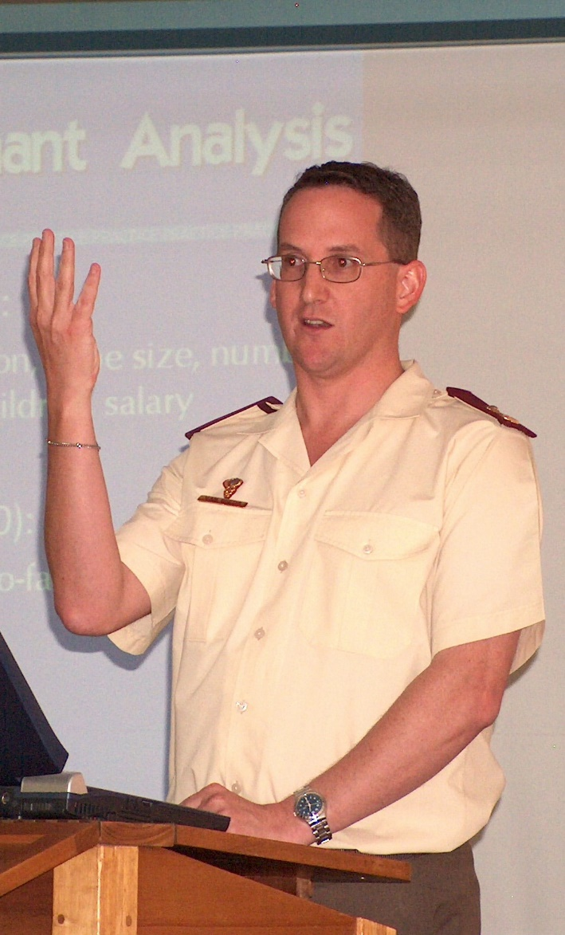
Introduction to Adrian
SA Military: 1991-2007
Detention barracks, as military social worker
SA Navy, as military social worker
Military Psychological Institute
Social Work Research & Development, Founder and Head
Military Health Research Centre, Founder and Head
Resigned with military rank Lt Col (Deputy Director)
University of Johannesburg: 2007-
Resilience
Youth transitions (leaving care)

Slide 3
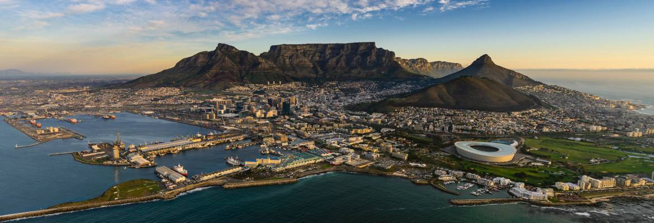
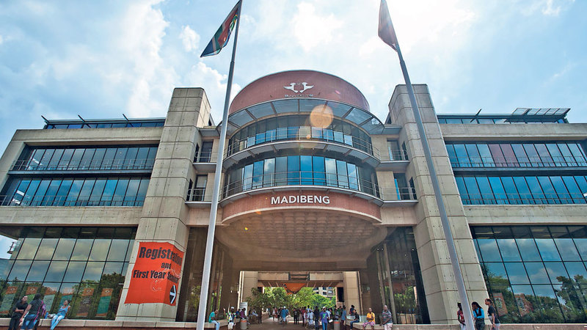
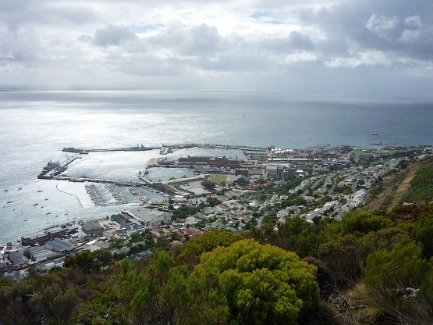
South Africa

Slide 4
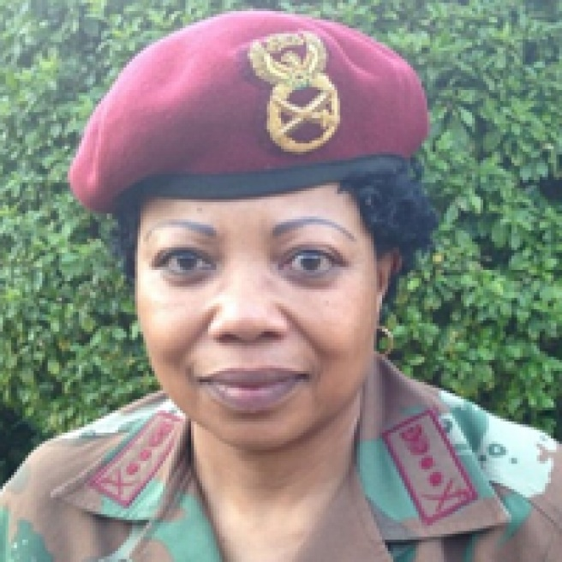
SA National Defence Force
Pre-1994
SADF, TBVC militaries, MK, APLA
Since 1994
SANDF: Army, Air Force, Navy & SA Military Health Service
Under civilian control
73 844 members, about 85% uniformed, including
170 1-star generals, including Brig Gen (ret.) Moremi
40 2-star generals, including Maj Gen Memela-Motumi
167 social workers, mostly uniformed
Notes:
170 1-star generals –
83% black (114 African, 29 white, 21 Coloured and 6 Indian);
36% women (61)
40 2-star generals
18% women (7)
8 3-star generals (no women)
1 4-star general (SANDF Chief General Solly Shoke)
https://www.defenceweb.co.za/sa-defence/sa-defence-sa-defence/sandf-personnel-strength-by-the-numbers/

Slide 5
Conceptualisation of MSW in South Africa

Slide 6
MSW rooted in OSW
MSW as clinical social work (Applewhite et al., 1995)
MSW as occupational social work (OSW) (Harris, 1993)
Employee as person (Du Plessis, 2001)
Person as employee
Organisation as client (Googins & Davidson, 1993)
Employee as citizen (Caraphina, 2009)
OSW allows system-wide interventions (Bouwer, 2009)
Occupational social work is ”a specialised field of social work practice which addresses the human and social needs of the work community through a variety of interventions which aim to foster optimal adaptation between individuals and their environments” (Straussner, 1990, p. 2)
(Van Breda, 2012; Van Breda & Du Plessis, 2009)

Slide 7
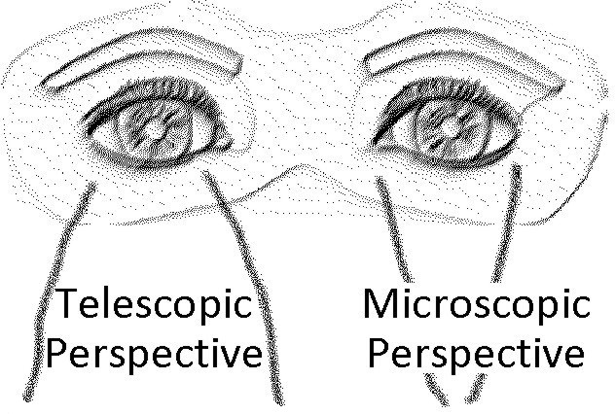
MSW practice model Binocular vision
(Van Breda, 2012; Van Breda & Du Plessis, 2009)

Slide 8
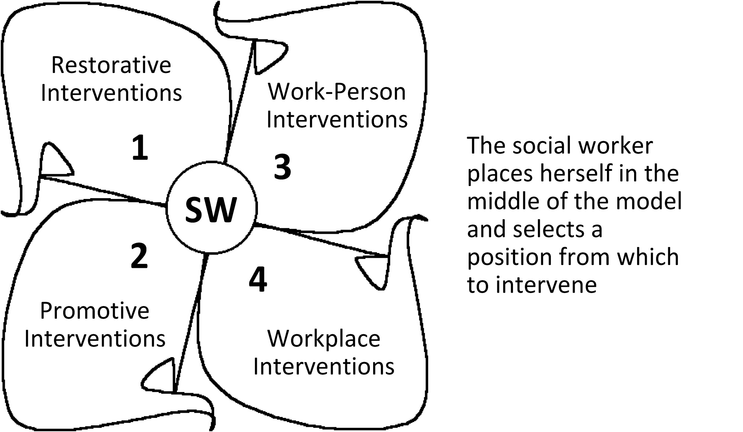
MSW practice model Practice positions
(Van Breda, 2012; Van Breda & Du Plessis, 2009)

Slide 9
MSW resilience lens Positions 3 and 4 interventions
Deployment resilience
Van Breda, A. D. (1998, February). Developing resilience to deployments. Paper presented at the national conference on Police as Victims of Trauma and Crisis, Technikon South Africa, Johannesburg, South Africa.
Deployment Resilience Seminar
Van Breda, A. D. (1999). Developing resilience to routine separations: An occupational social work intervention. Families in Society, 80(6), 597-605.
Military Social Health Index (Concurrent Health Assessments)
Van Breda, A. D. (2008). The Military Social Health Index: A partial multicultural validation. Military Medicine, 173(5), 480-487.
SA DOD resilience model assessment protocol
Van Breda, A. D. (2011). Resilience assessments in social work: The case of the SA Department of Defence. Social Work / Maatskaplike Werk, 47(1), 1-14.
Resilient workplaces
Van Breda, A. D. (2011). Resilient workplaces: An initial conceptualization. Families in Society, 92(1), 33-40.
Van Breda, A. D. (2001). Resilience theory: A literature review. Pretoria, South Africa: South African Military Health Service.
(Van Breda, 2001, 2018)

Slide 10
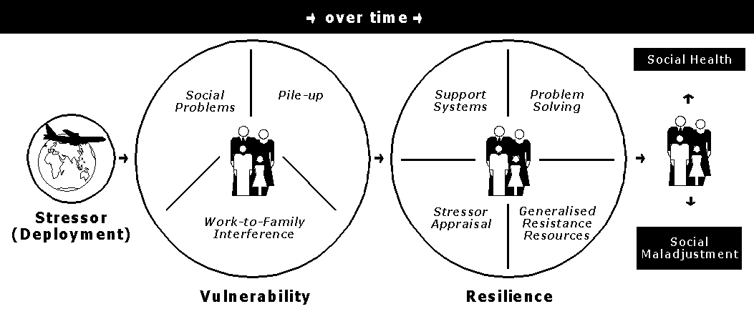
SA DOD Resilience Model of Social Health
Foundation of the Current Health Assessment for deployment readiness
(Van Breda, 2011)

Slide 11
MSW research History
These innovations enabled (in part) by the MSW R&D Department:
1996 – establishment of SW Research Dept at MPI
1997 – appointed as SW researcher
1997-2002 – expanded to 5 SW R&D posts
2002-2007 – Military Health Research Institute

Slide 12
MSW research Other projects
Designed the SANDF’s HIV prevention programme (Masibambisane)
Designed and implemented the M&E of the SANDF’s HIV programme, including annual HIV KAP studies
Design M&E systems for social work, a military hospital, CD Transformation Management
National study on violence against women and children
Studies on gender mainstreaming and on the role of women in combat
Participated in an NIH-funded ART clinical trial (Phidisa)
Impact of peacekeeping on military families
Cultural diversity training for integrated forces

Slide 13
MSW research Critical success factors
Strategic focus and energy
Talent management
Entrepreneurial spirit (no status quo)
Assignment of human and financial resources
SWOT analysis

Slide 14
References
Applewhite, L. W., Hamlin, E. R., BrintzenhofeSzoc, K., & Timberlake, E. M. (1995). Clinical social work practice in the U.S. Army: An update. Military Medicine, 160(6), 283-288.
Bouwer, A. (2009). Occupational social workers as organisational change agents. Social Work Practitioner-Researcher, 21(3), 386-402.
Caraphina, R. (2009). Aligning occupational social work and corporate citizenship. Social Work Practitioner-Researcher, 21(3), 334-352.
Du Plessis, A. W. (2001). Occupational social work in South Africa. Employee Assistance Quarterly, 17(1/2), 97-118.
Googins, B., & Davidson, B. N. (1993). The organization as client: Broadening the concept of employee assistance programs. Social Work, 38(4), 477-484.
Kruger, A., & Van Breda, A. D. (2001). Military social work in the South African National Defence Force. Military Medicine, 166(11), 947-951.
Straussner, S. L. A. (1990). Occupational social work today: An overview. Employee Assistance Quarterly, 5(1), 1-17.
Van Breda, A. D. (1998, February). Developing resilience to deployments. Paper presented at the national conference on Police as Victims of Trauma and Crisis, Technikon South Africa, Johannesburg, South Africa.
Van Breda, A. D. (1999). Developing resilience to routine separations: An occupational social work intervention. Families in Society, 80(6), 597-605.
Van Breda, A. D. (2001). Resilience theory: A literature review. Pretoria, South Africa: South African Military Health Service.
Van Breda, A. D. (2008). The Military Social Health Index: A partial multicultural validation. Military Medicine, 173(5), 480-487.
Van Breda, A. D. (2011). Resilience assessments in social work: The case of the SA Department of Defence. Social Work / Maatskaplike Werk, 47(1), 1-14.
Van Breda, A. D. (2011). Resilient workplaces: An initial conceptualization. Families in Society, 92(1), 33-40.
Van Breda, A. D. (2012). Military social work thinking in South Africa. Advances in Social Work, 13(1), 17-33.
Van Breda, A. D. (2018). A critical review of resilience theory and its relevance for social work. Social Work / Maatskaplike Werk, 54(1), 1-18. doi:10.15270/54-1-611
Van Breda, A. D., & Du Plessis, A. W. (2009). A model of occupational social work practice: A developmental social welfare critique. Social Work Practitioner-Researcher, 21(3), 316-333.
adrian@vanbreda.org / https://johannesburg.academia.edu/AdrianVanBreda

Slide 15
Buzz groups
How appropriate would OSW be as a foundation for MSW in your country?
How could the MSW practice model be adopted or adapted into your country context?
Consider the use of resilience in your context for both personal/family practice and organisational/operational/deployment practice.
Imagine what you could accomplish if you had a small team dedicated to SW research and development in your military.

