Slide 1
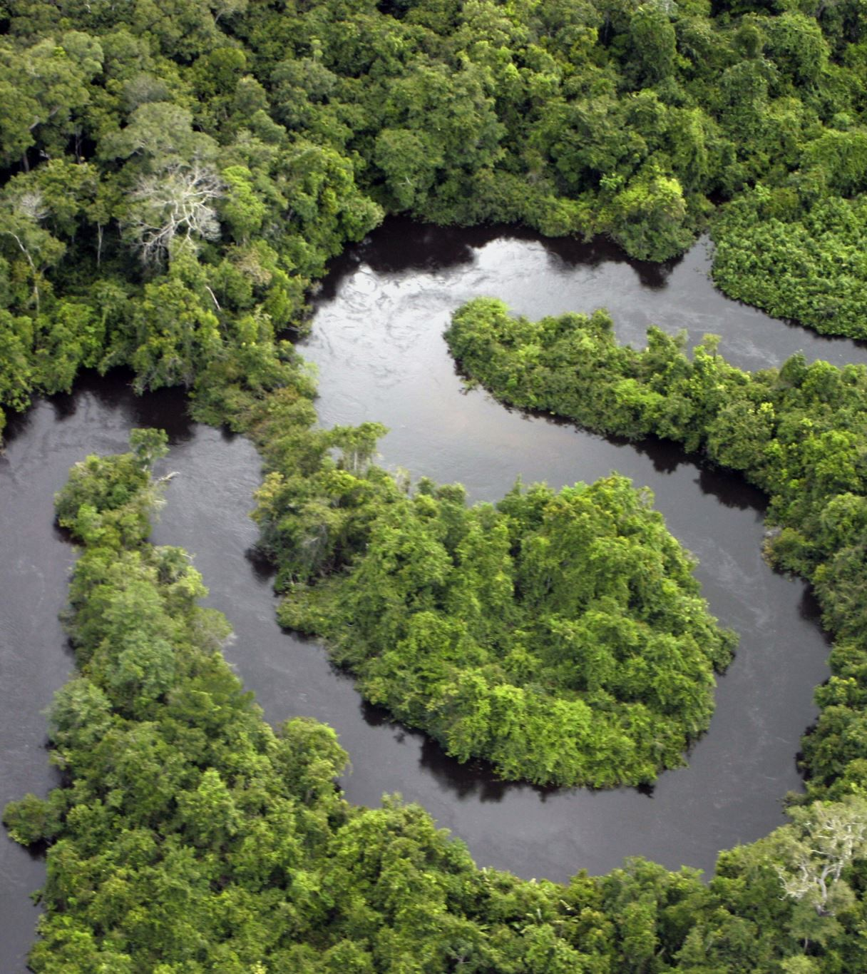
Climate disasters in Brazil:
the case of the Yanomami in the Amazon
and the rain floods in the country
Alexandra Mustafá

Slide 2
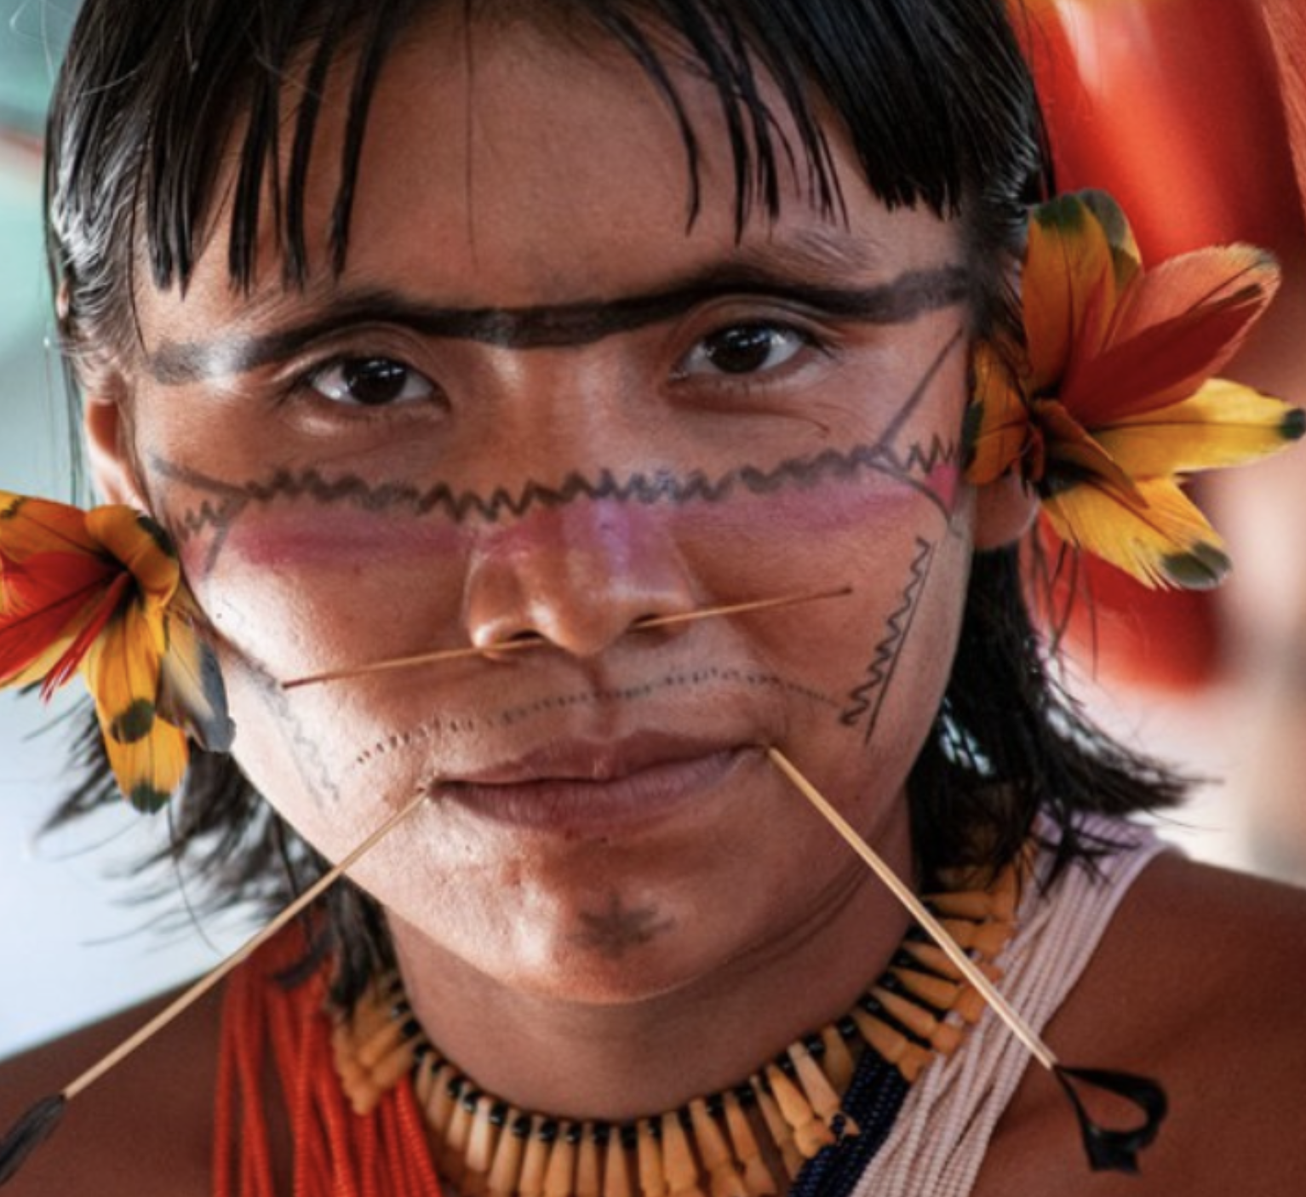
Yanomami people, as well as all the remaining indigenous peoples in Brazil represent a source of stored knowledge about all of humanity

Slide 3
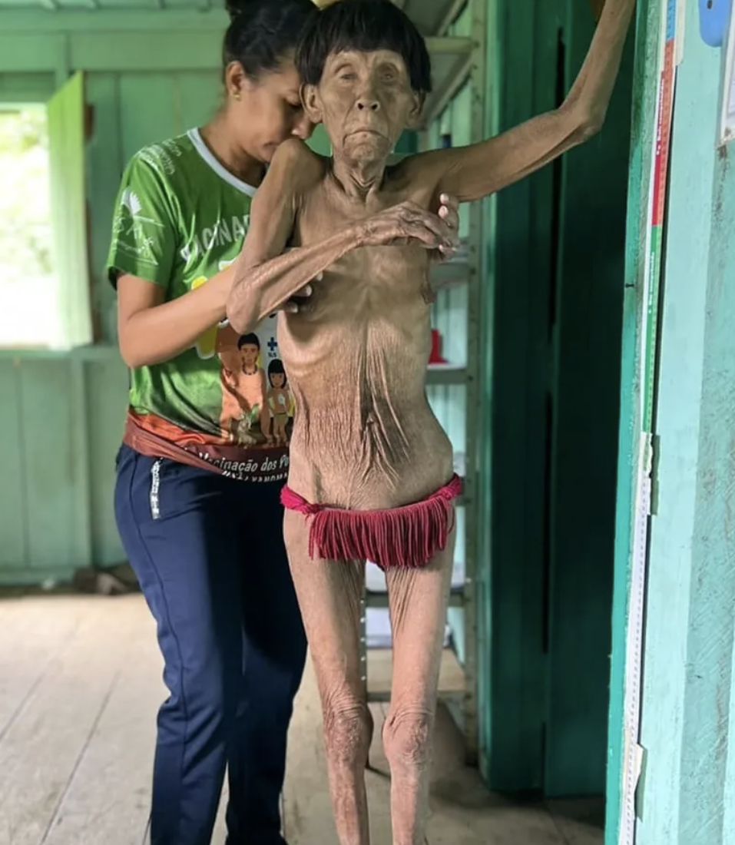
In the first months of this year of 2023, which coincided with the beginning of the Lula government, the scandal of worldwide repercussion of severe malnutrition and threat of extinction of the Yanomami people in the Amazon erupted.

Slide 4
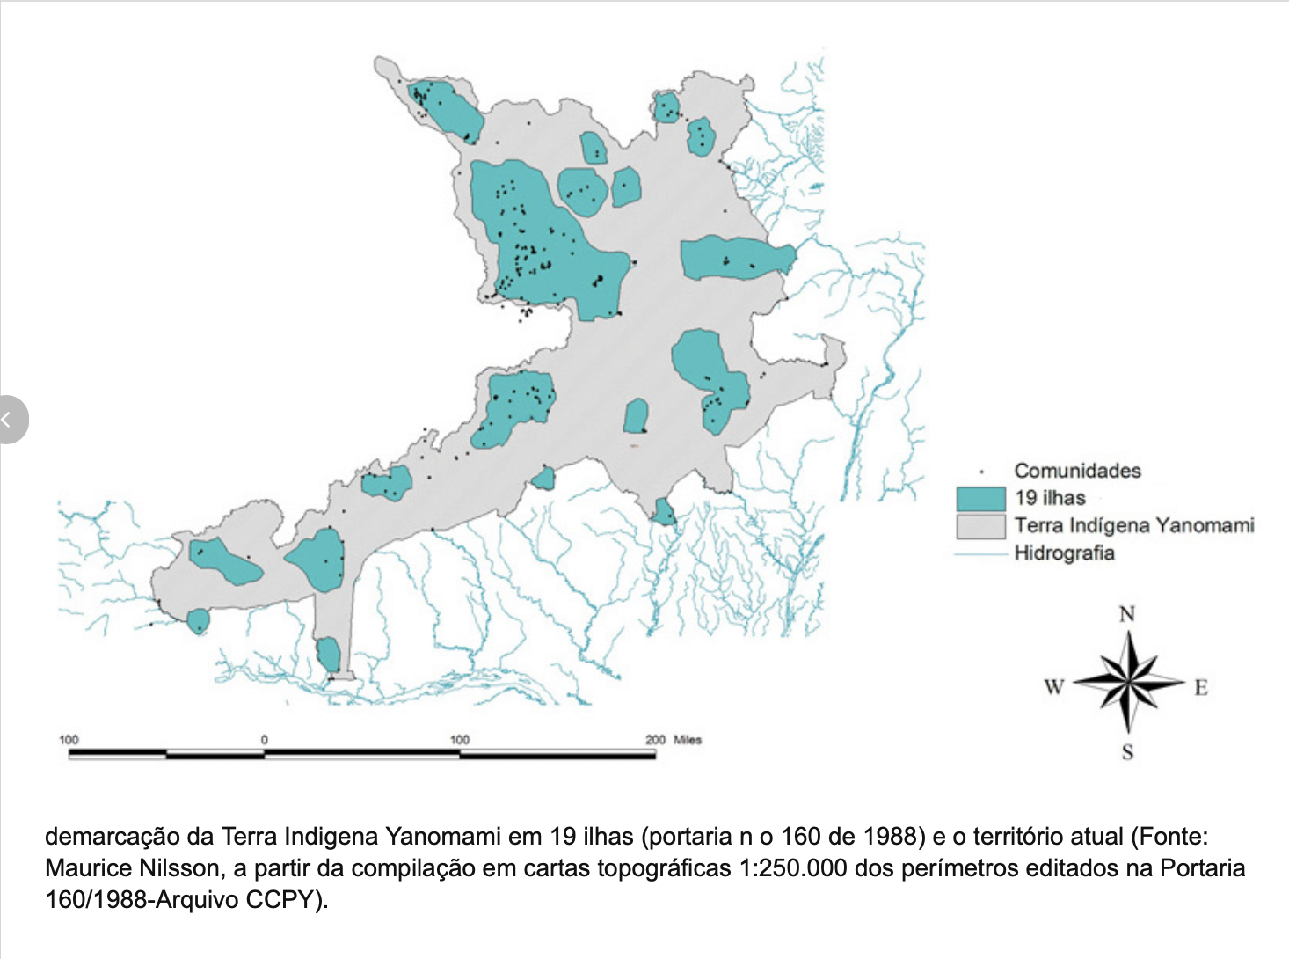
Demarcation of the Yanomami Indigenous Land into 19 islands (Ordinance No. 160 of 1988) and the current territory

Slide 5
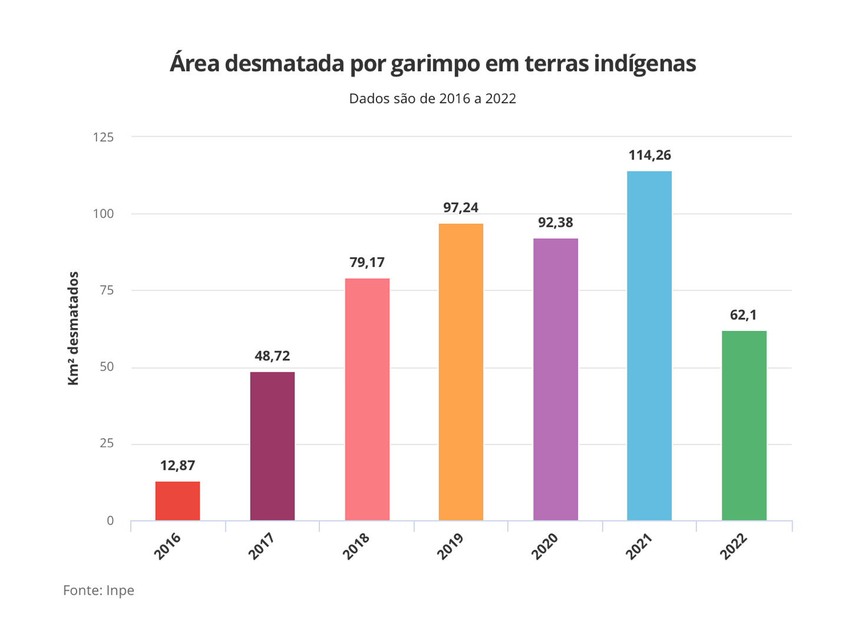
Area deforested by mining in indigenous lands
Data is from 2016 to 2022
Source: Inpe

Slide 6
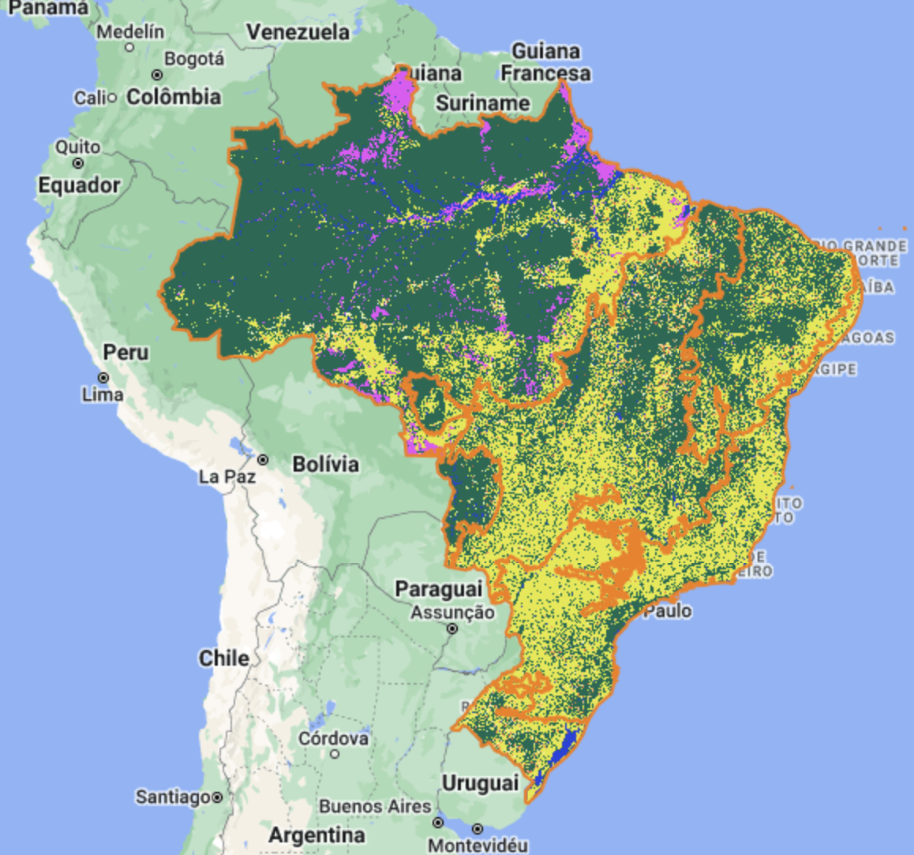
Deforestation
The activities were detected in the Yanomami Indigenous Lands, in Roraima, and in six reserves of Pará: Sai-Cinza, Munduruku, Baú, Kayapó, Apyterewa and Trincheira/Bacajá.

Slide 7
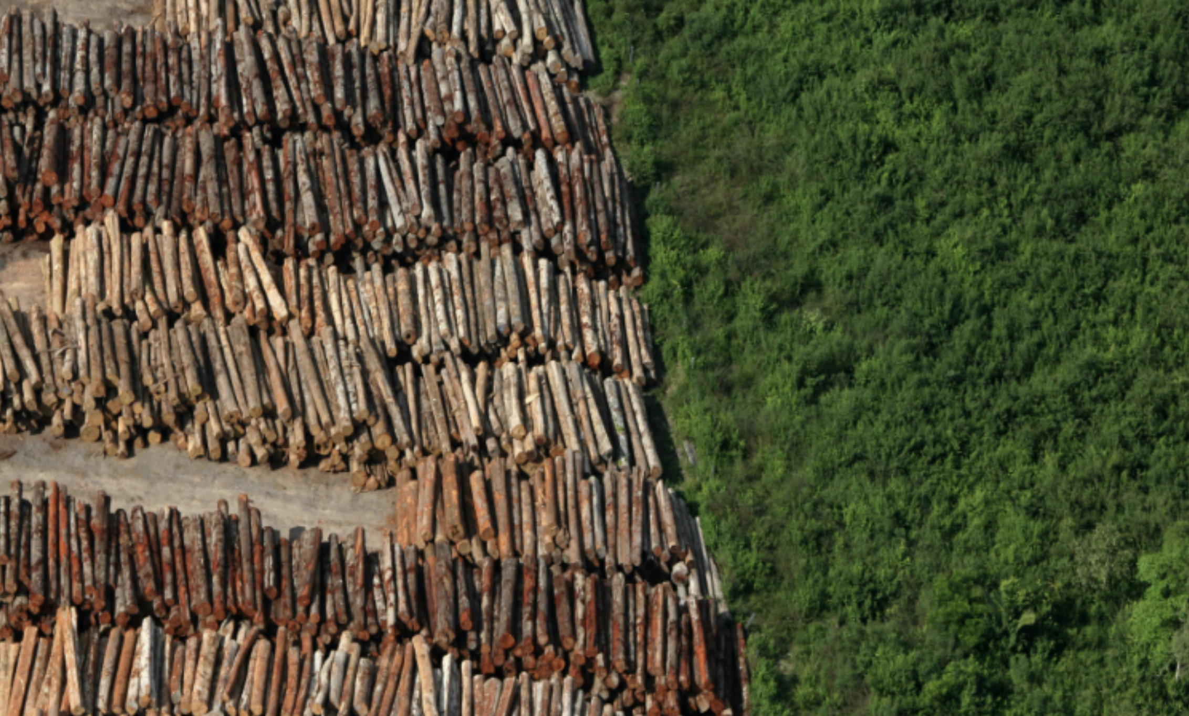

Slide 8
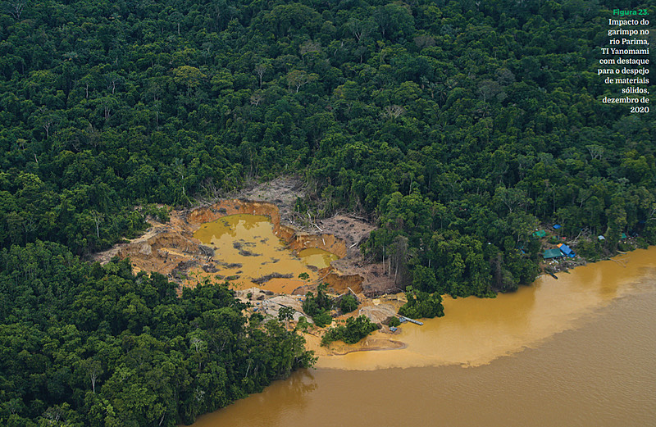
The rivers are contaminated with mercury, which totally prevents the use of drinking water, fishing, hygiene and the planting of cereals to feed the indigenous people. The hunting of animals becomes impractical, as they are chased away by the presence of prospectors in the region.

Slide 9
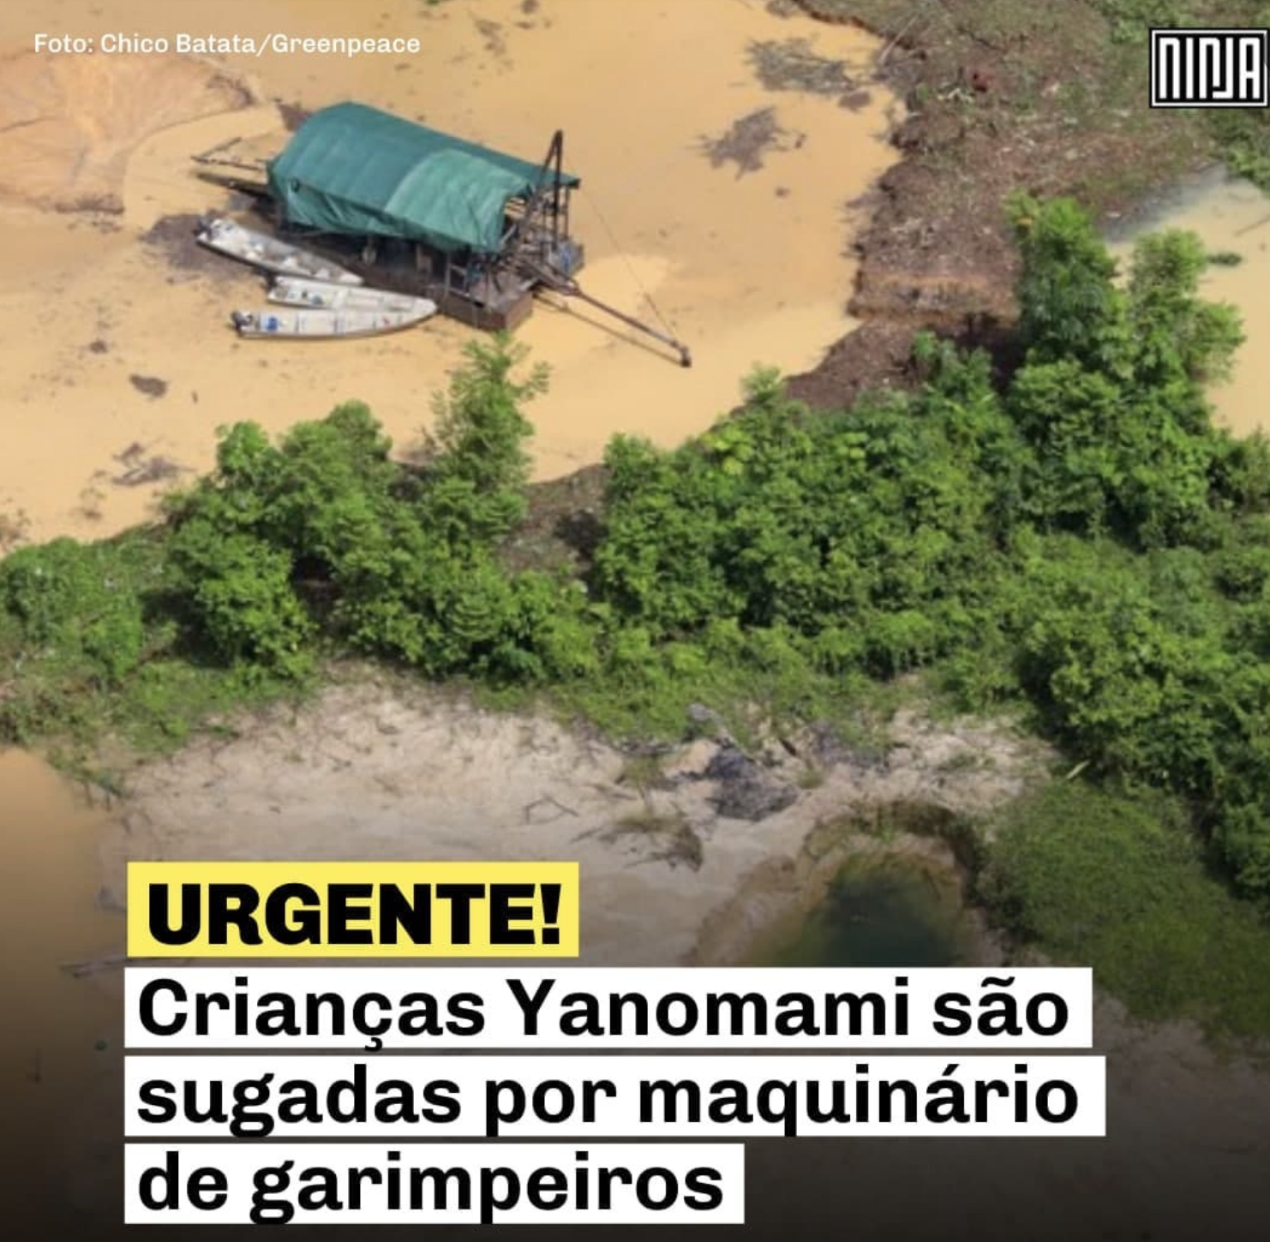
URGENT
Yanomami children
are sucked up by mining machinery

Slide 10
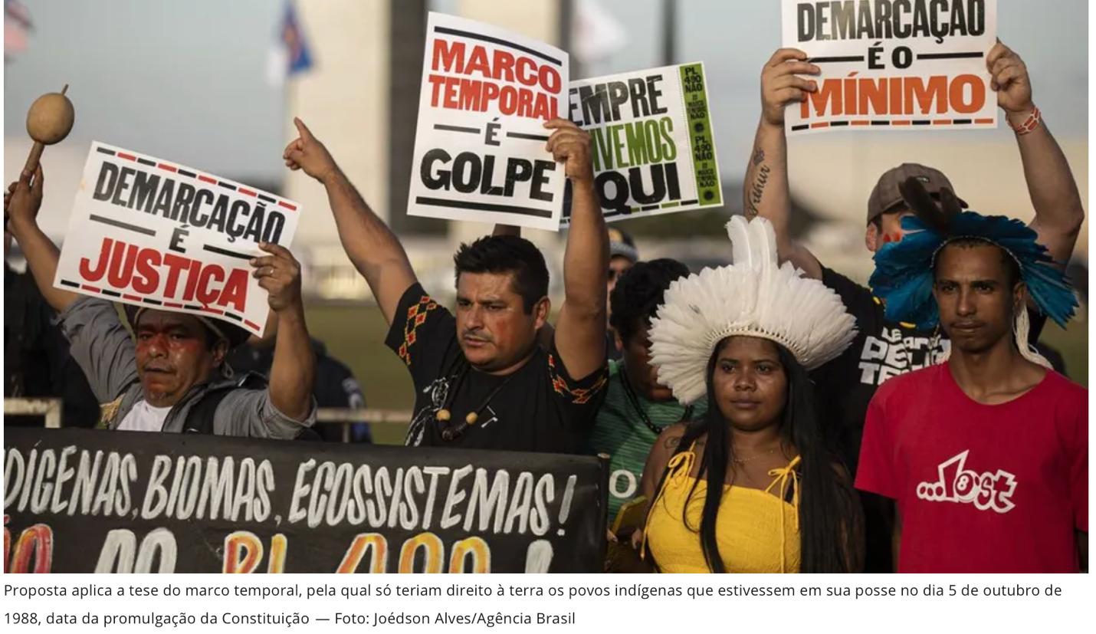

Slide 11
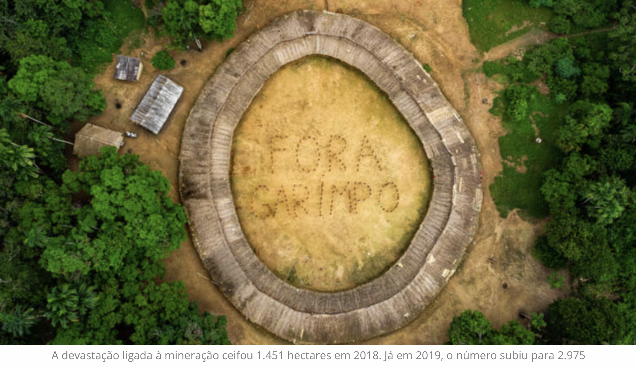

Slide 12
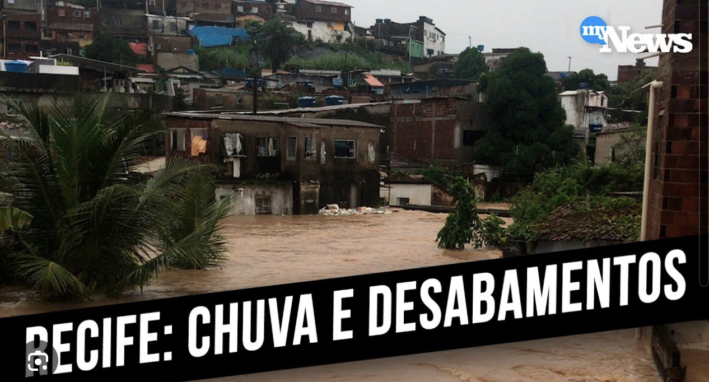

Slide 13
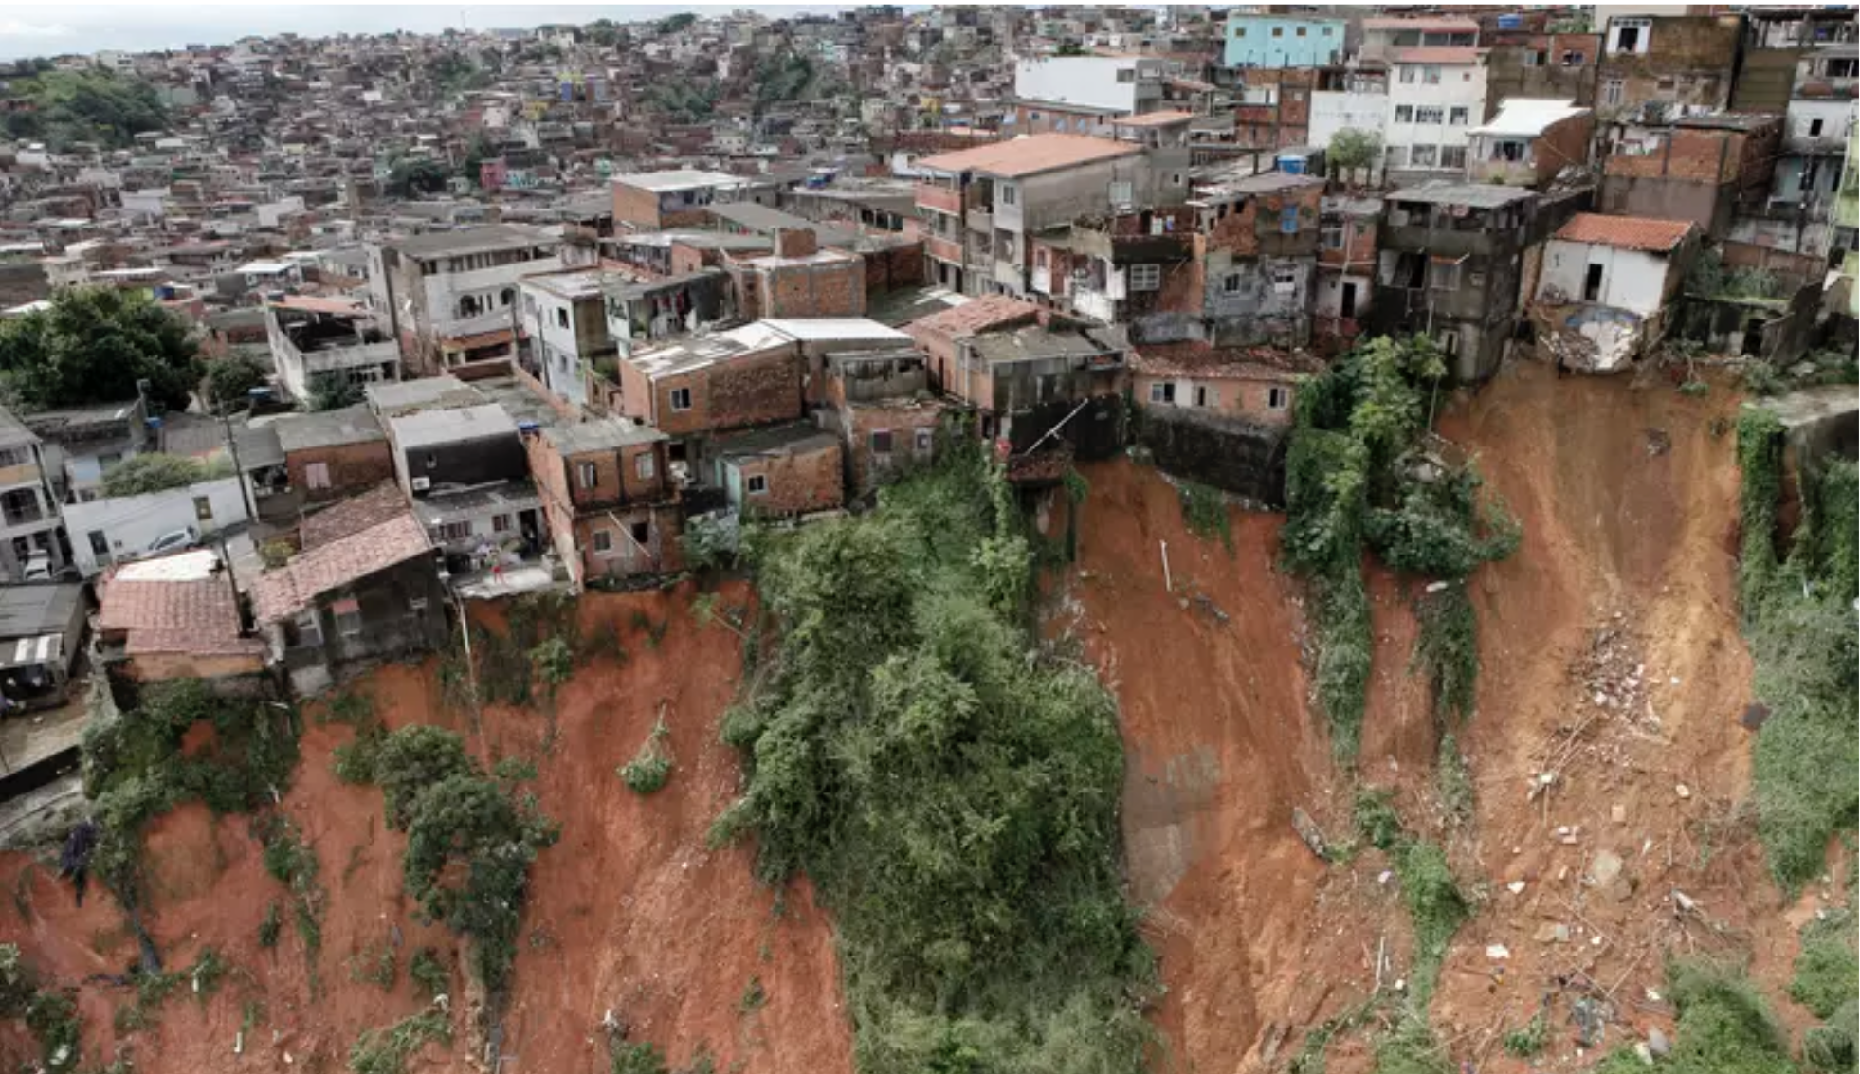

Slide 14
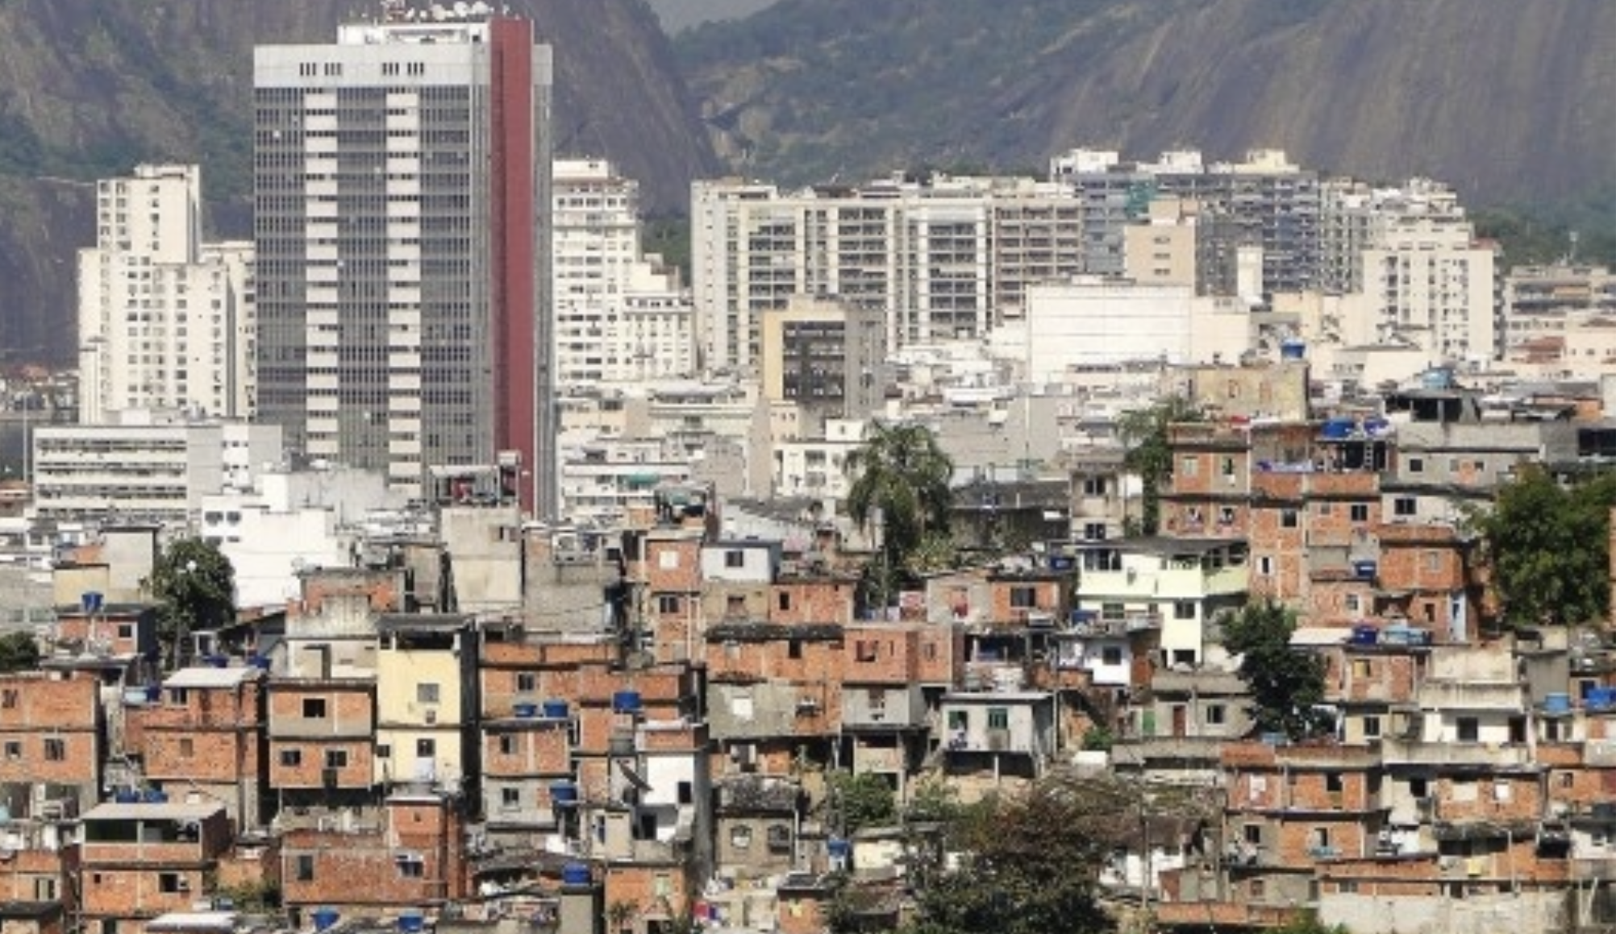

Slide 15
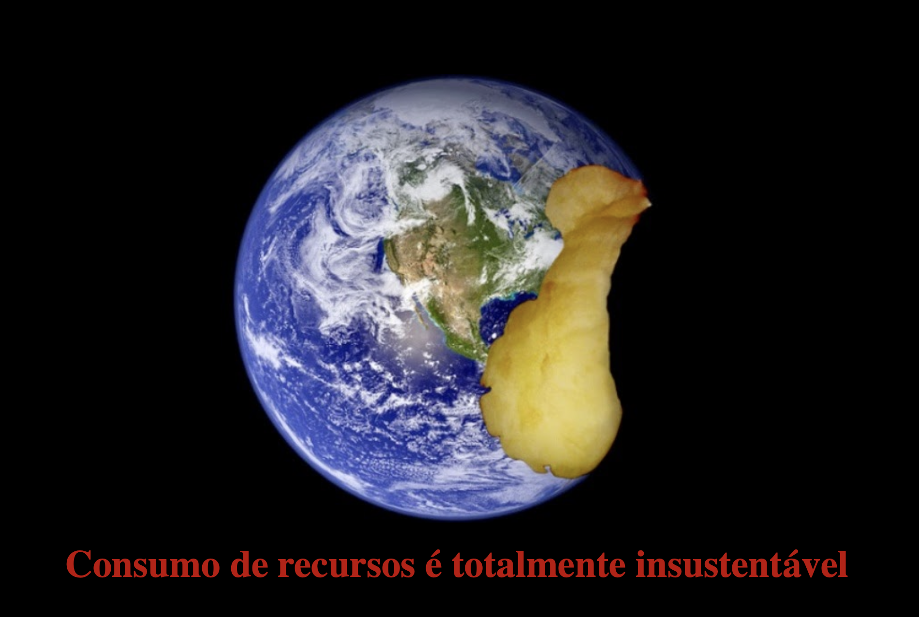
Resource consumption is totally unsustainable

