Slide 1

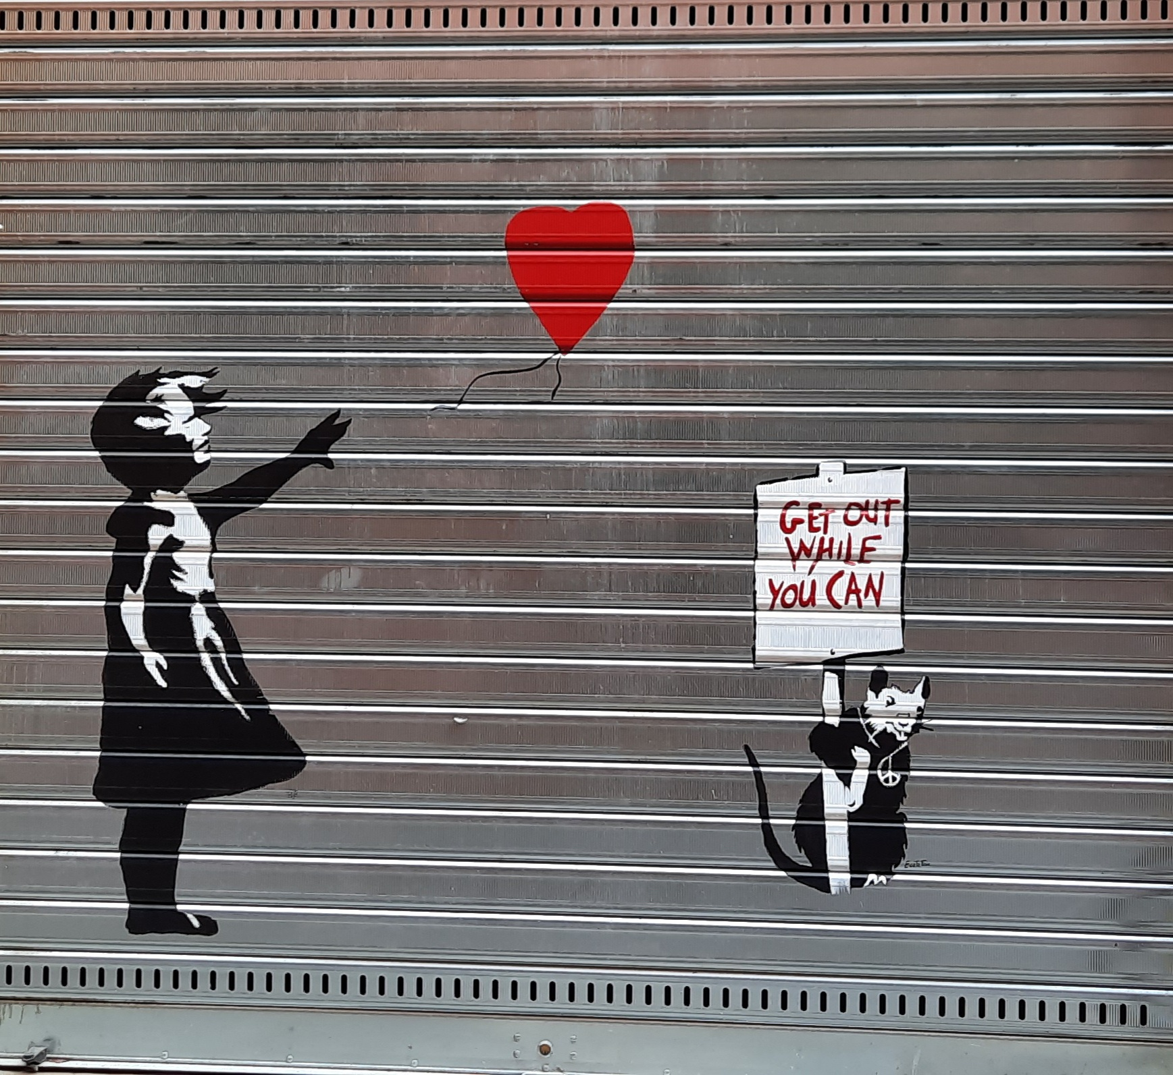
Closing remarks: Capacity building from macro level perspective; The importance of democracy as united platform to act from.
Disasters: Human and Natural
Marlene Corydon Harritsø

Slide 2
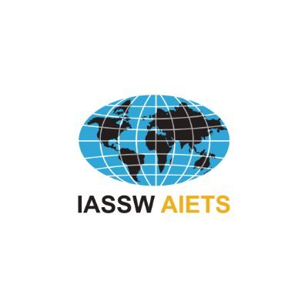
Social Work is deeply rooted a democratic tradition: Global definition of social work
“Social work is a practice-based profession and an academic discipline that promotes social change and development, social cohesion, and the empowerment and liberation of people. Principles of social justice, human rights, collective responsibility and respect for diversities are central to social work. Underpinned by theories of social work, social sciences, humanities and indigenous knowledges, social work engages people and structures to address life challenges and enhance wellbeing. The above definition may be amplified at national and/or regional levels.”
Marlene Corydon Harritsø

Slide 3
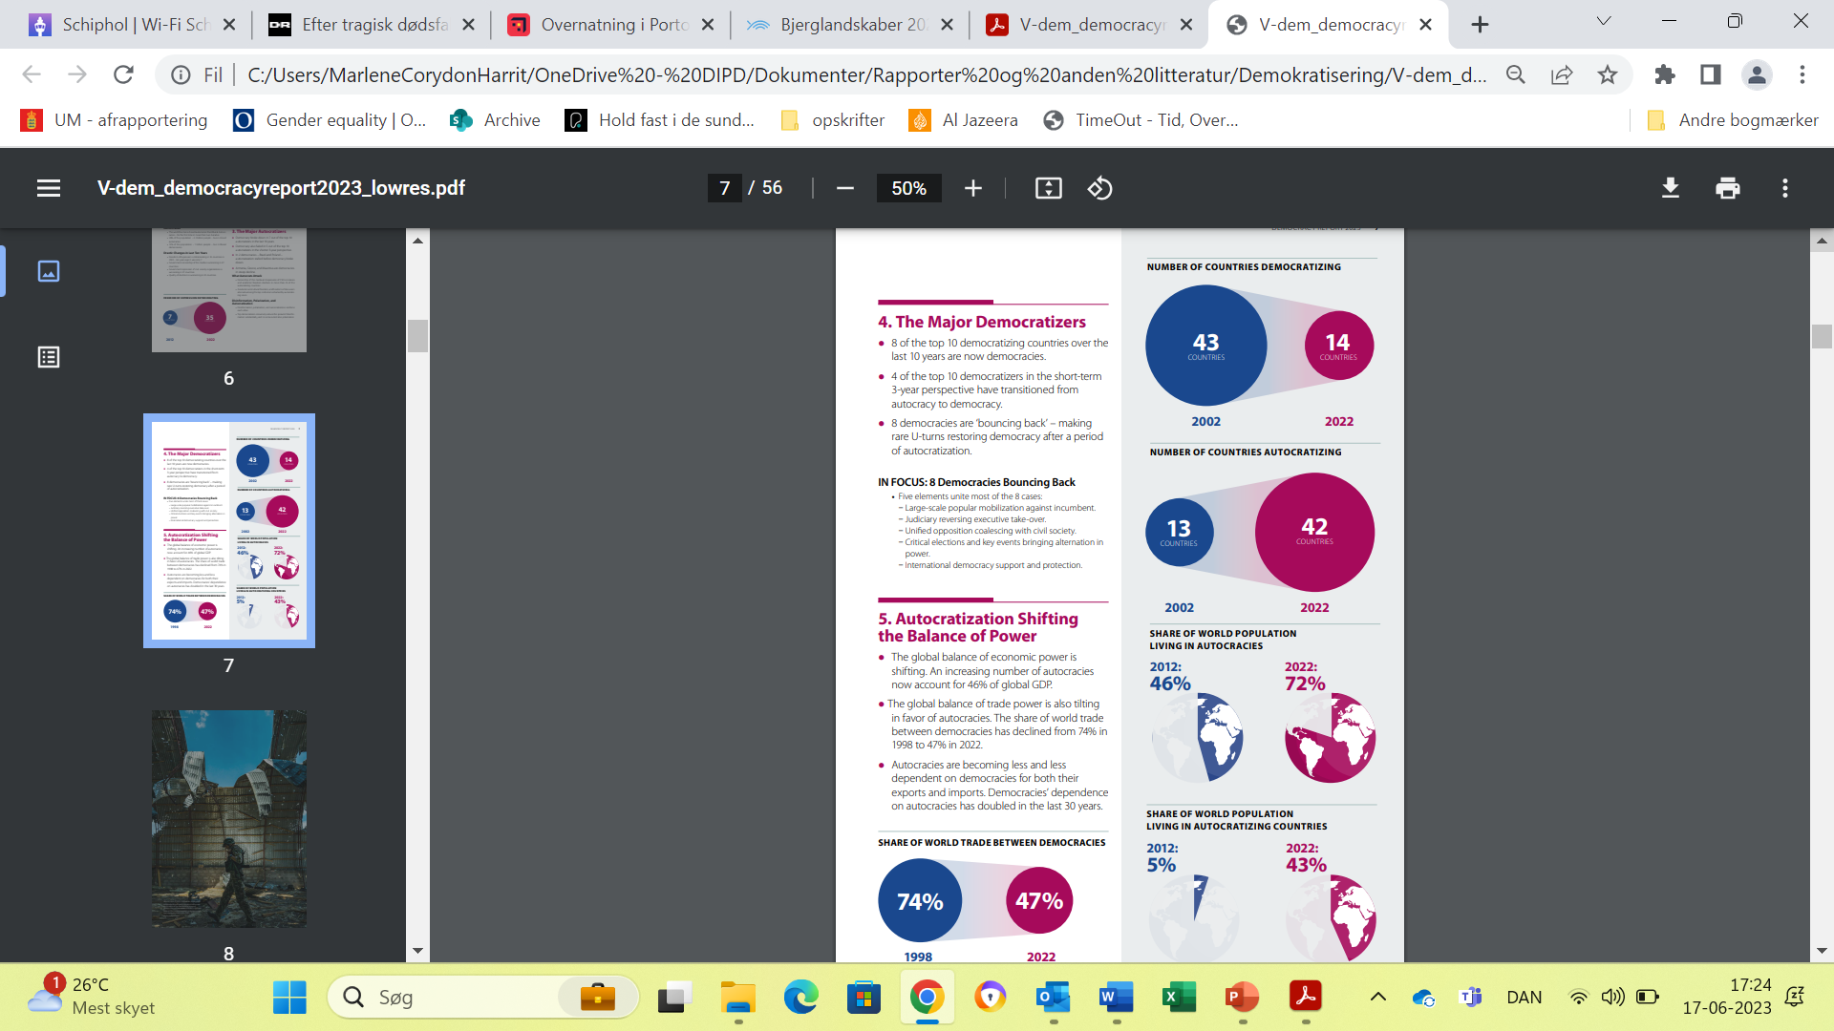
Disasters & link to decline in democracy
Global democracy level is back to 1986 level
A staggering 72 percent of the world population live in autocracie
Autocratic governments:
  Hesitated to react to disasters if not beneficial: Brazil: climate change, consequences of the pandemic, etc.
  Freedom of speech in an educational setting is threatened with autocratic governing
  Hesitation in response to migration issues and collaboration with autocratic governments e.g. European migrant situation
V-dem institute, 2023: Defiance in the Face of Autocratization
Marlene Corydon Harritsø

Slide 4
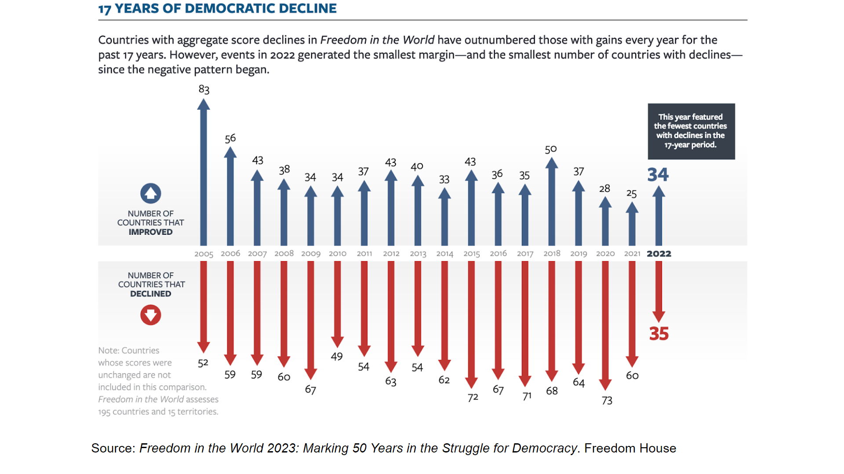
Marlene Corydon Harritsø

Slide 5
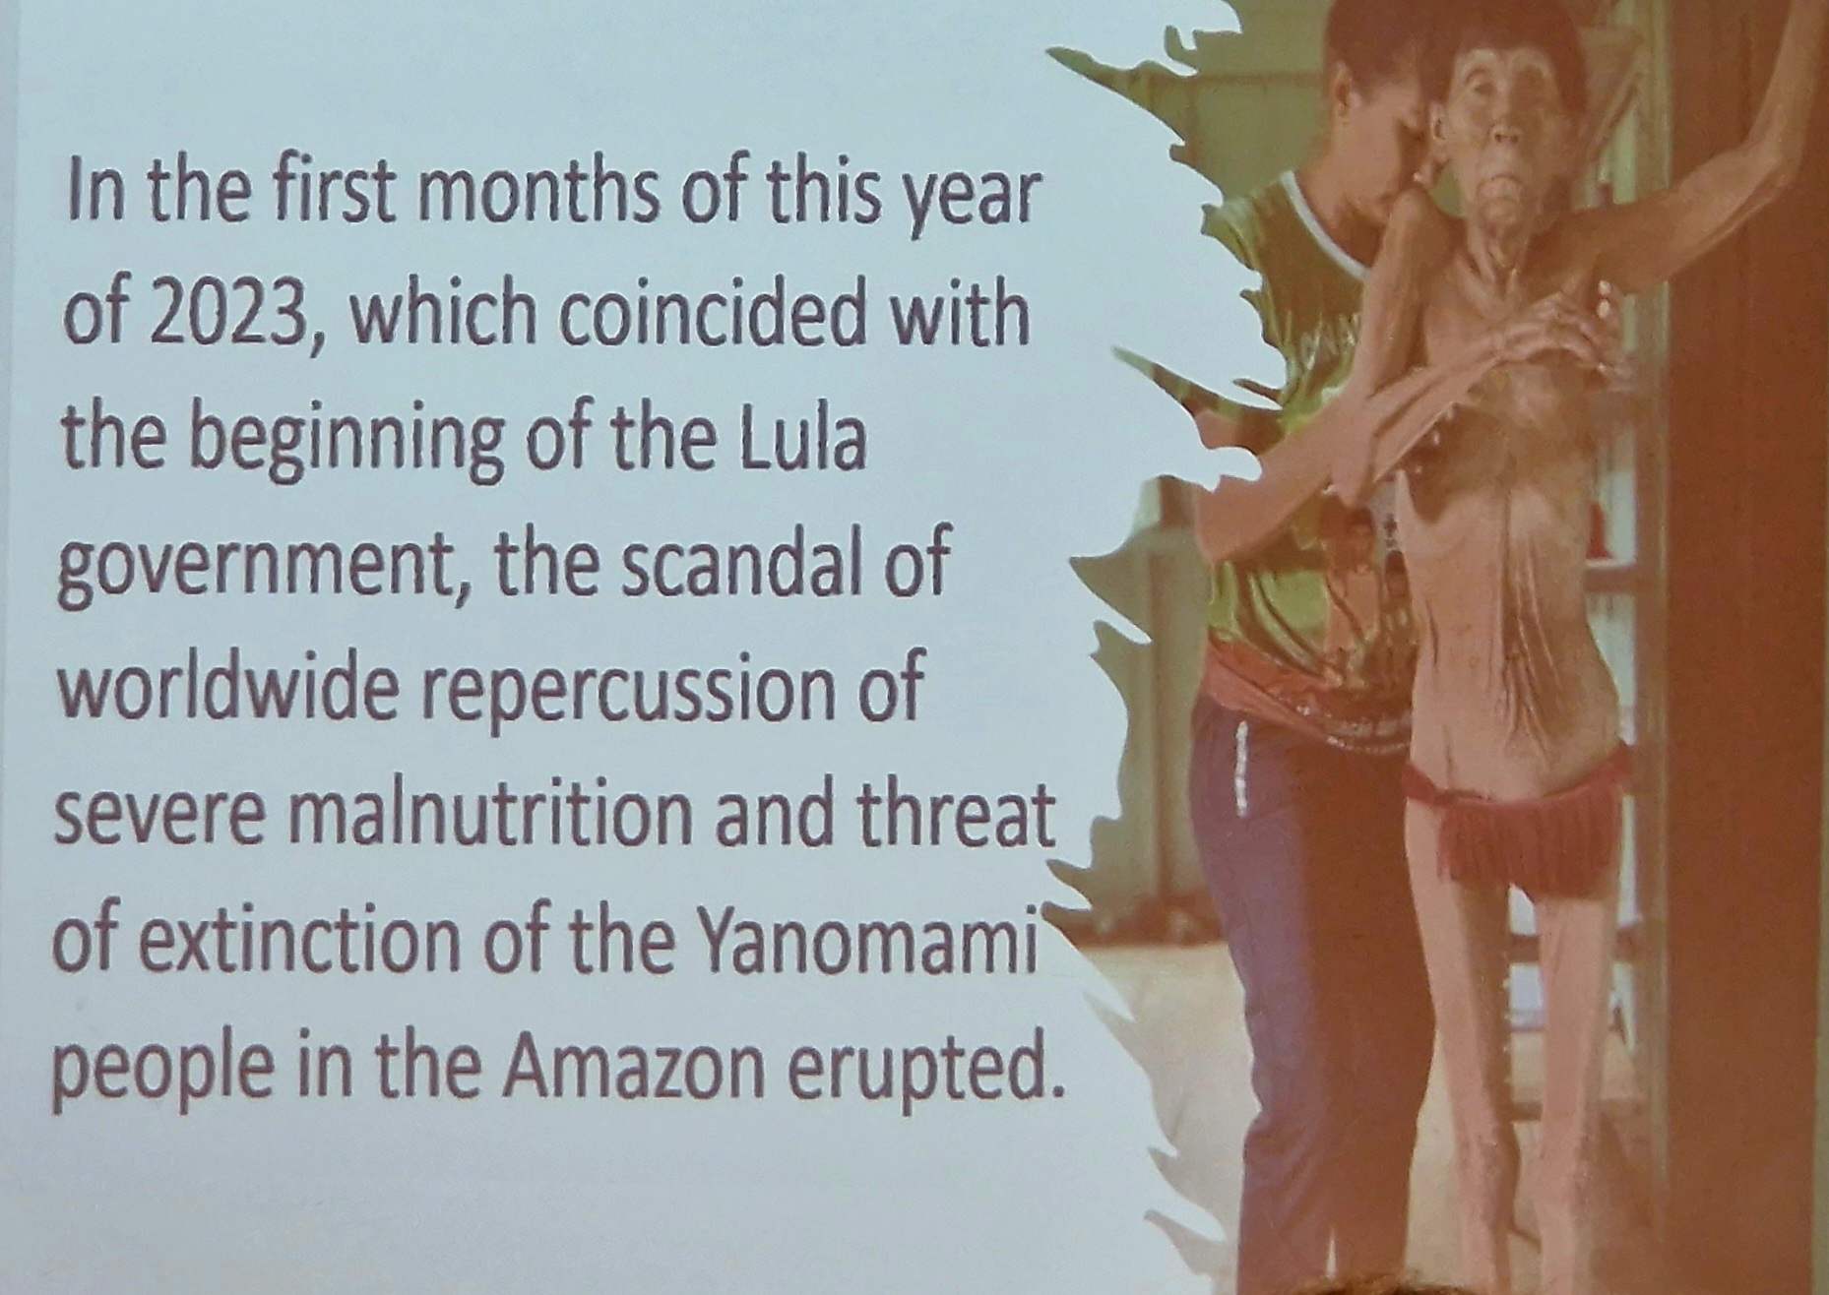
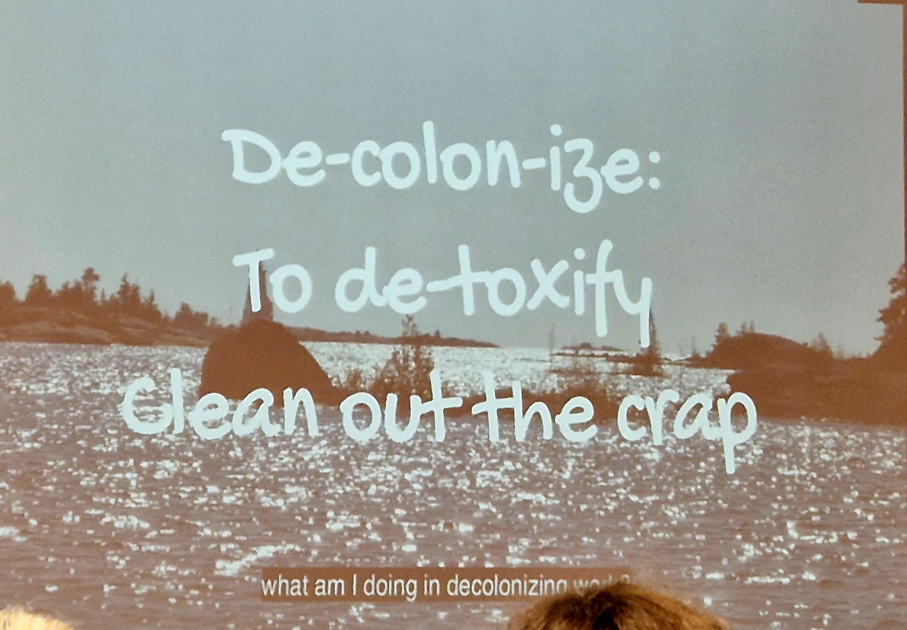
Takeaways from today’s sessions:
Kareen, Caribbean Trinidad & Tobago): example of macro level of the international society like IMF, UN etc.:
Alexandra, Brazil: the indigenous genocide – we need to stand together. Use our voice as Social Workers
Kathy, Anishinaabe from Flying Post First Nation, Canada:
1 dish 1 spoon: We have to unite to protect the dish. For that we need social workers, politicians and educators (all everyone else!). Most of all we need sustainable living traditions.
Discussion: All regions must take action. We all have responsibility to change the way we teach, we practice and behave as social workers. Take responsibility for prior behaviour and take pride in listening to each other.
Marlene Corydon Harritsø

Slide 6
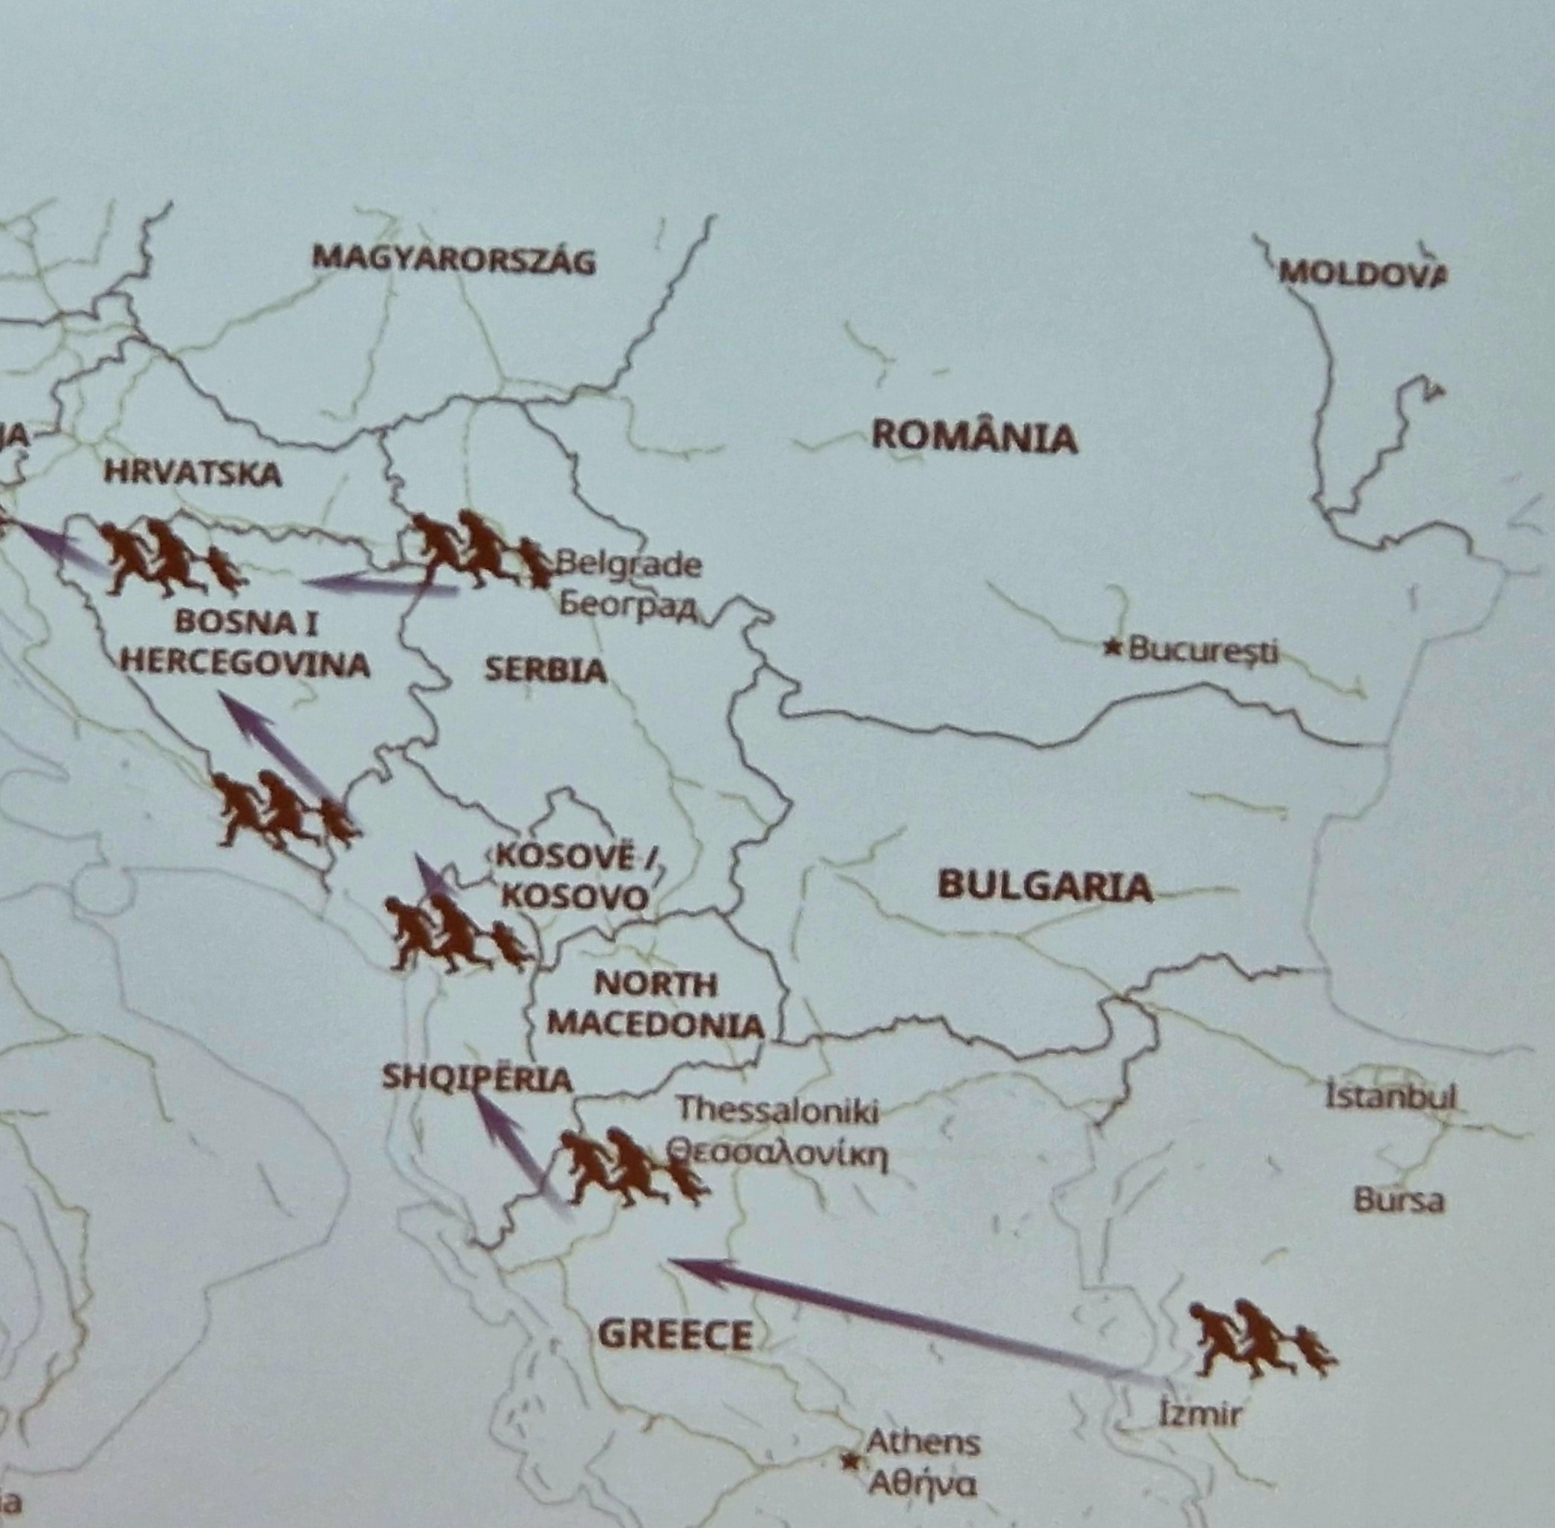
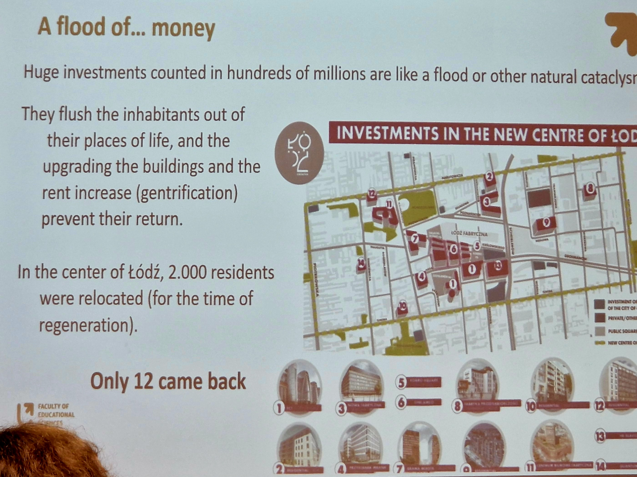
Takeaways from today’s sessions:
Vjollca Krasniqi, Prishtina Kosovo: Migration, dislocation and refugees: The Balkans have a history of migration and internal displacements: Kosovo war resulted in the biggest displacement in Europe since 2nd WW – 2014 started the largest migration through the Balkans towards EU → call for joint solutions and political willingness. Just last week politicians made new joint agreement in EU.
Mariuz, Poland: A flood of money → gentrification, dislocation, and new social problems. Disadvantaged neighbourhood, displacement of disadvantaged: no voice to speak up! Gentrification is a social international threat to cities around the world → political decision makers and capitalistic powers
Create agents is a common ground for the 2 examples. The power lies within the communities and we must find a way to provide the space/voice to create agents
Marlene Corydon Harritsø

Slide 7
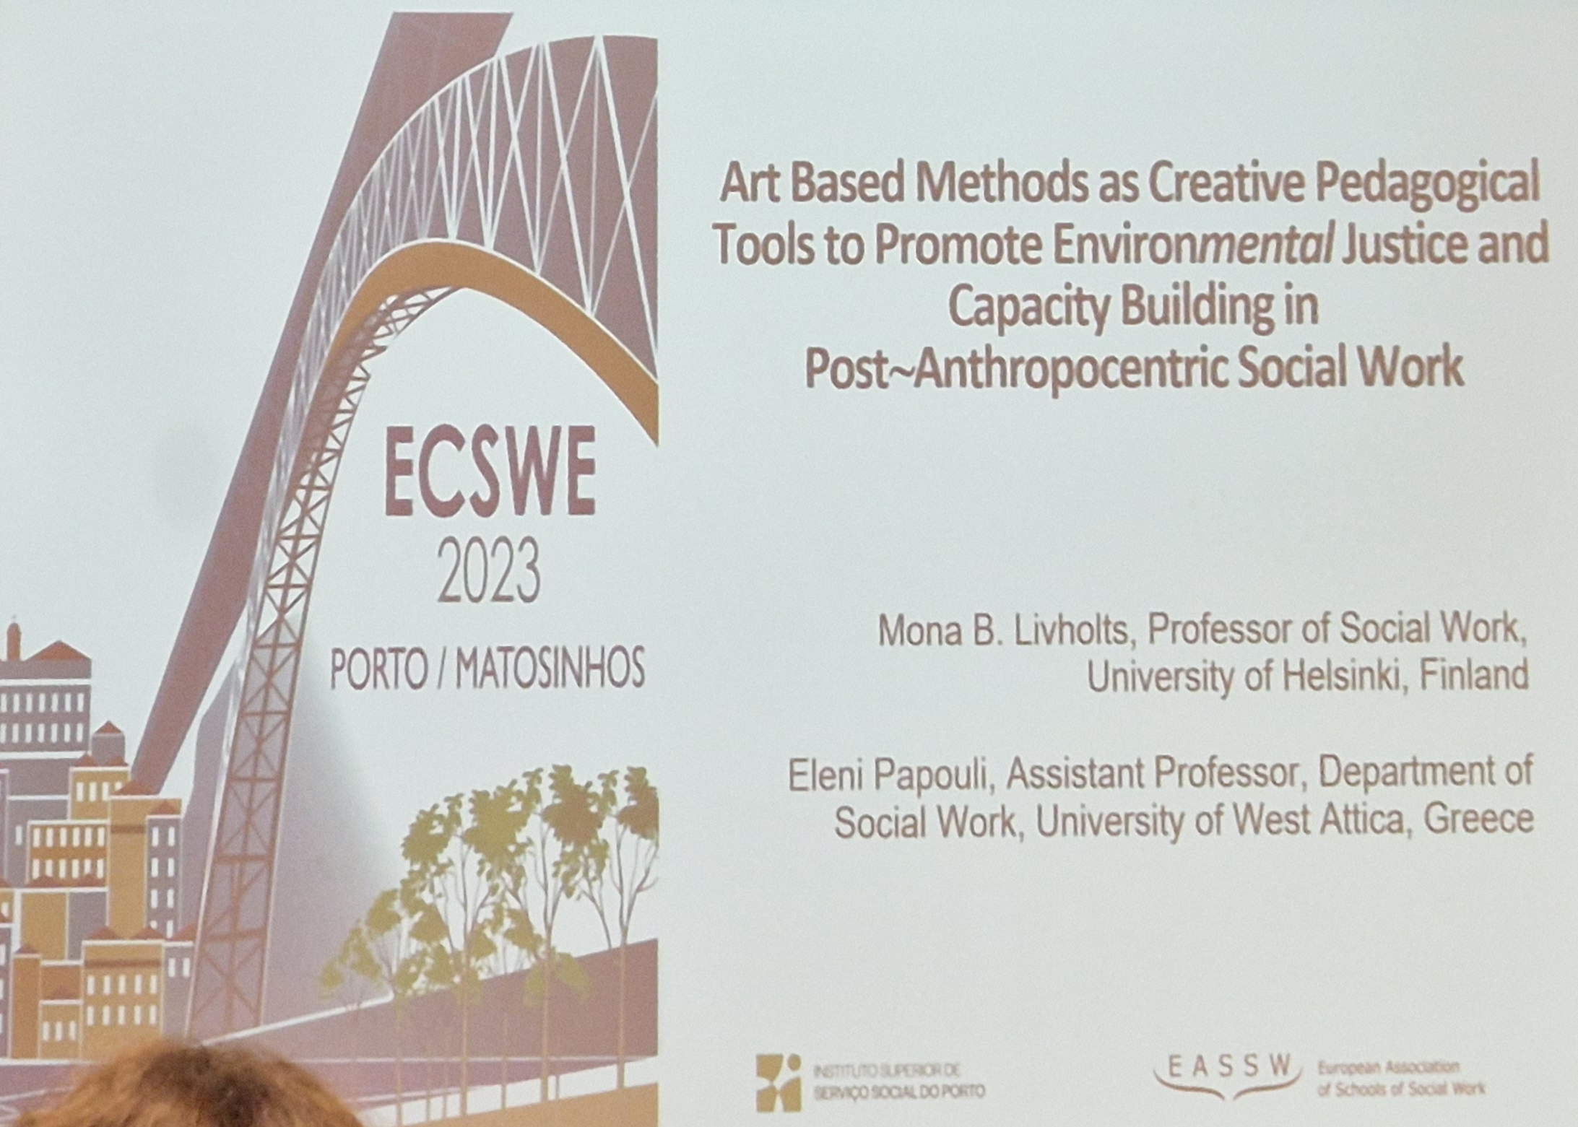
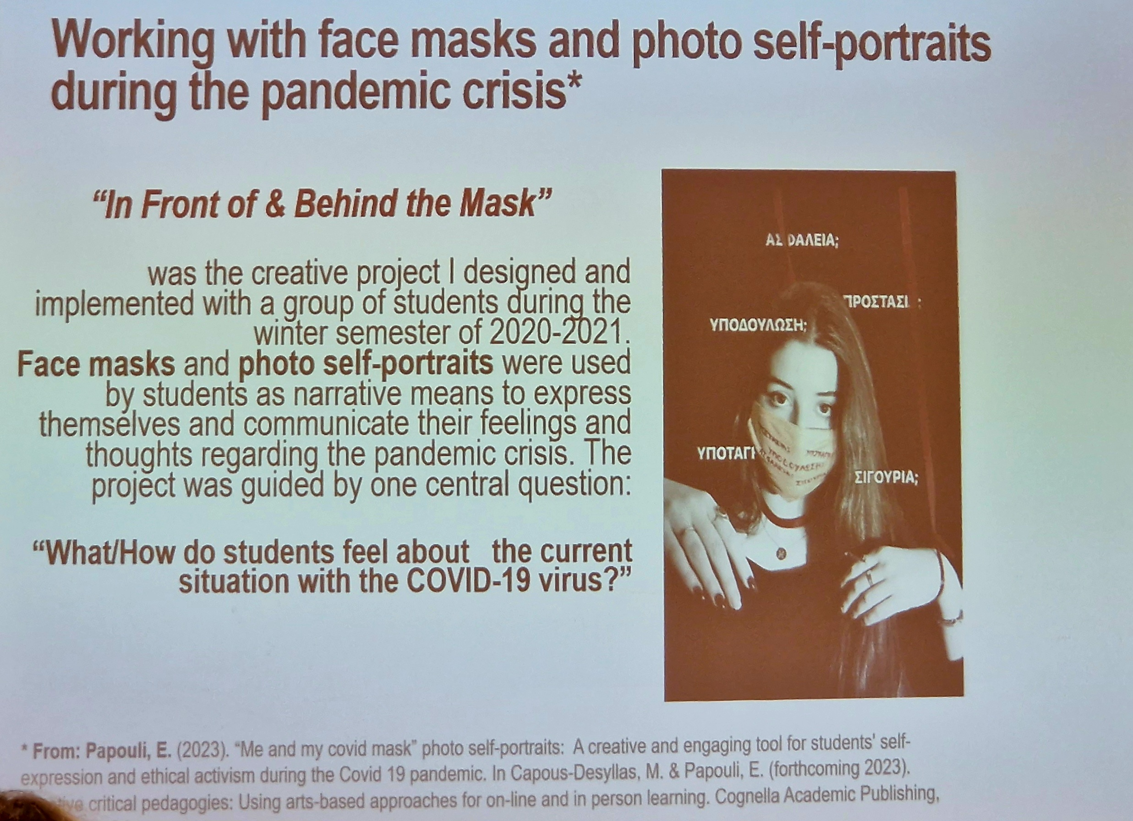
Takeaways from today’s sessions:
Mona Livholts and Eleni Papouli: Art Based Methods as Creative Pedagogical Tools to Promote Environmental Justice and Capacity Building in Post-Anthropocentric Social Work
Academic need more “swung” – more create methodologies and language
Re-word(I)ling Social Work in the Anthropocene
Exhaustion vs extinction: Exhaustion symbolism of racism, squeezing minorities (e.g. Floyd 2020). The power of breathe
Face Masks: transformation, visible symbol of Covid, hide and protect identity, social & political messages
THE FUTURE IS COMING AT US AT FULL SPEED (Stengers, 2018:130)
Marlene Corydon Harritsø

Slide 8
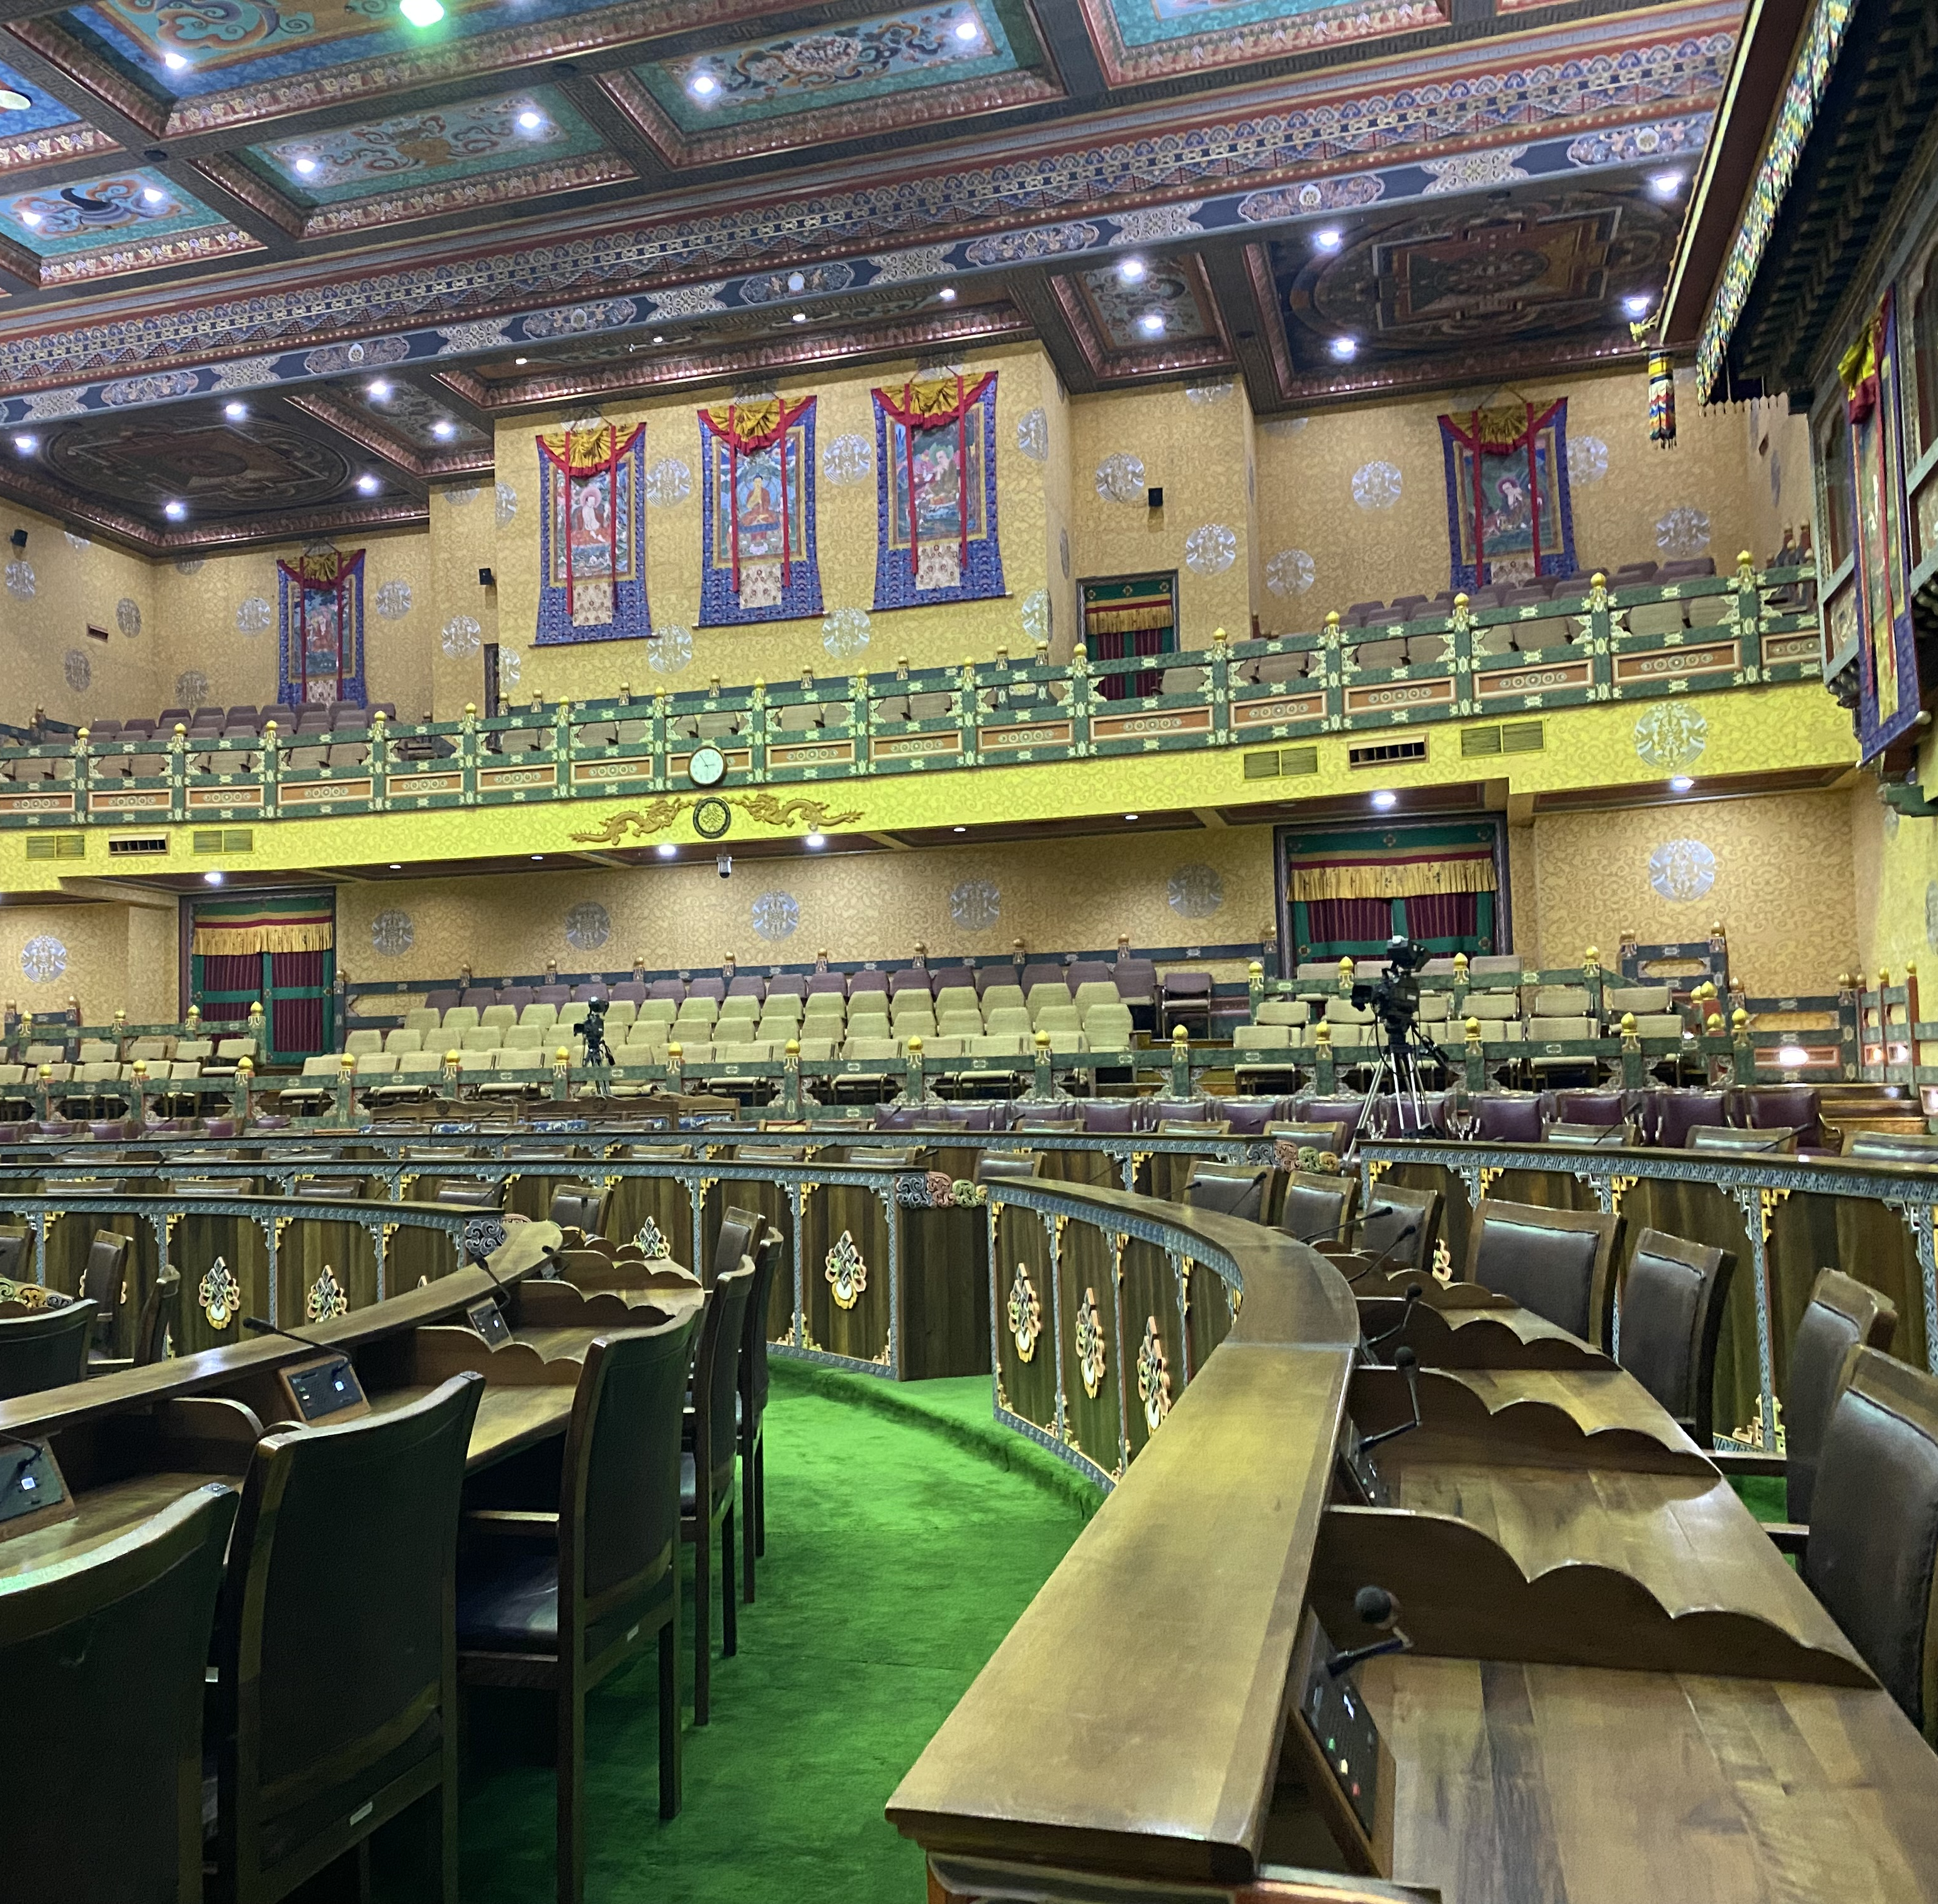
Social work and democracy: Local problems call for global solution
Climate change, decolonisation & migration and urban planning are all connected to the political climate of the host country / region and the international society:
To put pressure on the decision makers on all levels
Political climate is important to move the dialogue to action
Democratic dialogue is the key to influence
Social movements are links to decision makers
Marlene Corydon Harritsø

Slide 9
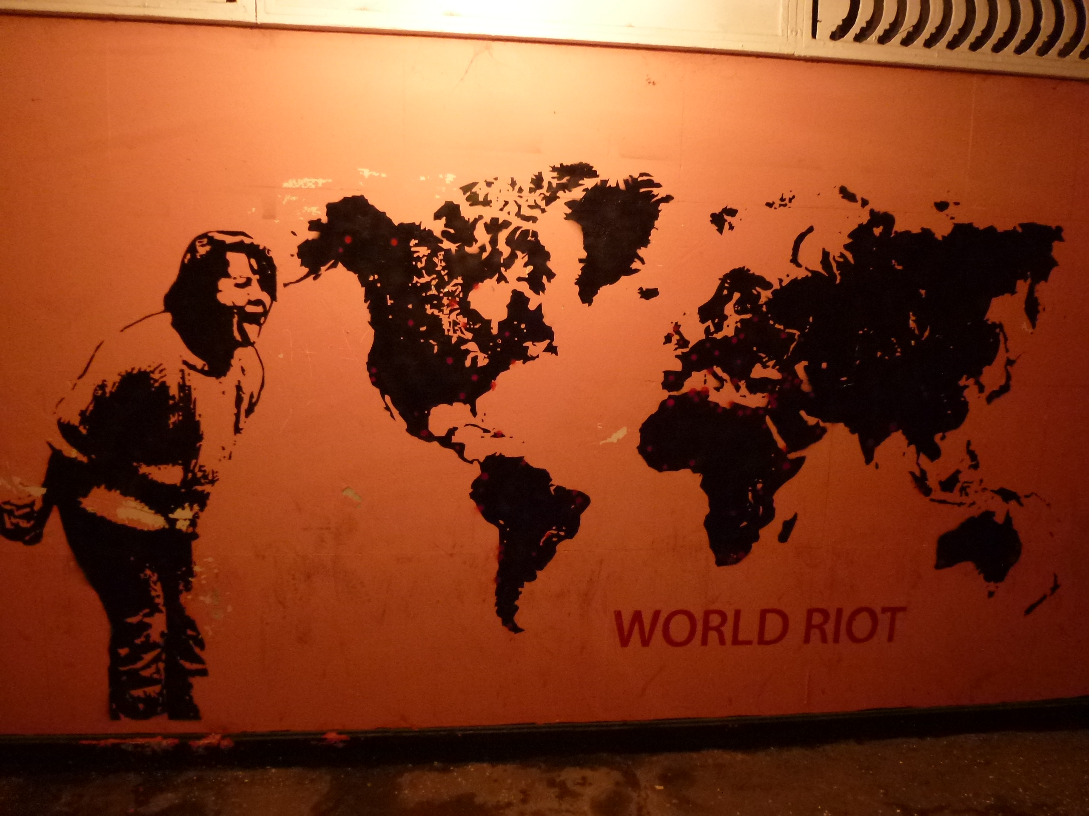
Fourth democratic wave through social movements
“ In retrospect, all revolutions seem inevitable. Beforehand, all revolutions seem impossible.” diplomat, Ph.d. Michael McFaul
Civil resistance movements must play a role. As we have heard today – Movement and community building are important voices and often overheard:
Decision makers begin to take interest in social movements and resistance movemnts As Social Workers we must use this window of opportunity
Advocate for a stronger link. Seek influence and mobilise the communities we work in
Marlene Corydon Harritsø

Slide 10
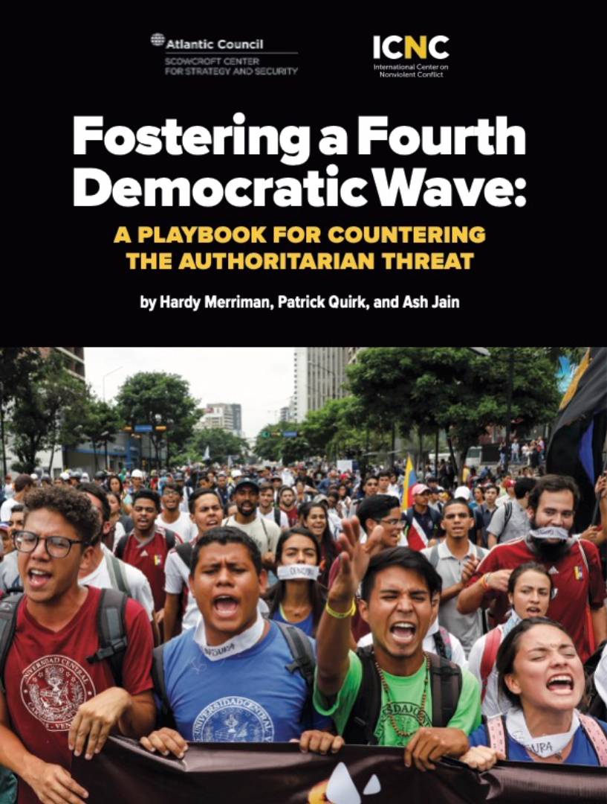
NDI: Approaches to influencing autocracies and backsliding democracies
Top down
Diplomacy and negotiations
Trade
Aid
Sanctions
Threats of hard power
Bottom up
Support to civil society
Support for civil resistance movements
© From Hardy Marriman presentation of the report, DIPD May 17th 2023

Slide 11
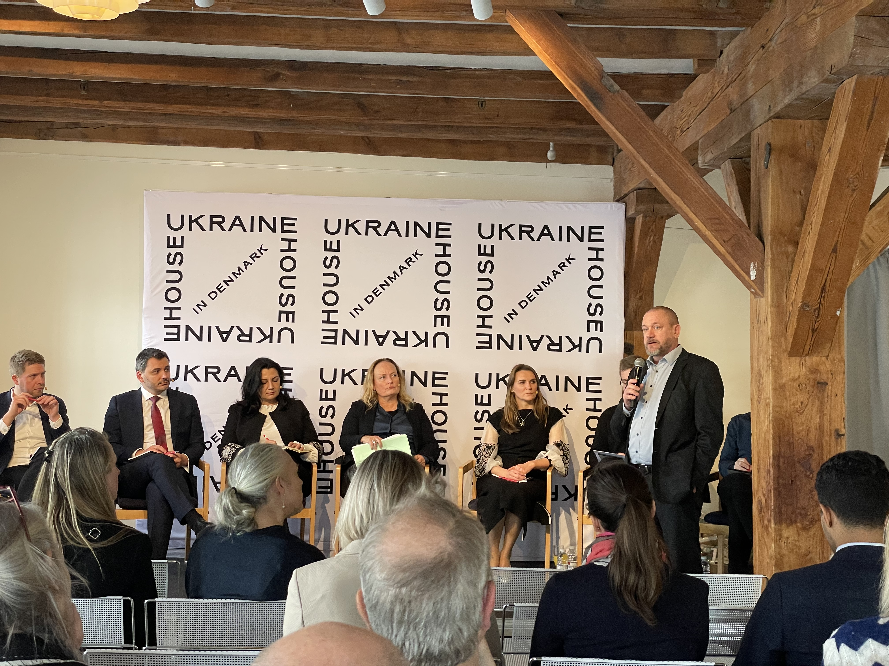
Advocate, lobby & collaborate
Decision makers, politicians, civic society actors, social workers in the field, social work educators and researchers must stand together to make a difference
An example of creating democratic dialogue: Ukrainian parliament members from right to left wing parties, Danish MP’s from different parties, Ukrainian civic society activist and a researcher from the V-dem institute in Gothenburg, Sweden discuss the future for a Ukraine post war (rebuilding institutions, democratic institutions etc.).
Moderated by DIPD, Copenhagen
Marlene Corydon Harritsø

