Slide 1
The imperative of common education base towards professional social work solidarity
Vadim Tarna, MSW, National Association of Social Workers in Moldova

Slide 2
Social work profession in Moldova
1998 – The social work profession was included in the national professions nomenclature and in the specialty nomenclature of study programs of two universities in the republic;
1999 – National Social Work Reform Strategy (Parliament's decision nr. 416 from 28.05.1999);
2003 –Social Work Law, nr. 547 din 25.12.2003;
now - 6 universities offering bachelor's and master's degree programs in social work
01.01.2018 – ~1120 community social workers. 1 unit of social worker to 5000 inhabitants in urban areas and up to 3000 inhabitants in rural areas;
2016 – National Social Work Agency - strengthening the professional capacities of employees in the social work system at national level.

Slide 3
Community social worker
social workers are viewed only as intermediaries to financial benefits, this way their status remained low compared to other fields;
very high rate of the staff turnover (~30% per year);
2700 lei (~132 euro) average salary (in the budgetary area, the average earnings are approximately twice higher);
lack of professional solidarity and poor organization of the community of social workers until the ANEASM have started the activity

Slide 4
Social workers education level

Slide 5
Obstacles to an effective social work education in Moldova
*Disconnection between social work education and practice
*Social work education provided by non-social work faculty
*Social work departments and programs are administered by non-social workers
*Subservience to the Western theoretical orientation and models of practice

Slide 6
The Wellness Social Work Curriculum for the New Century

Slide 7
The Wellness Social Work Curriculum for the New Century was developed on the foundation of:
The current MSW curriculum at the Free International University of Moldova – developed by the Project Casa Mare Academic Consortium in 2012.
The feedback from the dialectic curriculum framework presented at the EASSW Conference in Milan in 2015.
The Comenius Social Work Curriculum for the New Century – developed by the EASSW-funded Visegrad-Plus Consortium at the Second International Congress for Advancement of Social Work in Post-Socialist Countries in 2016.
The York College MSW Proposal – developed by York College Social Work Department faculty in 2016.
The First, Second, and Third International Conference for Advancement of Social Work in Post-Communist Countries in Moldova and Georgia in 2015, 2016, and 2017
The IASSW, EASSW, and CSWE social work education standards.

Slide 8
The Wellness Social Work Curriculum for the New Century will
1. Serve as an innovative model of internationalized social work curriculum that is centered on dialectics, system analysis, community development, and social entrepreneurship.
2. Become a model of sustainable international collaboration and networking in the area of social work in post-socialist countries and beyond.
3. Utilize innovative and effective pedagogies.
4. Serve as a catalyst for innovation and improvement of social work education and practice.
5. Prepare students to serve as leaders who work on behalf of communities toward collective empowerment and wellness.
6. Prepare students for professional social work in such fields as policy analysis, community organizing, health, mental health, and education.

Slide 9
Principles of professional social work practice and education
1. Wellness is the basic measure of human empowerment and well-being in the areas of community health, physical health, and mental health.
2. Competencies-based in the areas of specialized social work values, knowledge, and skills applicable on nano-, micro, mezzo, and macro levels.
3. Accredited by local and international independent educational accreditation agencies
4. Enhanced professional employment oriented: Social Expert in the context of post-socialist countries
5. Praxis as signature pedagogy: field education, community organizing, social entrepreneurship, and collaborative education practices.

Slide 10
Principles of professional social work practice and education
6. Deontological orientation: Values-based
7. The leading role of the macro-level learning
8. Systems and dialectic theoretical orientations – social workers as experts on conflict and system analysis and interventions.
9. Scholarship production: publications, conferences, presentations
10. Flexible and progressive

Slide 11
Principles of professional social work practice and education
11. Global and local orientation.
12. Collaborative – pedagogies through group and teamwork
13. Cohesion and integration – vertically between the semesters and horizontally among the courses in the same semester
14. Integrative learning through utilization of the student portfolio
15. Student research across the curriculum

Slide 12
Principles of professional social work practice and education
16. Nano-practice through self-examination, understanding, and awareness.
17. Concepts-based – toward the glossary of professional terminology
18. Theory-based – from allied disciplines – sociology, anthropology, psychology, etc.
19. Post-graduate success-oriented: Employment and further studies
20. Innovation

Slide 13
Core principles underlying the Wellness Social Work Curriculum for the New Century
*Social workers are experts on conflict (dialectic social work)
*Optimal social work practice is on the community level (community organizing and community building)
*Social work practice is project management (social entrepreneurship)
*Clinical/individualized social work contradicts fundamental social work ethics
*Deconstruction of the systems of oppression, exploitation, and disempowerment
*Community wellness is the ultimate goal of social work practice

Slide 14
Semester I Courses – Macro-level orientation:
1. Research: Strategies of inquiry and research methodologies
2. Society/Community: Human societies in dialectic transformation
3. Welfare Policies and Social Work: History of social work and social welfare policies
4. Community organizing: A methodology toward community wellness
5. Ecology: Toward harmony between humans and nature
6. Field Seminar I: Social entrepreneurship group projects researched and formulated

Slide 15
Semester II Courses – Mezzo-level orientation:
1. Group work: The primary skill of the social work profession
2. Organization behavior: Understanding organizations
3. Medical systems: The dominant and alternative approaches to understanding of health and treatment of disease.
4. Casework: Methodologies of working with client systems
5. Project management: Tangible outcomes-oriented practice
6. Field Seminar II: Social entrepreneurship group projects planned

Slide 16
Semester III Courses – Micro-level orientation:
1. Nano-level practice: Working with self
2. Family: Family systems and working with families
3. Mental health systems: The history, theories, and treatment of mental illness
4. Counseling: The empowering dialogue
5. Spirituality: Toward harmony within and among people
6. Field Seminar III: Social entrepreneurship group projects implemented

Slide 17
Semester IV - Assessment of the Projects and Individual Master Theses Preparation

Slide 18
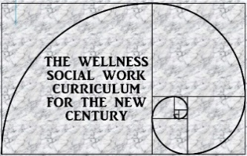
Training modules for social Assistants: Professional growth through Social Expert knowledge and skills
These training modules are based on the Wellness Social Work Curriculum that was developed through the efforts with the Project Casa Mare Social Work International Academic Consortium in accordance with international social work practice and education standards and best practices:
1. Bio-Psycho-Social Assessment of individuals
2. Individual Social Work counseling
3. Working with families (including children and the elderly)
4. Working in teams and across disciplines
5. Working with communities
6. Crisis Intervention
7. Working with organizations (including medical settings)
8. Working with substance abuse and alcoholism
9. Dealing with violence (including bullying, crime, abuse, assault)
10. Working with the mentally ill

Slide 19
Working with the mentally ill: Training Module for Social Assistants
Option 1: Five full-days module – equivalent to one university course on the Master’s level at the Social Expert Program.
Day 1: Conceptualization of mental illness as a social phenomenon in the contemporary world – policies, community response, deviance, stigma, etc.
Day 2: Construction of mental illness historically and in different cultures.
Day 3: Psychiatry and the mentally ill: etiology, diagnosis, treatment, care delivery systems, institutions of mental treatment, deinstitutionalization.
Day 4: Alternative paradigms for understanding of the mentally ill: the community connection, holism, toxicities, etc.
Day 5: Working across disciplines in the mental health field.
Option 2: One-full-day condensed model with a certificate but without the university credit.

Slide 20
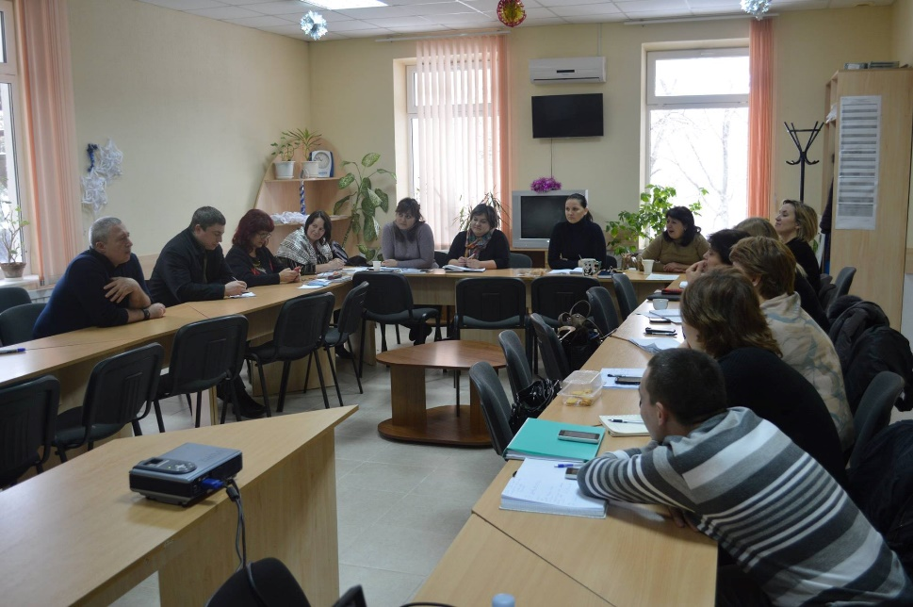
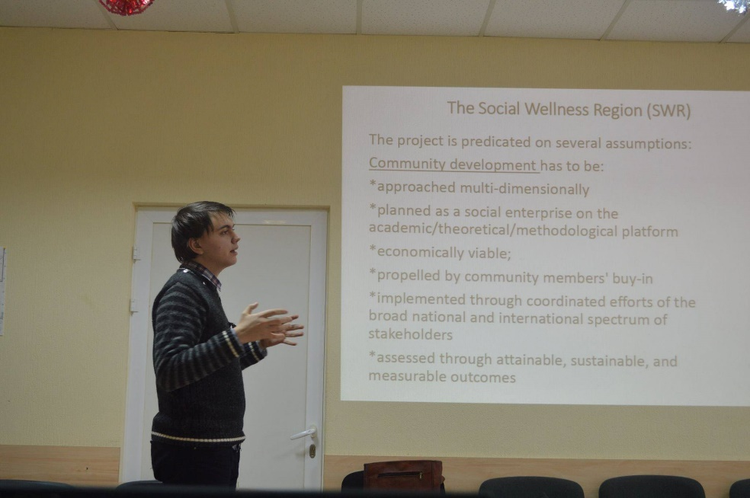
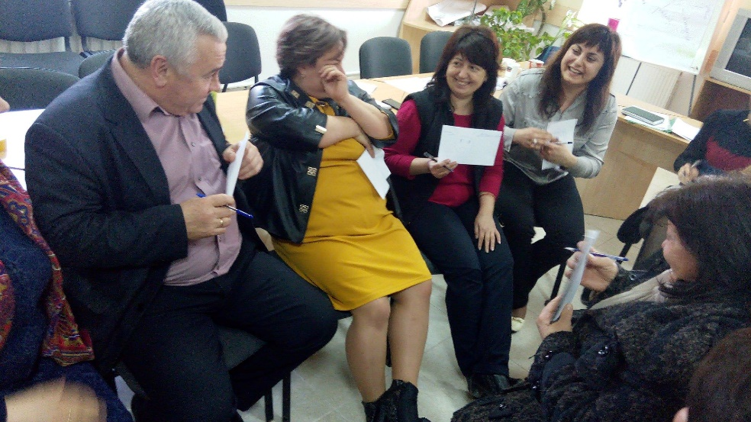
MSW degree outside the University facilities

Slide 21
Thank you!

