Slide 1
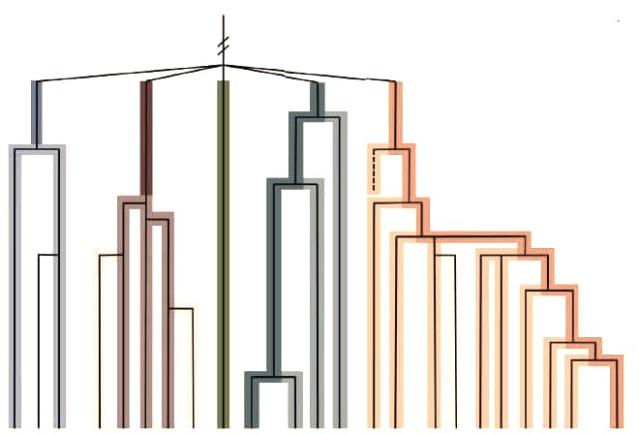
Science in Social Work: Perspective from the United States
Justin Grotelueschen
Licensed Social Worker (Virginia, Iowa)

Slide 2
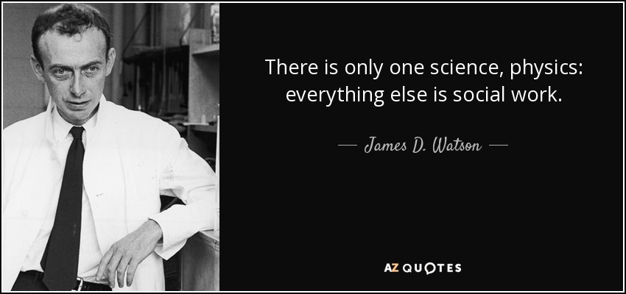
Social Work + Science: Simple
Notes:
Molecular biologist

Slide 3
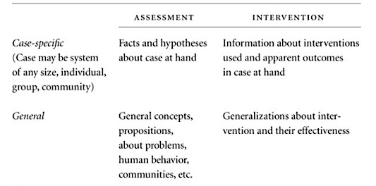
Social Work + Science: Simple
Gathering of Knowledge (Assessment)
Application of Knowledge (Intervention)

Slide 4
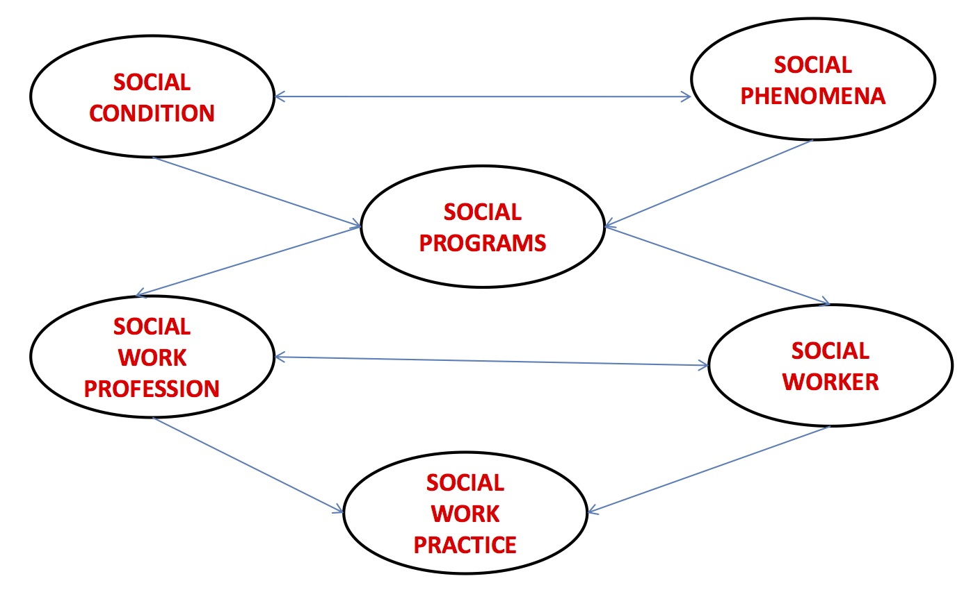
Social Work + Science: Simple?
Yadav, R. (n.d.) Social Work Science.

Slide 5
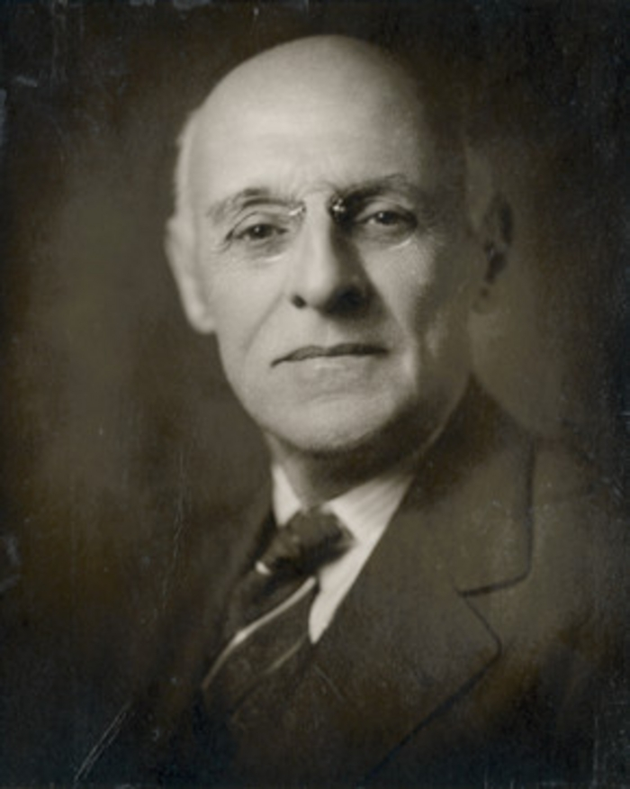
U.S. Social Work: Early 20th Century
Abraham Flexner, Assistant Secretary, General Education Board, NYC, 1915:
“Is Social Work a Profession?” Social work will become a genuine profession with interplay between theory, research, education, + practice

Slide 6
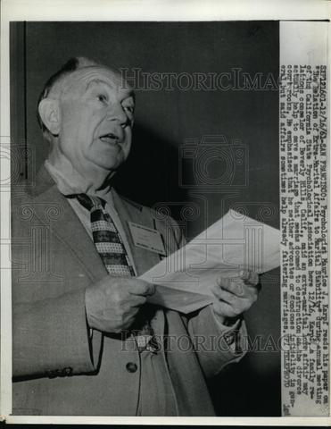
U.S. Social Work: Early 20th Century
Maurice Karpf, Austrian-born social worker, psychologist. First extensive study of social work practice, 1931:
Social workers use science (psychiatry) as a diagnostic tool, but use “common sense concepts and judgments” for daily practice

Slide 7
U.S. Social Work: Throughout 20th Century
Belief that services are more effective and clients better served if practice is based on “sound foundations”
Belief that production of science announces social work publicly as a credible profession

Slide 8
U.S. Social Work: Late 20th Century
1991 NIMH Task Force
The most comprehensive analysis of social work research to date
Re-analyzed data from 20+ studies; reviewed journal articles; reviewed course syllabi; surveyed CVs of faculty; interviewed doctoral students and deans; examined sources and patterns of research funding

Slide 9
NiMH: U.S. Model Lacks Science
1985-1991: approx. 400,000 members in NASW, only 900 of them producing original research
Those who publish do not publish often and showcase limited research skills
Researchers aren’t answering questions that practitioners want answered
Limited dissemination of research

Slide 10
NiMH: U.S. Model Lacks Science
Research education is lacking at all levels
Research training is inadequate at doctoral level
Research funding is “grossly inadequate”
Few social work researchers end up on national panels that determine research priorities, policies, funding decisions

Slide 11
Today: Four Relationships Between Science and Practice
Knowledge Transfer | Action Research | Evidence-based Practice | Reflective Professionalism
Research results transferred directly to guide practice | Research and practice are intertwined, aimed at social change | Evidence guides practice decisions, improves practice | Evidence interprets service user problems, find solutions
Gredig, D., and Marsh, J. “Improving Intervention and Practice”

Slide 12
Today: Four Relationships Between Science and Practice
 | Knowledge Transfer
Does it improve practice? | Research results transferred directly to guide practice
What type of knowledge is foregrounded? | Conditions leading to social problems, societal function of social work
Values and ethics – part of the model? | Minimally
Who ultimately makes decisions? | Social workers alone, as experts
Gredig, D., and Marsh, J. “Improving Intervention and Practice”

Slide 13
Today: Four Relationships Between Science and Practice
 | Action Research
Does it improve practice? | Research and practice are intertwined, aimed at social change
What type of knowledge is foregrounded? | Research relevant to planning for action
Values and ethics – part of the model? | Both set prior to research and action: self-determination and liberation
Who ultimately makes decisions? | Researchers and practitioners through mutual discourse
Gredig, D., and Marsh, J. “Improving Intervention and Practice”

Slide 14
Today: Four Relationships Between Science and Practice
 | Evidence-based Practice
Does it improve practice? | Evidence guides practice decisions, improves practice
What type of knowledge is foregrounded? | Scientifically generated data on interventions + outcomes
Values and ethics – part of the model? | Service user values and professional ethics explicitly considered
Who ultimately makes decisions? | Service users and practitioners collaborate to decide
Gredig, D., and Marsh, J. “Improving Intervention and Practice”

Slide 15
Today: Four Relationships Between Science and Practice
 | Reflective Professionalism
Does it improve practice? | Evidence interprets service user problems, find solutions
What type of knowledge is foregrounded? | Knowledge for understanding nature of problem, plan of action
Values and ethics – part of the model? | Attention to service user perspective and values, also professional ethics
Who ultimately makes decisions? | Service users and practitioners collaborate to decide
Gredig, D., and Marsh, J. “Improving Intervention and Practice”

Slide 16
Future Considerations
Social work is not a “unitary profession” (drawing from psychology, sociology, psychiatry) and therefore has no unified narrative in the field.
Perhaps social work is best understood by recognizing the different paradigms in which social workers function? (Bradley and Moxley, 2016)

Slide 17
Future Recommendations
The process of knowledge transfer (“implementation science”) must link empirical research to clinical practice (Cabassa, 2016)
Practitioners who do not conduct research need formal channels to convey practice observations, contribute to knowledge base (Kirk and Reid, 2002)

Slide 18
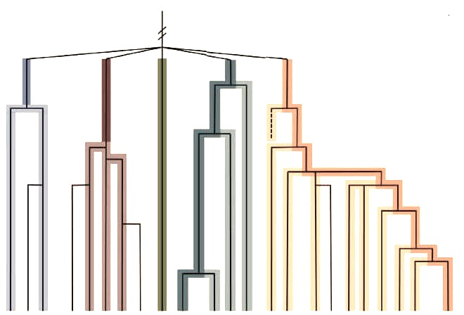
Citations
Brady, S.R., and Moxley, D. (2016). Plurality and Fragmentation in Social Work: Analyzing the Implications of Flexner Using a Philosophy of Science Perspective.
Cabassa, L. J. (2016). Implementation Science: Why it Matters for the Future of Social Work.
Ehrenreich, J. The Altruistic Imagination: A History of Social Work and Social Policy. Cornell U. Press.
Gredig, D., and Marsh, J. “Improving Intervention and Practice” - Sage Handbook of Social Work Research.
Kirk, S.A., and Reid, W.J. (2002) Science and Social Work: A Critical Appraisal. Columbia U. Press.
Yadav, R. (n.d.) Social Work Science (PPT). Retrieved from https://www.slideshare.net/raazsw/social-work-science

