Slide 1
Social Work Ideology for the 21st Century as an Educational Imperative
Vadim Moldovan, PhD in Social Work York College of the City University of New York Associate Professor
Free International University in Moldova
Lecturer

Slide 2
Abstract
Social work practice is anchored in values, principles, and practices that comprise social work university curriculum. Since social work is known as a values-based profession, teaching professional ethics is fundamental to social work education. The social work values system that emerged a century ago remains immutable and forever relevant to practice. However, social conditions have changed dramatically on the global scale. The tectonic geopolitical shifts, technological innovation, and changes in the way people relate to each other compel a reexamination of ethical principles in application to current social conditions. This paper discusses the meaning of six fundamental social values in the environment of perpetual warfare, fake news, deception, virtualization, consumerism, and economic globalization. Theoretical work of such philosophers as Foucault, Bauman, McLuhan, and Baudrillard is utilized in an effort to articulate a social work ideology that is appropriate to current social challenges. Furthermore, this paper identifies pedagogies for effective promulgation of such ideology in educational milieus.

Slide 3
National Association of Social Work (USA)
service
social justice
dignity and worth of the person
importance of human relationships
integrity
competence

Slide 4
British Social Work Values
Human rights
Social justice
Professional integrity

Slide 5
International Association of Schools of Social Work
respect for the inherent worth and dignity of human beings
doing no harm
respect for diversity
upholding human rights
social justice

Slide 6
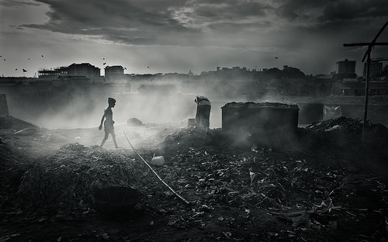
Dire global social problems postulated
Perpetual warfare
Environmental degradation
Ubiquitous toxicity
Deception
Dehumanization
Consumerism
Economic exploitation

Slide 7
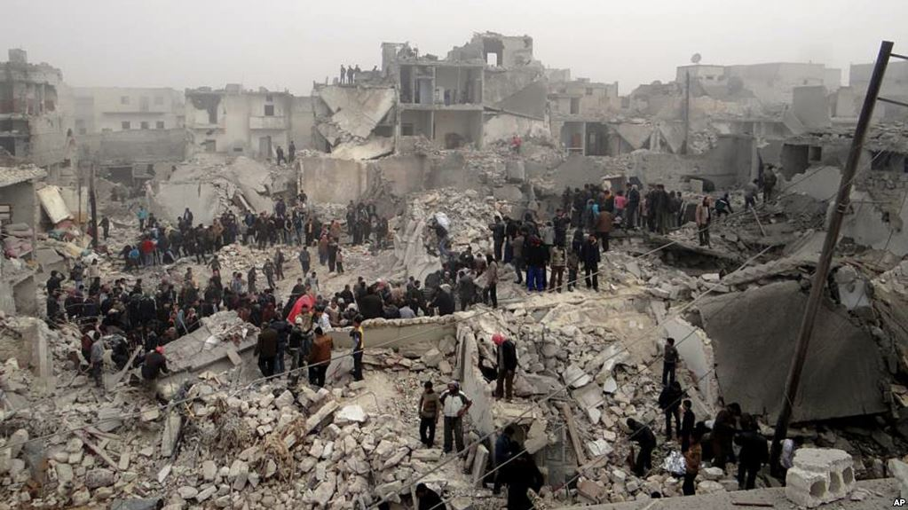
Where
art
social work?

Slide 8
Consequences of the micro-level practice focus of contemporary social work
Social workers as agents of social control
Market-based profession
Proletarization of social work cadre
Irrelevance of the social work profession on the macro- policy level
Abandonment of social work values of social justice and human rights

Slide 9
Social work roots in antiwar movement

Slide 10
Social Work Curriculum – the necessary components
Strong ethical foundation – that is taught as an ideology that supersedes all other ideologies and creeds
Social worker is firstly and foremostly loyal to the profession, its values and ethical principles
Other creeds – ideological, political, nationalistic, and religious are secondary to the social work creed and can guide social worker’s action as long as they are congruent with the social work paradigm.

Slide 11
Emphasis on the Macro-level practice
Social workers must adopt the stance that macro-level practice is pre-eminent. Social work historic calling is to work on restructuring society for the benefit of the people and not to mold the people to the norms of society.
Social workers do not owe fealty to the state, religious institutions, political entities, etc.
Social workers serve the people in the name of cardinal social work values

Slide 12
Social work is a values-based profession
The unique character of social work makes it the only paradigm that is capable of social change – local and global.
Social work education is on the one hand, driven by the profession’s values.
On the other hand, by the carefully-developed and deliberately-applied system of community action methodologies that are designed to compel the state to adhere to social work values.

Slide 13
Conclusion
For social work to succeed locally, e.g. in Azerbaijan, Moldova, the United States, Ukraine, Armenia, Turkey, etc., global solidarity, that transcends ethnic, religious, and political animosities is absolutely essential.
Social work is resistance.
Social work is a global action in response to global calamities.
Social work educators bear heavy responsibility for preparing a competent cadre of professionals that is capable of promoting global social change in line with fundamental social work values.

