Slide 1
The State of Social Work Education in the U.S.
Global becomes Glocal

Slide 2
Current Status
682,100 social work jobs in the US
Field of social work is growing at 16%, compared to average growth rate of all occupations of 7%
Levels of Education
BSW – Bachelor’s Degree in Social Work
Prepares students for direct-service positions (ex: casework or mental health assistant)
MSW – Master’s Degree in Social Work
2-year program
Required for clinical positions
Area of specialized practice
DSW – Practice Doctorate
Distinct from the PhD
15 programs and growing
PhD – Research Doctorate
78 programs
Bureau of Labor Statistics, U.S. Department of Labor, Occupational Outlook Handbook, Social Workers, on the Internet at https://www.bls.gov/ooh/community-and-social-service/social-workers.htm (visited November 20, 2018).
Notes:
MSW: Programs prepare students for work in a chosen specialty, including clinical assessment and management skills; require supervised practicum or internship

Slide 3
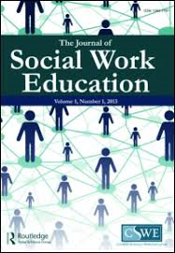
Current Status of Social Work Education in the United States
Council on Social Work Education (CSWE)
Founded in 1952, CSWE is the national association representing social work education the US.
Accreditation is a voluntary, non-governmental process of review.
Multi-step process: preparation & self-examination, peer review, visit and examination, decision, continuous review
As of the October 2018 Commission on Accreditation meeting, there are:
521 accredited baccalaureate social work programs (BSW)
262 accredited master’s social work programs (MSW)
16 baccalaureate social work programs in candidacy
30 master’s programs in candidacy
Notes:
Some challenges with accreditation: - push/pull about being perscriptive, this is our way, but not necessarily the only way! There exists some tension about being perscriptive vs. more context-based.

Slide 4
Macro Issues Affecting Education and Profession

Slide 5
Globalization
Populism
Neoliberalism
Waning Confidence in Public Institutions
Immigration/Refugees
Climate Change/ Environmental Impact
Technology & Automation
Violence

Slide 6
Globalization
Notes:
Globalization results in the expansion of international cultural, economic, and political activities. As people, ideas, knowledge, and goods move more easily around the globe, the experiences of people around the world become more similar."

Slide 7
Nationalism/White Supremacist Culture
Groups focused on the alleged inferiority of nonwhites (Ku Klux Klan, neo-Confederate, neo-Nazi, racist skinhead, Christian Identity)
Rise of antisemitism as well
Tension rising during and post 2016 Presidential election, inciting violence
Increased polarization of political positions
Voss, T., Bailey, J.D., Ife, J. et al. J. Hum. Rights Soc. Work (2018) 3: 109. https://doi.org/10.1007/s41134-018-0072-5
Notes:
- White nationalists seek to return to an America that predates the implementation of the Civil Rights Act of 1964 and the Immigration and Nationality Act of 1965 – both landmark pieces of legislation

Slide 8
Neoliberalism and managerialism

Slide 9
Waning confidence in public institutions

Slide 10
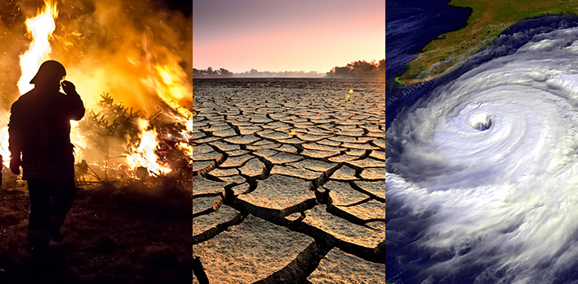
Climate Change/ Environmental Impact
Synopsis
Overwhelming body of evidence affirming that the earth is warming, largely due to greenhouse gas produced by human activities.
The Intergovernmental Panel on Climate Change (IPCC) states, "...the net damage costs of climate change are likely to be significant and increase over time."
Social Work Considerations
Climate change is a public health issues because of its impact on water, air, food supplies, and living spaces
Climate-centered crises (draught, flood, fire, hurricane, etc.) impact on communities and livelihoods
New, worsening health conditions (infections disease, illness, emotional/mental stress)
Vulnerable populations more at risk
Social workers as change agents – macro-level work, advocacy
https://climate.nasa.gov/effects/ text

Slide 11
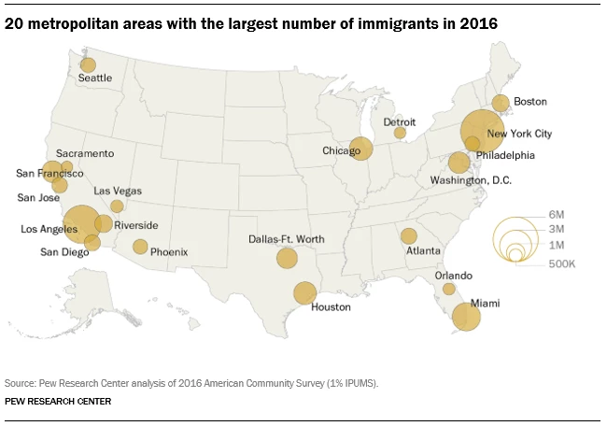
Immigration & Refugees
Synopsis
40 million immigrants in the US (1/5th of the world’s migrants) – more than any other country in the world
Mexico, China, and India are top birthplaces for immigrants in the U.S.
Largest origin group: Democratic Republic of Congo, Iraq, Syria, Somalia, and Burma (Myanmar)
In 2017, 22,861 were Muslims (43%) and 25,194 were Christian (47%)
Roughly half (46%) of nation's 43.7 million immigrants live in California, Texas, and New York
Social Work Considerations
Political and social anti-immigrant and refugee rhetoric, dehumanization
Documentation challenges for clients, students
Increased violence & tension in communities
López, G., Bialik, K., & Radford, J. (2018, November 30). Key findings about U.S. immigrants. Retrieved from http://www.pewresearch.org/fact-tank/2018/11/30/key-findings-about-u-s-immigrants/
Notes:
Example of increased violence:
From November 6th – November 11th, 2016 (following election), 201 incident of election-related harassment and intimidation across the country (source: Southern Poverty Law)

Slide 12
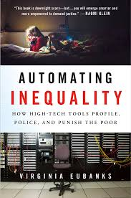
Technology & Automation
Synopsis
Rapid growth in technology sector leading to the "computerizations" of American businesses, industries, and homes.
Technology transforming the way, and the speed with which, people think, connect, collaborate, locate resources, manipulate and conduct research, etc.
Digitization, the rise of robots, artificial intelligence seem to favor capital and higher-level skills at the expense of orgindary workers.
Notes:
United States Department of Labor. (1999). Futurework—trends and challenges for work in the 21st century. Retrieved from http://www.dol.gov/oasam/programs/history/herman/reports/futurework/report.htm.
https://www.brookings.edu/blog/up-front/2018/02/16/globalization-technology-and-inequality-its-the-policies-stupid/

Slide 13
Violence
Synopsis
Interpersonal Violence
500,000 people killed by interpersonal violence each year
10 million men & women in US are subject to domestic violence
5 million children are exposed to domestic violence in the US per year
Gun Violence
6.5 million people killed by gun violence worldwide since 1990
Gun violence is concentrated. Just 15 countries (35% of world's population) account for 75% of all gun deaths: the worst in the Americas (Guatemala, Venezuela, Colombia, Mexico, Brazil, & United States)
Social Work Considerations
Culture of violence
Systemic harm
Economic exploitation
Poverty
Unequal treatment under the law
Human Rights violations
Political atmosphere
Notes:
https://www.vox.com/2018/8/29/17792776/us-gun-deaths-global
http://www.socialworkpolicy.org/research/violence-and-injury-prevention.html
https://www.un.org/pga/70/wp-content/uploads/sites/10/2016/01/Conflict-and-violence-in-the-21st-century-Current-trends-as-observed-in-empirical-research-and-statistics-Mr.-Alexandre-Marc-Chief-Specialist-Fragility-Conflict-and-Violence-World-Bank-Group.pdf
https://www.economist.com/graphic-detail/2018/08/30/gun-violence-has-killed-65m-people-worldwide-since-1990
https://www.socialsolutions.com/blog/domestic-violence-statistics-2018/

Slide 14
Responses

Slide 15
American Academy of Social Work & Social Welfare
12 Grand Challenges
Ensure health development for all youth
Close the health gap
Stop family violence
Advance long and productive lives
Eradicate social isolation
End homelessness
Create social responses to a changing environment
Harness technology for social good
Promote smart decarceration
Reduce extreme economic inequality
Build financial capability for all
Achieve equal opportunity and justice

Slide 16
Future of the Profession: Futures Task Force
Embracing Technology to Enhance Practice
Social Workers are Leaders Everywhere
Social Work Leadership for a High-Tech World
Building on our Successes

Slide 17
Voter mobilization drive

Slide 18
Our responses need to be
Interdisciplinary/Interprofessional
Collaborative (Collective Impact)
Activist
Engaging in political activism / developing policy priorities
Educational Initiatives
Use of technology
Global collaborations
Faculty development
Field education opportunities

Slide 20
Thank you!

