Slide 1
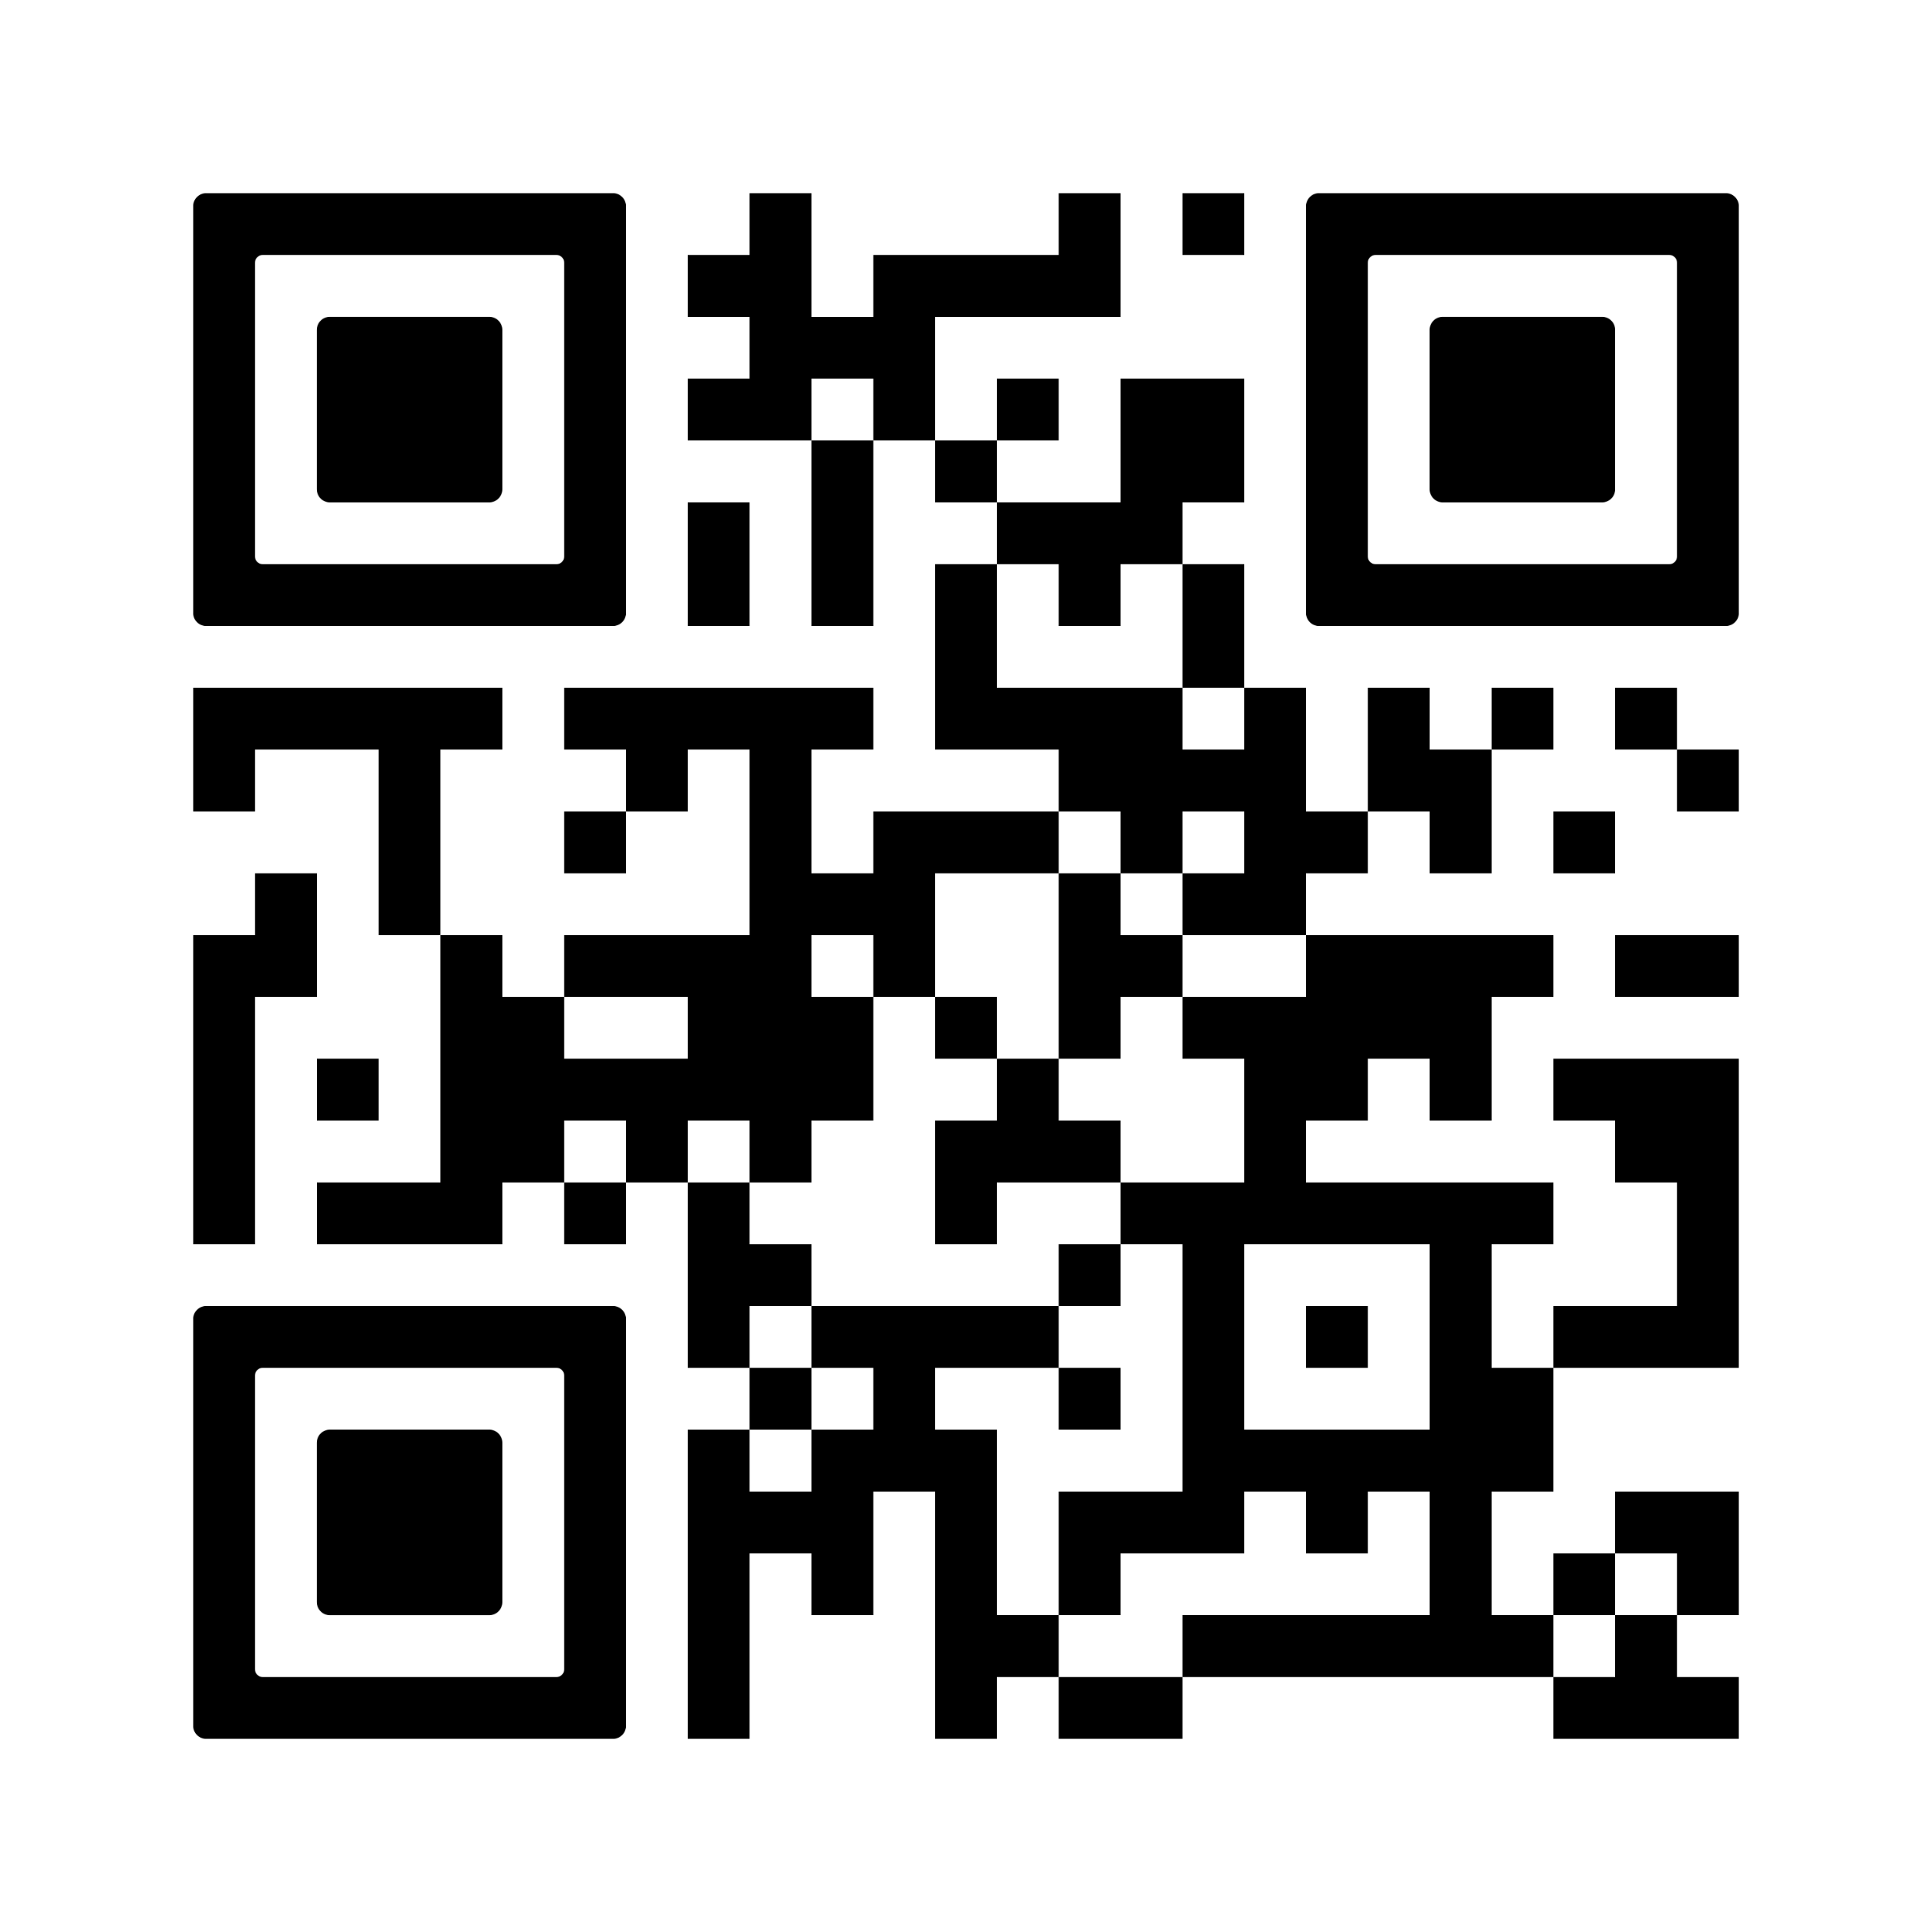






Ubuntu Digital Platform
By Prof. Janestic Twikirize
Contact us:
Email: asw@africasocialwork.net
Website:https://ubuntuplatform.ushahidi.io
Why This Platform Matters
How information is collected
Ubuntu Philosophy
Project team

Slide 2
Ubuntu Philosophy
“I am because we are” – an African philosophy rooted in human dignity, interconnectedness, and community.
Central theme to the Global Agenda for Social Work and Development 2020–2030.
2020-2022 theme: ‘Ubuntu: Strengthening Social Solidarity and Global Connectedness´.
The Agenda was adopted by (IASSW), (IFSW), and the (ICSW).
Ubuntu Digital Platform
Why This Platform Matters
How information is collected
Project team

Slide 3
Why This Platform Matters
Bridging the Resource Gap: Building a comprehensive Ubuntu database.
Provides resources showcasing Ubuntu’s application in teaching and practice.
This platform fills that gap with digital, globally collaborative content.
This digital platform brings together four to six social work institutions from different regions of the world to collaboratively design an Ubuntu-inspired virtual learning and teaching platform with multiple digital resources and test it in selected countries across the globe.
Ubuntu Digital Platform
Ubuntu Philosophy
How information is collected
Project team

Slide 4
How information is collected
The project teams search literature and the media and then upload.
Entries of information on Ubuntu on the platform by social workers from any part of the world
Interviews are conducted on selected experts on Ubuntu and social work uploaded on the plaform by the content creator.
The platform contains, in an engaging interactive manner, videos, lectures, photographs, audios, illustrations, stories and other resources.
Ubuntu Digital Platform
Why This Platform Matters
Ubuntu Philosophy
Project team

Slide 5
Project team
Associate Professor Janestic Twikirize, Department of Social Work and Social Administration, Makerere University, Uganda
Dr Rugare Mugumbate, University of Wollongong, Dharawal Country, NSW, Australia; University of Johannesburg, South Africa; ASWDNet
Jean-Claude Dorsainvil, Queensland University (UQ), School of Social Work, Nord-Est, Fort-Liberte, Haiti, Port-au-Prince, Haiti (W.I.)
Tanatswa Silvanus Chineka, Department of Social Work, University of Zimbabwe
Professor Mandla Mfundo Masuku, Associate Professor in the School of Built Environment and Development Studies at the University of KwaZulu-Natal, South Africa 6. Dr Sharlotte Tusasiirwe, Association of Schools of Social Work in Africa (ASSWA); School of Social Sciences, Western Sydney University (WSU)
Associate Professor Vincent Mabvurira, School of Psycho-social Health, North-West University, South Africa 8. Professor Chinwe R. Nwanna, Department of Social Work, Faculty of Social Sciences, University of Lagos, Akoka, Yaba, Lagos, Nigeria
Ubuntu Digital Platform
How information is collected
Why This Platform Matters
Ubuntu Philosophy

Slide 6
Acknowledgement
The International Association of Schools of Social Work (IASSW) for a grant to create and upload resources.
Technical support from Africa Social Work and Development Network (ASWDNet).
Project technical assistant Eriya Turyamureeba.
Project assistant Erina Nyahwema
Ubuntu Research Group.
Ubuntu Digital Platform
How information is collected
Why This Platform Matters
Ubuntu Philosophy

Slide 7


Acknowledgement
Practical Session of the platform.
Ubuntu Digital Platform
How information is collected
Why This Platform Matters
Ubuntu Philosophy
By Eriya Turyamureeba

Slide 8
Ubuntu Digital Platform
Questions?
………………….……End ………………...........

